Slide 1
Non-NATO vs NATO Standards
LtCol Christoph KÜCK
NSO, Policy and Coordination Branch
Warsaw, 18 September 2019

Slide 2
Agenda
1.
Introduction
2.
Benefits
3.
Direction
4.
Use
5.
Reference Documents

Slide 3
Agenda
1.
Introduction
2.
Benefits
3.
Direction
4.
Use
5.
Reference Documents

Slide 4
Standardization Document
Development Process
Phase 7
Requirements Identification
Requirements Validation and Task Development
Stand. Documents Selection /
Development
Ratification / Approval & Promulgation
Implementation / use of Standard(s)
Phase 1
Phase 2
Phase 3
Phases 4/5
Phase 6
Review

Slide 5
Non-NATO Standards
A non-NATO standard is a standard developed outside NATO.
Non-NATO standards include civil standards, national and multinational defence standards.
A civil standard is a standard published by a civil standar-dizing body and made available to the public. Civil standards are developed, established and coordinated by civil Standard Developing Organizations (SDOs).
A defence standard is a standard developed by nations or group of nations in the defence field.
!
Non-NATO standards become Allied Standards when adopted by NATO

Slide 6
Civil SDOs
Unique organizations
Specific interests
Variety of memberships
Variety of standards development processes
Variety of voting and funding mechanisms
STANDARDS PRODUCED
REFLECT THIS VARIETY
INTERNATIONAL
REGIONAL
NATIONAL

Slide 7
Agenda
1.
Introduction
2.
Benefits
3.
Direction
4.
Use
5.
Reference Documents

Slide 8
Benefits of Using Non-NATO Standards
Leverage the expertise of a very wide and diverse set of experts
Benefit from the most advanced technologies
Reduced procurement costs
Reduced costs for standards production
Possibly faster availability as Allied standard (reduced time between identification of requirements and availability of standards)

Slide 9
Agenda
1.
Introduction
2.
Benefits
3.
Direction
4.
Uses
5.
Reference Documents

Slide 10
NATO Interoperability Policy
“To be able to function in accordance with agreed political guidance and direction, NATO Allies must be able to interoperate with each other, and when required, with non-NATO nations, Non-Governmental and International Organizations and other (non defence-related) government departments, as appropriate.”
Requirements for interoperability, concerning in particular the ability to communicate, operate and support, shall be determined by the appropriate authorities. -CM-(2009)0145-
Interoperability with non-military actors
Appropriate NATO authorities determinate re- quirements
!

Slide 11
NATO Standardization Policy
NATO shall adopt and refer to suitable non-NATO standards (civil standards and national defence standards) […] to the maximum extent. NATO shall only develop a standard where no suitable non-NATO standard exists.
BASED ON:
utility for the NATO standardization requirement
broad acceptance
accessibility
technical excellence
- PO(2016)0315 -

Slide 12
Agenda
1.
Introduction
2.
Benefits
3.
Direction
4.
Use
5.
Reference Documents

Slide 13
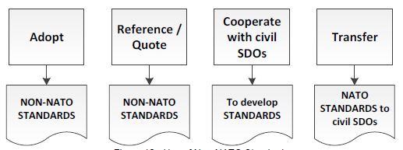
Use of Non-NATO standards

Slide 14
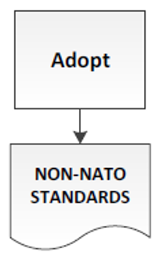
Adoption Process
Stand. Documents Development
Phase 3
WORKING GROUP:
Suitable Non-NATO Standards | Recommend Adoption
Suitable NATO Standards to Modify | Modify NATO Standards
Suitable civil SDOs for co-development | Co-develop
Develop new NATO Standards
YES
NO
YES
NO
YES
NO

Slide 15
Adoption Process
IDENTIFICATION … of SUITABLE NON-NATO STANDARD
Might be in the SP/SI responses/ST
WG can ask for support of experts in national defence standardization management bodies (SMG and NSO)
SELECTION
If necessary, WG modifies or augments
WG drafts covering document
WG proposes the selection to TA/DTA
ADOPTION
Through ratification or approval process
!
Adoption of a non-NATO standard is an expression of acceptance for use by NATO. Once adopted, a non-NATO standard becomes an Allied standard for NATO.

Slide 16
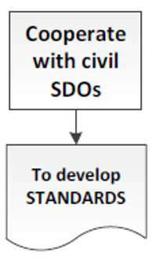
Co-Development Process
Stand. Documents Development
Phase 3
WORKING GROUP:
Suitable Non-NATO Standards | Recommend Adoption
Suitable NATO Standards to Modify | Modify NATO Standards
Suitable civil SDOs for co-development | Co-develop
Develop new NATO Standards
YES
NO
YES
NO
YES
NO

Slide 17
Co-Development Process
IDENTIFICATION …OF A RELEVANT CIVIL SDO
Might be in the SP/SI responses/ST
WG can ask for support of experts in national defence standardization management bodies (SMG and NSO)
AGREEMENT
WG informs TA/DTA
TA/DTA initiates formal contact → agreement
TA/DTA can ask for support by the NSO
CO-DEVELOPMENT
WG/custodian and civil SDO develop standard
WG drafts covering document
WG submits to TA/DTA
ADOPTION
Through ratification or approval process

Slide 18
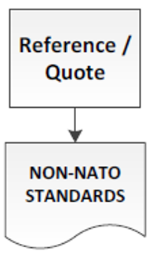
Reference / Quote
Copyrights shall be respected in all cases
(content can be reproduced only with the permission of the copyright holder)
All referenced non-NATO standards shall be included in the list of references
(owner, alphanumeric code, title and date of publication)
Specific use of referenced non-NATO standards shall be identified as follows:
normative references: those directly referenced as part of the requirement (in STANAG)
informative references: those listed for information purposes only (not part of the requirement)

Slide 19
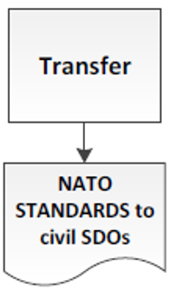
Transfer Process
SELECTION … OF A INTERESTED AND APPROPRIATE CIVIL SDO
WG can ask for support of experts in national defence
standardization management bodies (SMG and NSO)
AGREEMENT
WG informs TA/DTA
TA/DTA initiates formal contact → agreement
TA/DTA can ask for support by the NSO
TRANSFER
TA/DTA transfers NATO standard to civil SDO
Civil SDO publishes as its own standard – with or without modification
NATO standard kept in NSDD until cancelled or superseded
ADOPTION
TA/DTA may adopt standard published by civil SDO

Slide 20
Agenda
1.
Introduction
2.
Benefits
3.
Direction
4.
Use
5.
Reference Documents

Slide 21
Reference Documents
NATO Interoperability Policy C-M(2009)0145
NATO Policy for Standardization PO(2016)0315
Directive for the Production, Maintenance and Management of NATO Standardization Documents AAP-03 Edition K Version 1
Standard Related Document - Facilitating the Development and Use of Civil Standards AAP-03.1 Edition A, Version 1

Slide 22
Non-NATO vs NATO Standards
LtCol Christoph KÜCK
NSO, Policy and Coordination Branch
Warsaw, 18 September 2019

