Slide 1
INTEROPERABILTY AND STANDARDIZATION
Standardization and the Defence Planning Process
(NDPP)
Dieter Schmaglowski
Deputy Director NSO
Warsaw, 18 September 2019

Slide 2
Agenda
1.
Introduction to the NDPP
2.
Standardization in the NDPP

Slide 3
Aim / Purpose of the NDPP
To provide a common framework for national and Alliance defence planning activities
To harmonize national and Alliance defence planning activities to meet NATO agreed targets
To facilitate the timely identification, development and delivery of military and non-military capabilities
To ensure that national contributions are interoperable and adequately prepared, equipped, trained and supported
New NDPP endorsed by
Defence Ministers in October 2016

Slide 4
Focus of the NDPP
Timely identification, development and delivery of the forces and capabilities needed to undertake Alliance missions in SACEUR’s area of responsibility
New NDPP endorsed by
Defence Ministers in October 2016

Slide 5
Steps of the NDPP
Establish Political Guidance
Review Results
Determine Requirements
Improving Alliance Capabilities
Apportion Requirements/
Set Targets
Facilitate Implementation

Slide 6
NDPP: Constantly Running Circle
1. Establish Guidance
2. Determine Requirements
3. Set Targets;
Apportion Requirements
4. Facilitate Implementation
5. Review Results

Slide 7
Agenda
1.
Introduction to the NDPP
2.
Standardization in the NDPP

Slide 8
Standardization in the NDPP
Standardization and Interoperability one of 14 planning domains contributing to the various stands of capability development through the NDPP
NDPP Outline Model endorsed by Defence Ministers in October 2016: ‘NATO staffs will facilitate the development and implementation by Allies of agreed common standards (e.g. STANAGs and Allied Publications)’
More focus on interoperability and standardization due to increased multinationality of high-readiness tactical forces
Use on NDPP as tool to encourage Allies to improve national implementation of standards

Slide 9
NDPP – Step 1
Develop Guidance for NDPP Cycle
Final Product: Political Guidance
PO (2019)0077 Political Guidance (Appendix 1):
“…standardization is critical to defence planning. Implementation of NATO STANAGs by individual Allies and also NATO bodies is essential to bolster Alliance readiness and responsiveness.”
“Allies should align their standardization activities with NATO’s planning priorities and initiatives.”

Slide 10
NDPP – Step 2
Determine Requirements
Final Products: - Minimum Capability Requirements (defined pool of capabilities required to meet NATO’s level of ambition) and Prioritized Shortfall Areas - Bi-SC Capability Code and Capability Statements Catalogue

Slide 11
BiSC Capability Codes and Statements - Purpose -
Provides common language for capabilities in Defence Planning and Operational Planning
Describes each of the roughly 350 capabilities required by the Alliance
Crucial standards supporting delivery of the capability are addressed as reference documents

Slide 12
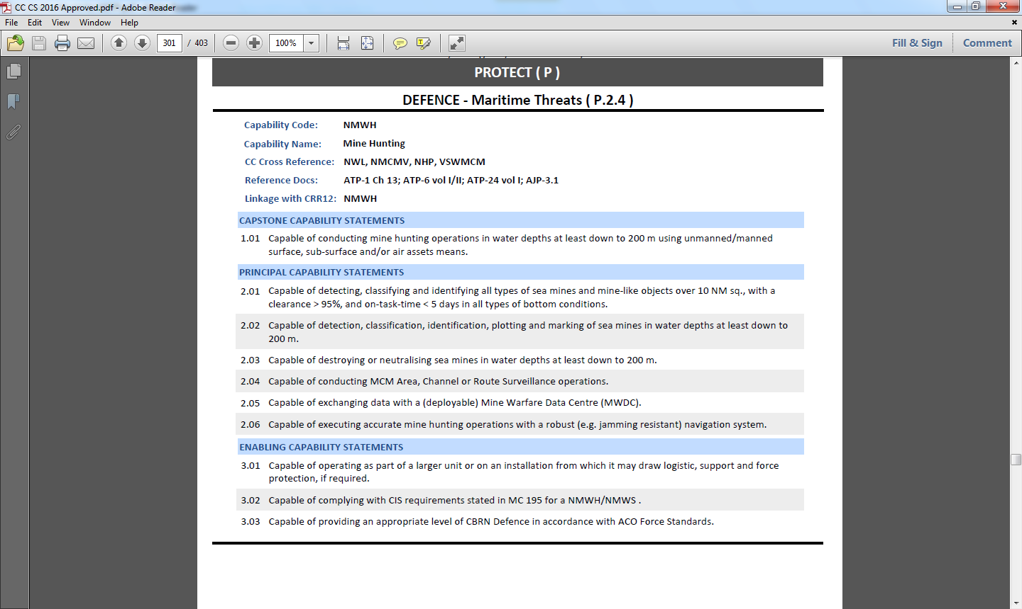
Standards in Support of Capabilities (CC/CS Catalogue, Example 1)

Slide 13
Standards in Support of Capabilities (CC/CS Catalogue, Example 2)

Slide 14
Standards in Support of Capabilities (CC/CS Catalogue, identification of standards)
Revision of CC/CS catalogue under lead of ACT SEE completed
NSO (P&C) coordinated identification of standards crucial for delivery of capabilities

Slide 15
NDPP – Step 3
Apportion Requirements
Final Product:
A set of Targets for each NATO nation (National Target Packages / Blue Books)

Slide 16
Link Between Targets and Standards Supporting Delivery of Targets
Blue Books are the ACT Targets Proposal sent to nations for their study before the Joint Consultation Meetings (tailored to every NATO nation)
Standards supporting a specific target are not addressed in the Blue Books but in the target related Capability Codes

Slide 17
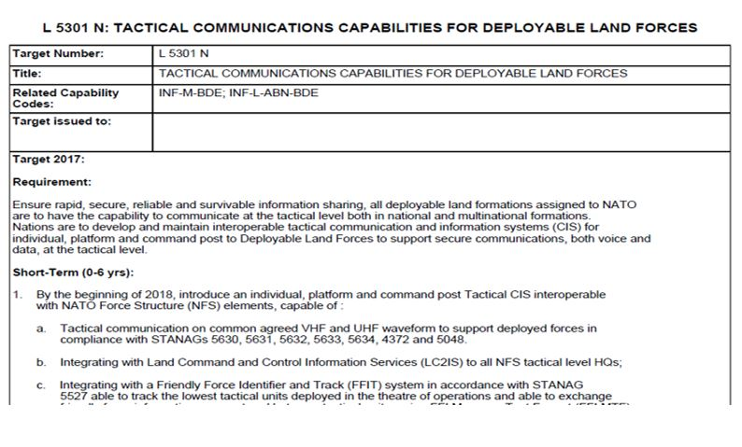
Blue Books and CC/CS - Example -

Slide 18
NDPP – Step 4
FINAL PRODUCT:
Targets delivered by Allies: procurement of materiel, establishment of training courses, facilities, personnel at the level of interoperability required (DOTLMPFI), includes implementation of standards referenced in related CC
Facilitate Implementation
Nations shall report implementation of standards (reflected in NSDD)

Slide 19
NDPP – Step 5
Review Results
Purpose:
To review efforts to address targets
Final Product:
NATO Capability Report
(every two years)

Slide 20
Defence Planning Capability Survey: Main Vehicle for Review Process
The Defence Planning Capability Survey (DPCS) seeks information on national plans and policies, including on Allies’ efforts (national, multinational and collective) to address their targets. It also seeks information on the national inventory of military forces and associated capabilities
2017 DPCS Questionnaire included a number of specific questions regarding the implementation status of some critical STANAGs
The answers to these questions were assessed by NSO Branches, consolidated NSO assessment provided for each country to IS DPP

Slide 21
Standard Related Questions in DPCS - Examples (1) -
Please indicate whether STANAG 3971 Ed 7 covering ATP 3.3.4.2, Air-to-Air Refuelling has been fully implemented. If not, please elaborate on the limitations preventing your nation from full implementation and indicate when you intend to fully implement this STANAG in the future

Slide 22
Standard Related Questions in DPCS - Examples (2) -
Question in DPCS 2017: “Considering that usability of multinational land manoeuvre formations requires a high level of interoperability, please specify if your nation has fully implemented the STANAGs and covered standards below. If not, please provide the reasons preventing your nation from full implementation:
STANAG 2288 Ed 2 and AJP-3.2, Allied Joint Doctrine for Land Operations
STANAG 2394 Ed 4 and ATP-3.12.1, Land Force Combat Engineer Doctrine
- …
Provide specification on how your nation plans to address the implementation of standards mentioned (detail the timelines, national caveats, capabilities)?
If standards are not being implemented, what are the reasons? What mitigation measures is your nation taking if these standards are not being implemented?

Slide 23
NDPP and Standardization - Summary -
STEP 1
Reference to interoperability/standardization in the Political Guidance Document
Establish Political Guidance
STEP 5
Review Results
Determine Requirements
Improving Alliance Capabilities
Assessment of key STANAGs implementation (DPCS)
STEP 2/3
Facilitate Implementation
Apportion Requirements
Set Targets
Key STANAGs addressed in CC/CS catalogue, targets refer to related capability code
Nations deliver capabilities and implement STANAGs in support of these capabilities
STEP 4

Slide 24
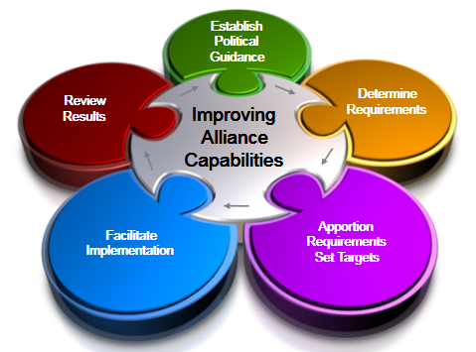
NSO Contribution to the NDPP
The NSO as focal point of contact for linking standards with capability delivery …
ensures that standardization is appropriately reflected in the political guidance (step 1) and the implementation phase by facilitating & monitoring the implementation of standards (step 4);
ensures that standards are adequately linked to capabilities (step 2 and 3) and assists in defining interoperability requirements and shortfalls (step 2);
contributes to DPCS questions and analyses the nations’ reports and suggests follow-on actions as appropriate (step 5).

Slide 25
Time for your questions…

