Slide 1
NATO STANDARDIZATION PROCESS
Ratification and Implementation of NATO Standards
Dieter Schmaglowski
Deputy Director NSO
Warsaw, 18 Sep 2019

Slide 2
Standard Development Process
IAW AAP-03(K)
DP
DP
DP
Standardization Proposal
Or Top-down directive
Validation
&
Draft ST Development
Development
Ratification
ST
Requirement(s)
ST
Promulgation
SP
Final Draft
Implementation
Standardization Task

Slide 3
Ratification Process
RATIFICATION DRAFT
TA/DTA Approval
NSO
REQUEST FOR RATIFICATION
?

Slide 4
Ratification Process
Ratification: process in which Allies analyse the standards covered by a STANAG in order to determine the national position regarding the implementation (identify if, and how to implement them)
Completion of process results in formal ratification response by Allies
Allies should complete staffing for ratification and reply within the timescale set by TA/DTA

Slide 5
Ratification
What needs to be analysed?
Requirements and impacts on national resources
capabilities supported and national plans for development/procurement of these capabilities
services concerned
required national actions for implementation ( procurement of new material/equipment, technical specification/tactics, change of national education and training courses, software changes to existing IT systems, etc.)
required and available resources
timelines/roadmaps for implementation
national limitations/caveats

Slide 6
Ratification Responses
ratifying and implementing
will implement fully
provide date/timescale
ratifying and implementing - with reservations;
will implement but has concerns/impediments in some areas
provide date/timescale
ratifying, future implementation;
will implement fully
unable to provide date/timescale
ratifying, future implementation - with reservations;
will implement but has concerns/impediments in some areas
unable to provide date/timescale
not ratifying
object to promulgation / inability to implement
not participating
do not have the capability / not interested

Slide 7
Ratification Responses Nation A
as of 23 Apr 2019
Reference: 1074 current STANAGs
* Rest represents “not participating”

Slide 8
Ratification Responses Nation B
as of 23 Apr 2019
Reference: 1074 current STANAGs
* Rest represents “not participating”

Slide 9
Ratification Responses Nation C
as of 23 Apr 2019
Reference: 1074 current STANAGs
* Rest represents “not participating”

Slide 10
STANAGs delayed in Ratification as of 23 Apr 2019
Examples
STANAG | Due Date | Promulgation Criteria | Ratification responses received
4137 Ed. 2 | 2000-01-31 | 14 | 9 (+ 4 not participating)
4142 Ed. 2 | 2003-11-14 | 14 | 14 (+ 3 not participating, 2 not ratifying)
4622 Ed. 2 | 2018-06-22 | 15 | 7 (+ 3 not participating, 1 not ratifying)
4684 Ed. 1 | 2018-06-12 | 14 | 8 (+ 7 not participating)
7219 Ed. 1 | 2011-05-13 | 14 | 10 (+ 4 not participating and 1 not ratifying, objection to promulgation)
4549 Ed. 1 | 2000-10-31 | 14 | 11 (+ 4 not participating, 1 not ratifying)
As secretary of the responsible DTA, which actions related to these documents would you recommend ?
Notes:
4137, CNAD (NNAG): Standard Underwater Explosion Test for Operational Surface Ships and Crafts
4194, CNAD (NNAG): Standardized Wave and Wind Environments and Shipboard reporting of Sea Conditions
4144, CNAD (NAAG): Firing Techniques to Determine Data for Fire Control Systems
4142, CNAD (NNAG): Shock Resistance Analysis of Equipment for Surface Ships
3575, CNAD (NAFAG): Aircraft Stores Ejector Racks
4093, CNAD (LCMG): Mutual Acceptance by NATO Member Countries of Qualification of Electronic and Electrical Components for Military Use
5511, C3B (CaP1): Tactical Data Exchange – Link 11/11B

Slide 11
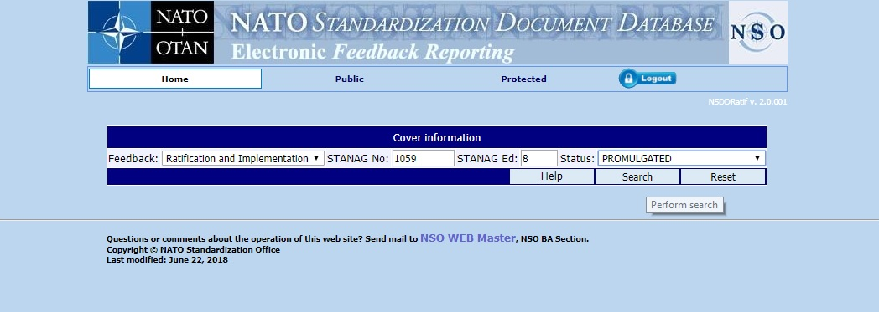
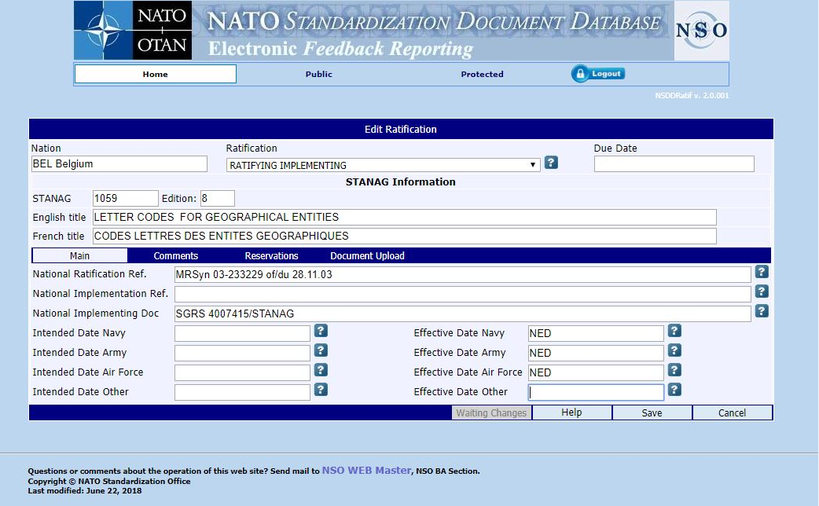
Ratification Reporting

Slide 12
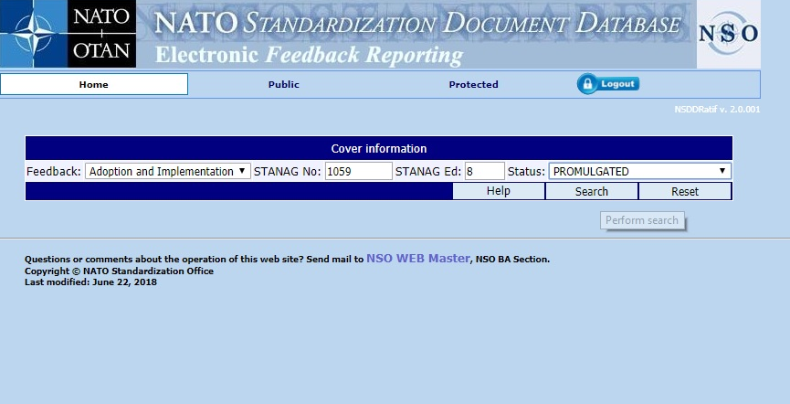
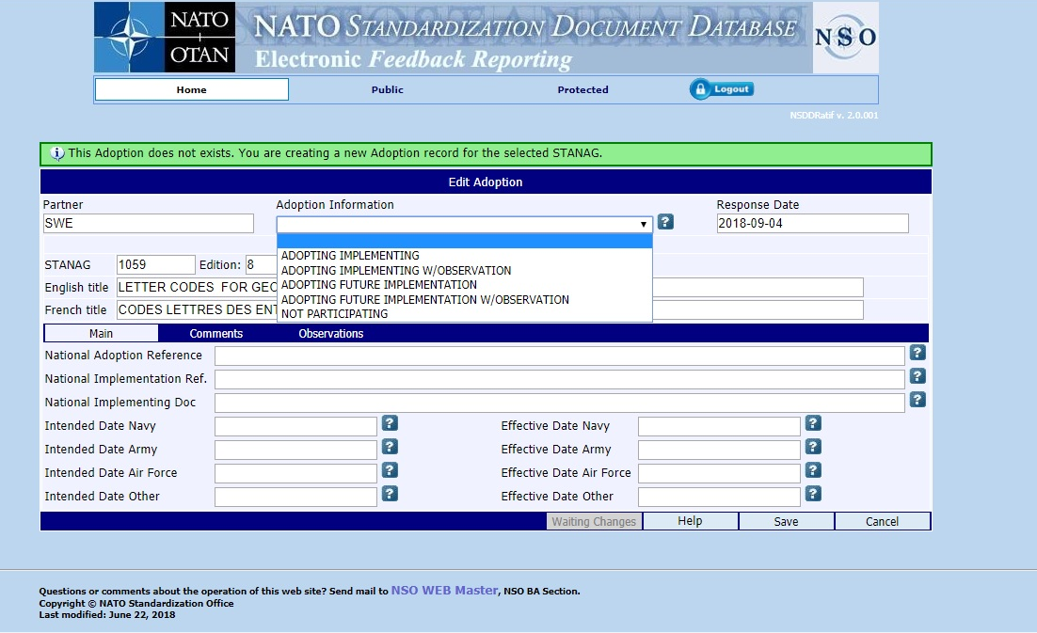
Adoption Reporting

Slide 13
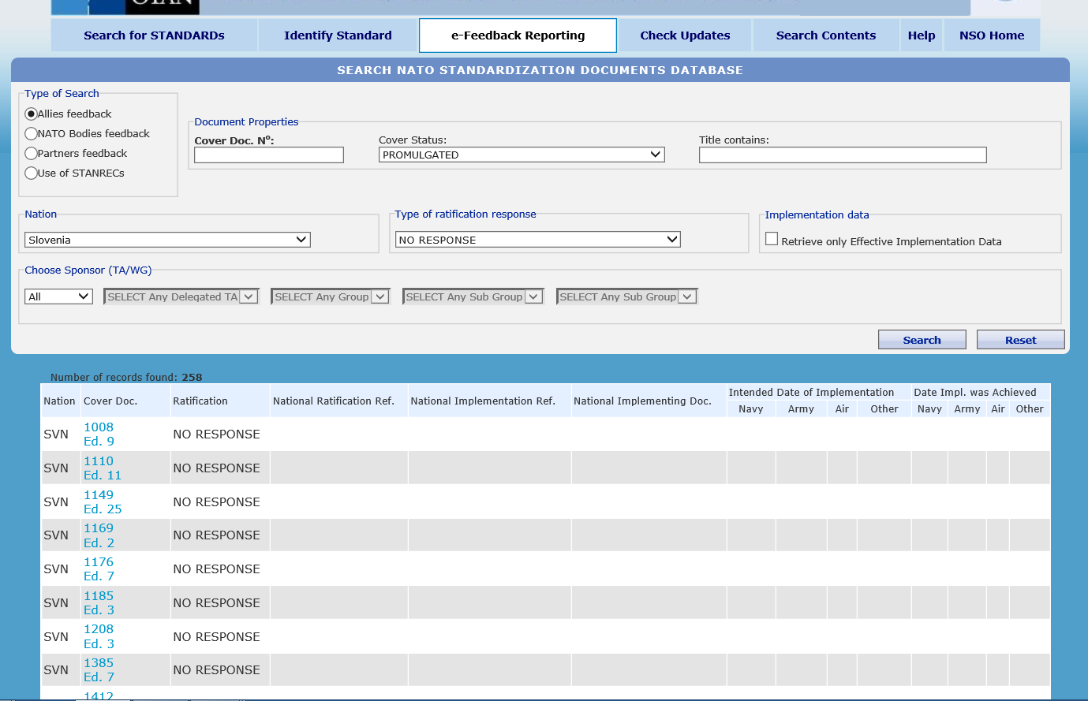
Ratification Responses by Nation
2
1
3
4
5
6

Slide 14
Standardization Document Development Process
Requirements Identification
Requirements Validation and Task Development
Standard(s) Development
Ratification / Approval & Promulgation
Use of Standard(s)
Review

Slide 15
Implementation Guidance in STANAGs - Requirement iaw AAP-03 (K) -
“For STANAGS, implementation guidance should be sufficiently detailed and shall set a list of specific actions, …, that Allies, and partner nations that have decided to adopt and implement the covered Allied Standards, should take, …”
Operational standards: may address need to include NATO standard in national concepts and doctrine and/or to change national education and training courses. May include use of standard in national exercises and evaluation programmes
Materiel standards: may address national technical specifications or defence standards, national procurement programmes, the development of interface solutions or even the participation in tests and trials with the standardization solution

Slide 16
Implementation Guidance in STANAGs
Consider DOTMLPF(I)
 | Questions to consider
DOCTRINE | Does implementation require inclusion of the standard in national procedures, regulations and education plans?
ORGANISATION | Which military organizations/services will have to implement the standard?
TRAINING | Will implementation require consideration of the standard in national education, training and exercises?
MATERIEL | Which specific materiel is affected by the standard ? Does the standard require consideration in national procurement programmes, the development of interface solutions, the participation in tests and trials with the standardization solution to confirm interoperability?
LEADERSHIP | Does the standard require leadership engagement? If, yes, at what levels?
PERSONNEL | Does the standard have an impact on personnel, i.e. education of a certain number of experts or the establishment of additionl positions in NATO force structure elements.
FACILITATIES | Does the standard requires changes to existing facilities (includes infrastructure like roads, bridges, communication lines) or even the building of new infrastructure?

Slide 17
Implementation of STANAGs - Reality -
Most implementation paragraphs very weak
Examples:
“Participating nations agree to implement xxx, Edition A, in accordance with their ratification responses”
“The agreement is implemented when a nation has issued instructions that all national documents will follow the provisions of this agreement”

Slide 18
Implementation of STANAGs - Requirement -
“Allies should provide feedback on implementation.” (2016 NATO Policy for Standardization Policy)
“Allies shall provide implementation details through the electronic reporting tool (e-Reporting).” (AAP-03(K), promulgated 28 Feb 2018)

Slide 19
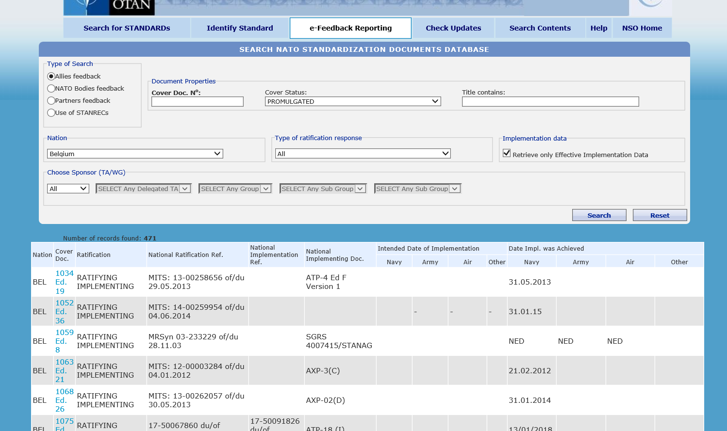
Implementation Reporting
Why is it important?
Provides a holistic picture of the Alliance’s interoperability.
What is it?

Slide 20
Implementation of STANAGs - Reality -

Slide 21
Implementation Reporting
Total
Status 01 Feb 2018
Number of Allies in each category:

Slide 22
Challenges
Missing ratification responses
- long ratification process – with extensions
- delayed promulgation
- unknown national positions
High number of responses “ratifying, future implementation”
- unclear national position
Missing implementation reports
- unknown national status
- unknown level of interoperability

Slide 23
Remedial Actions
Briefings to TAs/DTAs on ratification response status
Briefings to national standardization managers on ratification response status
More detailed guidance for setting promulgation criteria [AAP-03(K)]
E-Feedback Reporting
More detailed guidance for drafting implementation paragraphs [AAP-03(K)]
Complementary methods to assess implementation / level of interoperability (exercises reports, evaluations, NATO Defence Planning Process – NDPP)
Briefings to the Committee for Standardization on available implementation information

Slide 24
Take-aways
Related to ratification:
Provide national ratification response within timeline allocated by TA/DTA
Submit outstanding ratification responses for already promulgated STANAGs
Update response “ratifying, future implementation” as soon as implementation details are known (time, service, …)
Avoid stopping a document in ratification. Use options: - “ratifying with reservation” - “not participating”
Related to implementation:
As SME (custodian), provide detailed implementation guidance
As nation, report implementation to NSO

Slide 25
Time for your questions…

