Slide 1
Partners’ involvement in / contribution to
NATO Standardization
LtCol Christoph Kück
NSO, Policy and Coordination Branch
Warsaw, 18 September 2019

Slide 2
Agenda
1.
Partner Frameworks
2.
Partners’ Contribution to NATO Standardization
3.
NSO Support to Partners
4.
Release of Documents
5.
ePRIME / PCM

Slide 3
Agenda
1.
Partner Frameworks
2.
Partners’ Contribution to NATO Standardization
3.
NSO Support to Partners
4.
Release of Documents
5.
ePRIME / PCM

Slide 4
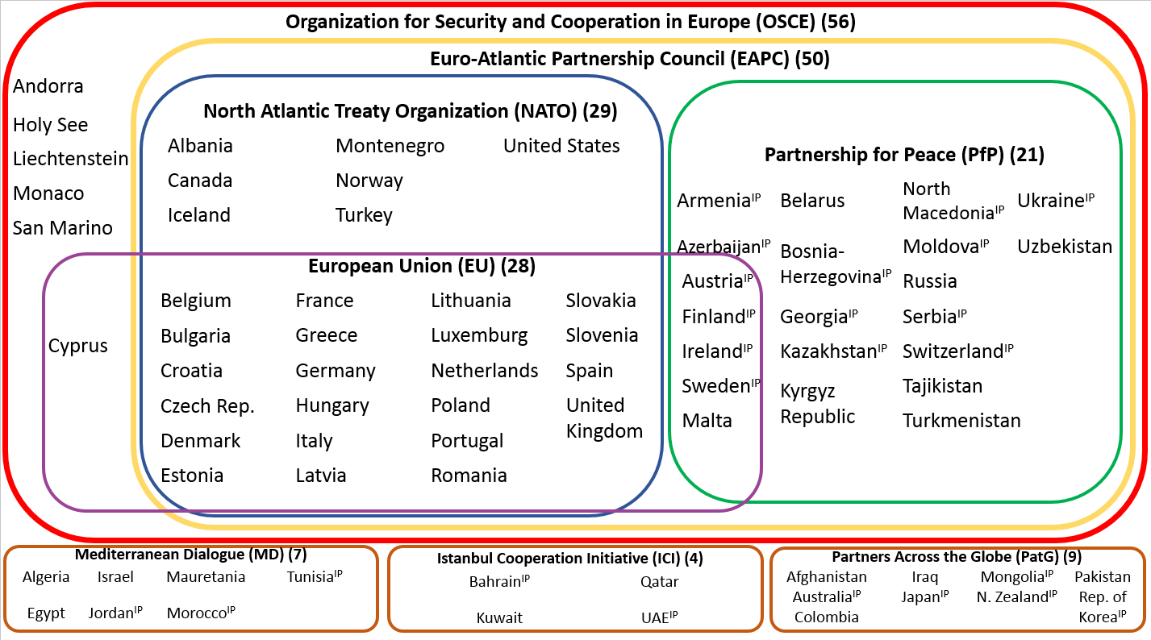
European and NATO Co-op Structures

Slide 5
Partnerships: projecting stability through cooperation
Partners are part of many of NATO’s core activities, from shaping policy to building defence capacity, developing interoperability and managing crises.
In partnering with NATO, partners can:
gain access to advice and support as they reform and strengthen defence institutions and capacities;
prepare together for future operations and missions by participating in exercises and training;
contribute to current NATO-led operations and missions.
Through partnership, NATO and partners also pursue a broad vision of security:
fighting against corruption in the defence sector;
enhancing efforts to control or destroy arms, ammunition and unexploded ordnance;
defence against terrorism.

Slide 6
NATO - an Evolving Alliance
2014 / 2016 / 2018 Summits: Strengthened Deterrence and Defence Posture, to include:
Forward Presence in the eastern part of the Alliance (eFP)
40.000-strong NATO Response Force (NRF) with a brigade-sized Very High Readiness Joint Task Force (VJTF)
NATO Readiness Initiative (4 - 30s: 30 battalions, 30 combat ships, 30 air squadrons ready to use within 30 days)
Improved rapid reinforcement / Alliance‘s military mobility by land, air, sea
Enhanced emphasis on regional Partnerships and capacity building efforts (e.g. Regional Hub for the South)
Notes:
VJTF: Very High Readiness Joint task Force, ntm 2-7 days eNRF: division size joint force

Slide 7
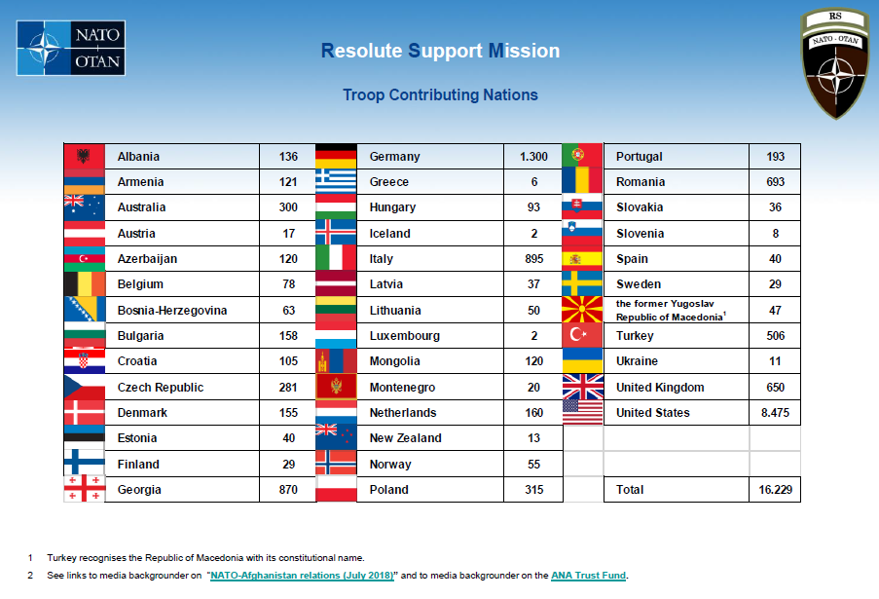
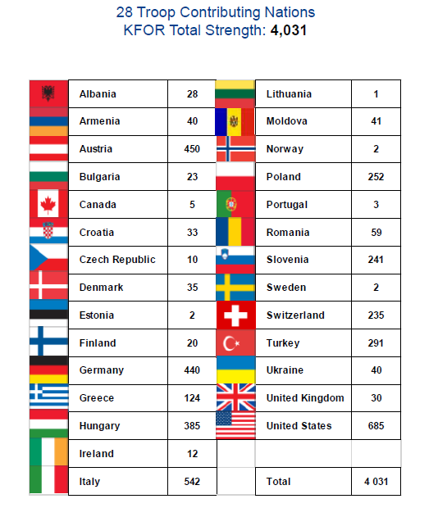
Troop Contributing Nations

Slide 8
Agenda
1.
Partner Frameworks
2.
Partners’ Contribution to NATO Standardization
3.
NSO Support to Partners
4.
Release of Documents
5.
ePRIME / PCM

Slide 9
Partners’ Involvement in the NATO Standardization Process
For partner Nations:
Adoption
‘TA/DTAs are encouraged
to involve partner nations’
Standardization Proposal
Electronic reporting
Electronic reporting
Requirements Identification
Requirements Validation and Task Development
Stand. Documents Development
Ratification / Approval & Promulgation
Implementation / Use of Standard(s)
Phase 1
Phase 2
Phase 3
Phases 4/5
Phase 6
Review
Phase 7
Possible Partner Involvement

Slide 10
Adoption of STANAGs
The “adoption” is a formal approval
with the aim of full or partial IMPLEMENTATION
of a NATO standard.
Transparent adoption reports are supposed to facilitate future operational planning of NATO with particular partners.
Partner
NATO

Slide 11
Adoption Process
Adoption: process in which partner nations analyse standards covered by a STANAG in order to determine the national position regarding the implementation (identify if, and how to implement them)
Completion of process results in an adoption report provided using the electronic reporting tool on the NSO protected website

Slide 12
Adoption
What needs to be analysed?
Requirements and impacts on national resources
capabilities supported and national plans for development/procurement of these capabilities
services concerned
required national actions for implementation ( procurement of new material/equipment, technical specification/tactics, change of national education and training courses, software changes to existing IT systems, etc.)
required and available resources
timelines/roadmaps for implementation
national limitations/caveats

Slide 13
Adoption Responses
Adopting and implementing
will implement fully
provide date/timescale
Adopting and implementing - with reservations;
will implement but has concerns/impediments in some areas
provide date/timescale
Adopting, future implementation;
will implement fully
unable to provide date/timescale
Adopting, future implementation - with reservations;
will implement but has concerns/impediments in some areas
unable to provide date/timescale
Not participating
do not have the capability / not interested

Slide 14
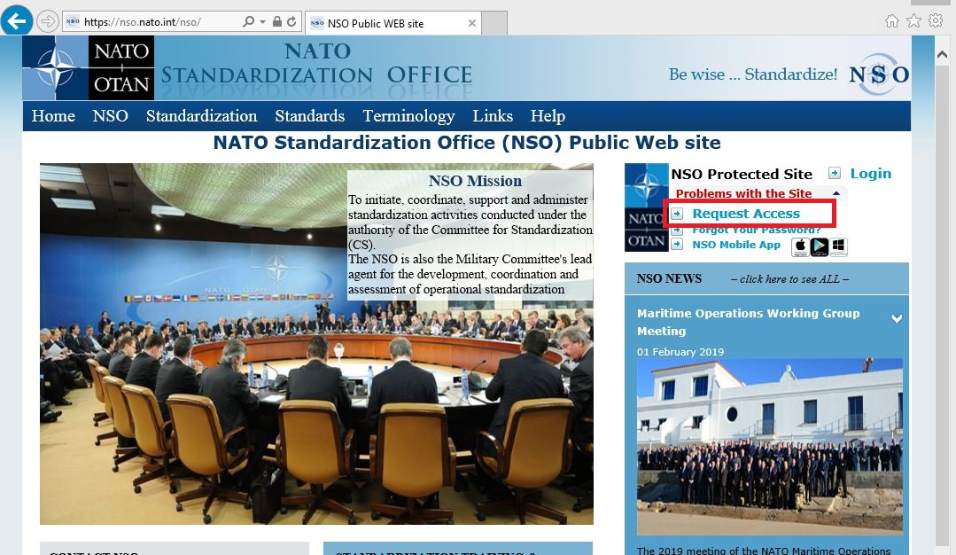
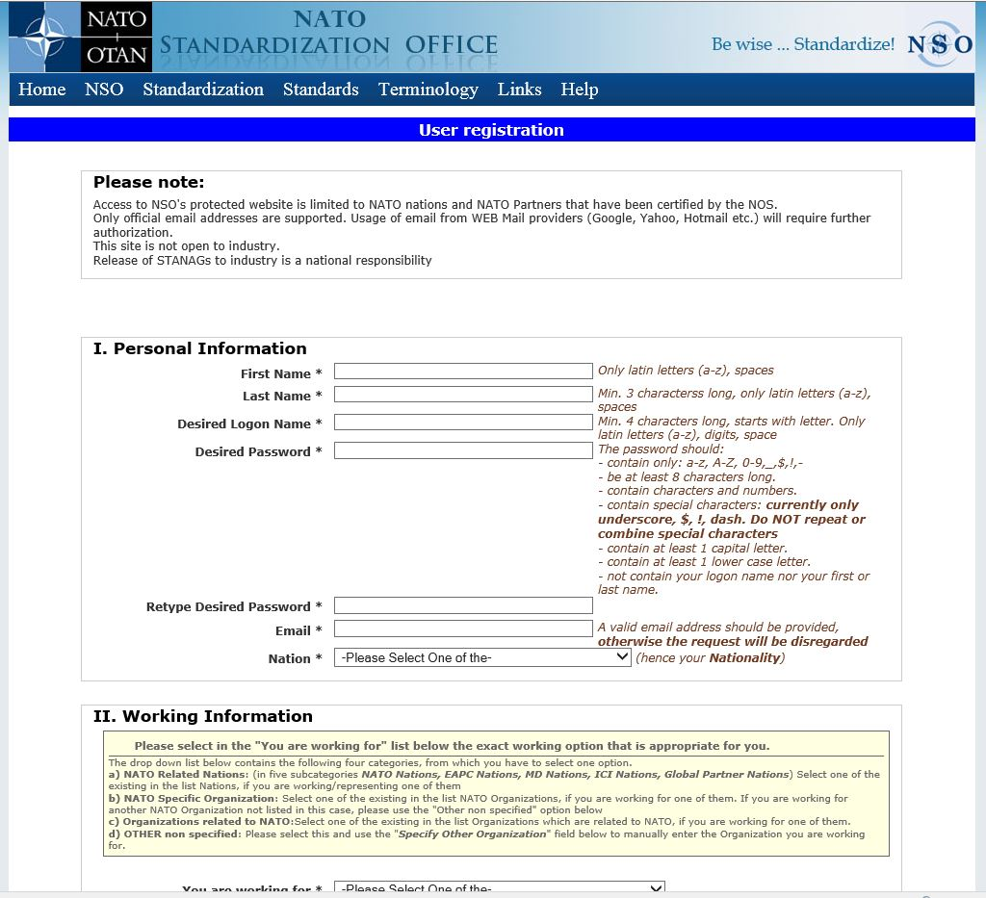
Adoption Reporting
Requires access to
NSO Protected Web Site!

Slide 15
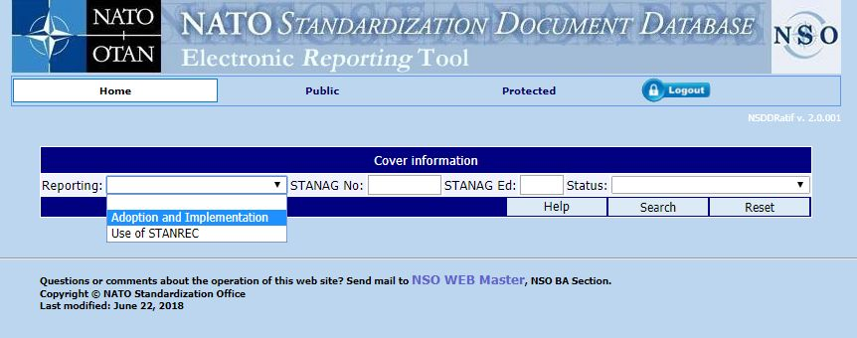
Adoption Reporting
Requires access to e-Reporting site: will be granted based on official request
1
2

Slide 16
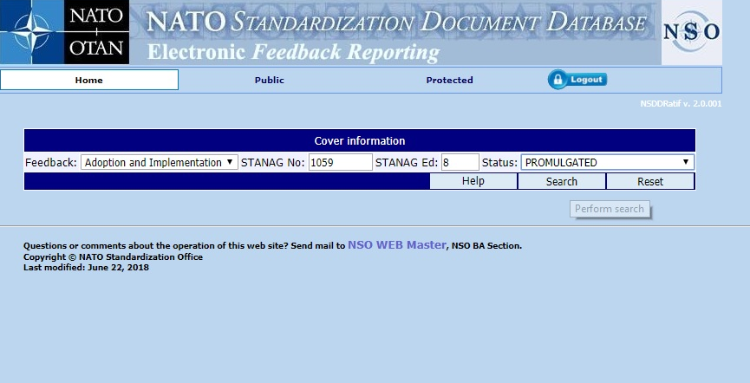
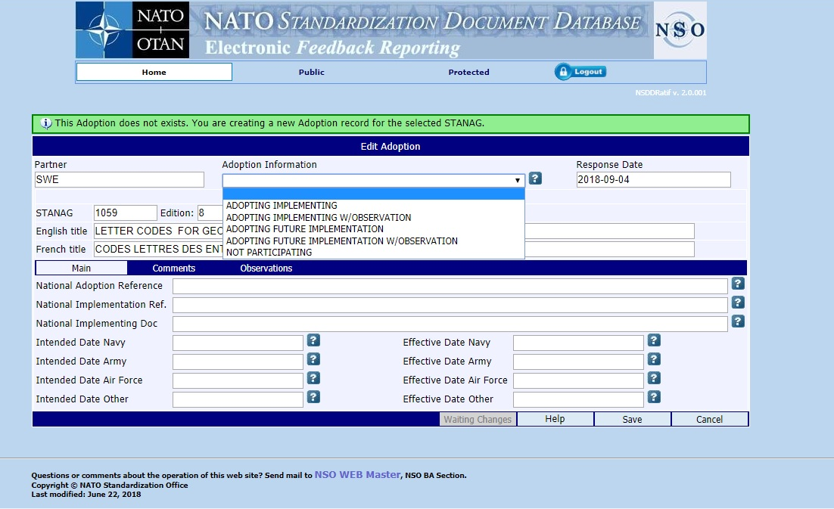
Adoption Reporting

Slide 17
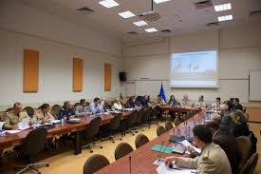
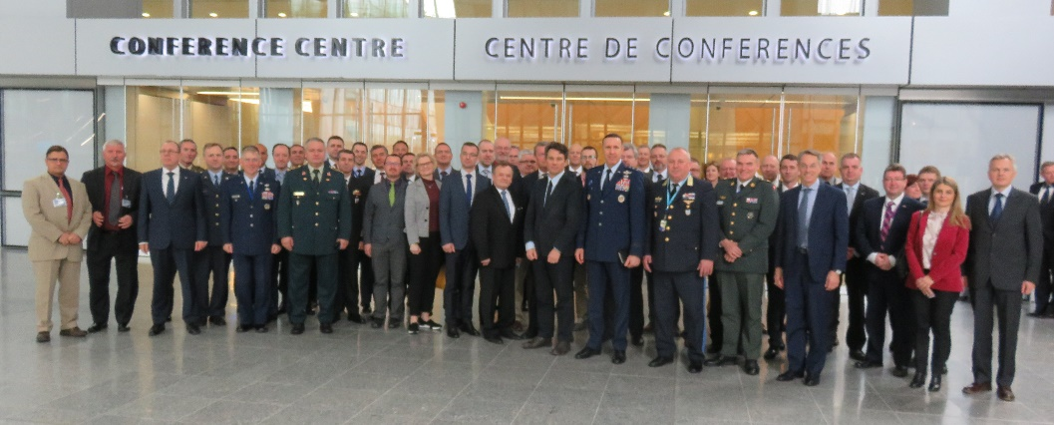
Contribution to
NATO Standardization
Active participation in / contribution to
the “governance and steering process” of NATO’s standardization efforts (w/ Partners)
the development and maintenance of standardization documents
Education & Training on Standardization
Use of the “feedback- mechanism”

Slide 18
Agenda
1.
Partner Frameworks
2.
Partners’ Contribution to NATO Standardization
3.
NSO Support to Partners
4.
Release of Documents
5.
ePRIME / PCM

Slide 19
NSO Support
Education and training on standardization
PSE posts within NSO (P&C and Joint Branch)
Release of Documents
NSO Expert Visits (upon request by Partner Nation)

Slide 20
Training Opportunities
- Overview -
Participation in the following courses
NSO Orientation Course, NATO HQ, Brussels
Standardization-within-NATO Course, Warsaw, Poland
Drafting, Production & Maintenance of NATO Standards, Crete, Greece
Expert visit / MTT
On-the-job Training, NSO
Online education

Slide 21
NSO Expert Visits – Set up
Expert Visits can be conducted
on the working level (2 SOs, 2 – 3 days) or
as a VIP visit (DNSO + supporting staff)
Always on invitation by a partner Nation
Content / agenda tailored to the needs of partner Nation(s)

Slide 22
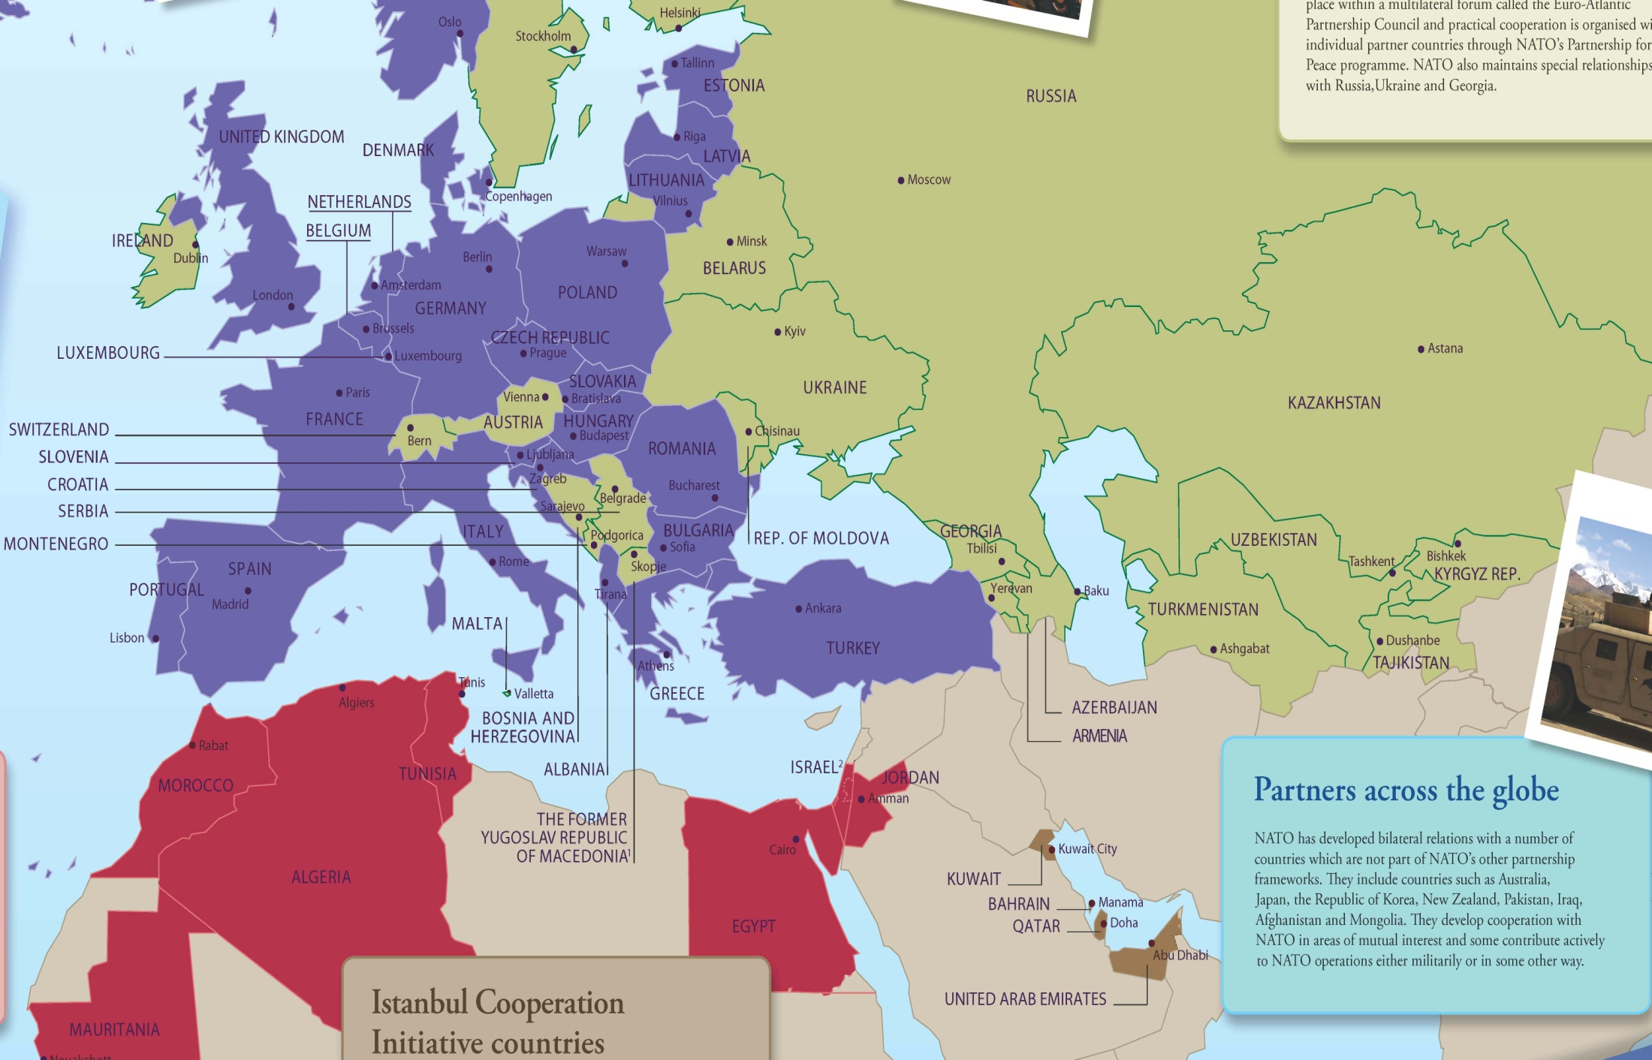
NSO Expert Visits
2015 - Sweden
2014 - Ireland
2011 - Moldova
2012, 2014, 2018, 2019 - Serbia
2015 - Moldova
2012 - Ukraine
2019 - Switzerland
2016 - Ukraine
2009, 2014 - Georgia
2009, 2012 - Montenegro
2010 - Azerbaijan
2015 - Azerbaijan
2012 - the former Yugoslav Republic of Macedonia*
2012 - Jordan

Slide 23
NSO’s Contribution to NATO’s PARP
Partnership and Planning Process as a biennial cycle
Cooperation with IS Defence Policy and Planning Division (DPP), IOT identify standards linked to capabilities (PGs)
Verify that all standards are valid, up to date and not classified
Support IS DPP during bi-lateral meetings and in the assessment

Slide 24
Agenda
1.
Partner Frameworks
2.
Partners’ Contribution to NATO Standardization
3.
NSO Support to Partners
4.
Release of Documents
5.
ePRIME / PCM

Slide 25
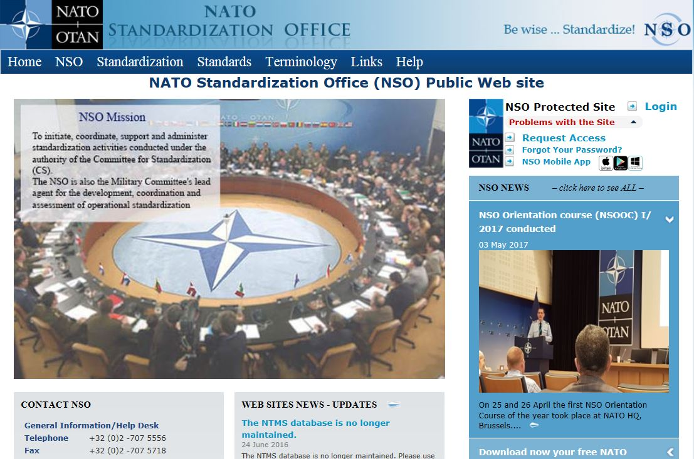
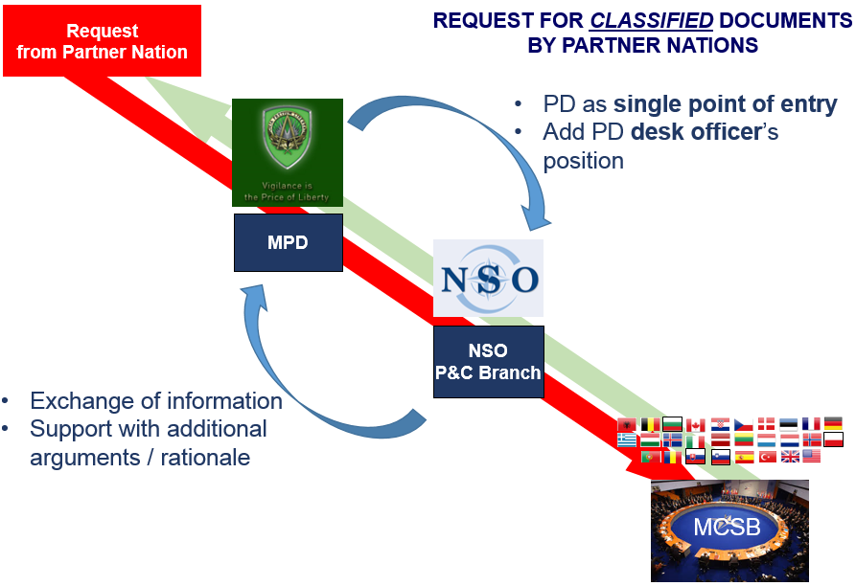
Access to / Release of Documents
UNCLASSIFIED
STANDARDIZATION DOCUMENTS
REQUEST FOR CLASSIFIED DOCUMENTS BY PARTNER NATIONS
NSO protected website (http://nso.nato.int)
Decision by TAs on a case-by-case basis
Consensus principle
Strong justification required
> 1.100 standards

Slide 26
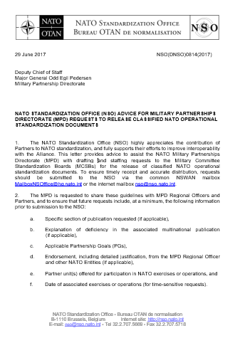
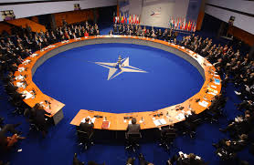
Guideline for Nations
To make that decision, Nations need as many information as possible:
Applicable Partnership Goal(s) (if applicable);
Specific section / chapter of publication (if applicable);
Explanation of deficiency in the associa-ted MP (if applicable);
Endorsement, including detailed justifi- cation, from the PD Regional Officer and other NATO Entities (if applicable);
Partner unit(s) offered for participation in NATO exercises or operations; and
Date of associated exercise or operation _______(for time-sensitive requests).
Request
from Partner Nation
PD
NSO
P&C Branch
MCSB

Slide 27
Agenda
1.
Partner Frameworks
2.
Partners’ Contribution to NATO Standardization
3.
NSO Support to Partners
4.
Release of Documents
5.
ePRIME / PCM

Slide 28
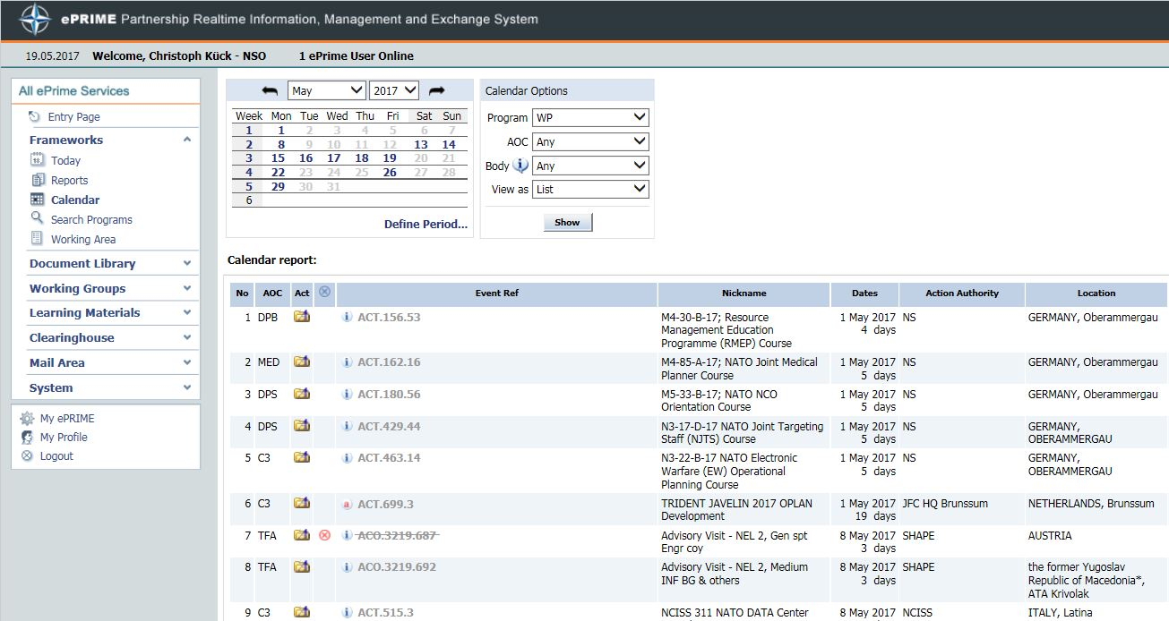
ePRIME System
ePRIME is an electronic tool to manage the Partnership cooperation Menu (PCM) (list of events)
NSO annually contributes ≈ 80 events to the PCM

Slide 29
Contribution to NATO Standardization
via ePRIME / PCM
Committee for Standardization (CS) Meetings
Standardization Management Group (SMG) Meetings
(Operational) Standardization Working Group / Panel Meetings
Training and Educational Events
Expert / High Level Visits

Slide 30
Time for your questions…

Slide 31
Partners’ involvement in / contribution to
NATO Standardization
LtCol Christoph Kück
NSO, Policy and Coordination Branch
Warsaw, 18 September 2019

