Slide 1
INTEROPERABILITY AND STANDARDIZATION
Key Enablers and Capability Multipliers
for the Achievement of Alliance Objectives
Dieter Schmaglowski
Deputy Director NSO
Warsaw, 16 Sep 2019

Slide 2
What is NATO standardization ?
How does it relate to interoperability ?
Why is it important ?
What are NATO’s principles for standardization ?
Which key documents guide NATO standardization activities ?

Slide 3
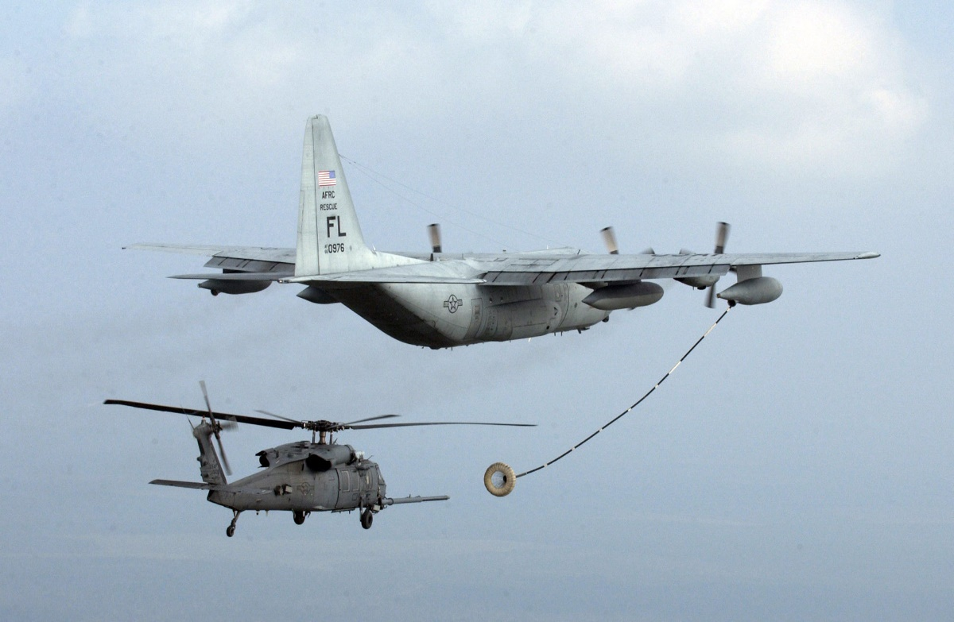
What is NATO standardization ?

Slide 4
Standardization
“The development and implementation of
procedures, designs and terminology
to the level necessary for the
interoperability required by Allies,
or to recommend useful practices in
multinational cooperation.”
NATO Policy for Standardization (2016)

Slide 5
Levels of Standardization
Commonality:
“The state achieved when the same doctrine, procedure or equipment are used.
Interchangeability:
“The ability of one product, process or service to be used in place of another to fulfill the same requirements.”
Compatibility:
“The suitability of products, processes or services for use together under specific conditions to fulfil relevant requirements without causing unacceptable interactions.”
Source: NATOTerm

Slide 6
Levels of Standardization
COMMONALITY
Same systems – Same data
INTERCHANGEABILITY
Different systems – Same data
m
Information
Exchange Gateway
COMPATIBILITY
Different systems – Different data
Notes:
Compatibility: (low)
“The suitability of products, processes or services for use together under specific conditions to fulfil relevant requirements without causing unacceptable interactions.”
Interchangeability:
“The ability of one product, process or service to be used in place of another to fulfill the same requirements.”
Commonality: (high)
“The state achieved when the same doctrine, procedure or equipment are used.

Slide 7
Fields of Standardization
Operational
Doctrine
Tactics, Techniques and Procedures
Materiel
Weapon-systems and sub-systems
C3 systems
Administrative
Terminology
Human resources
Interfaces
Components, spare parts and consumables
Military ranks
…
…

Slide 8
Promulgated NATO Standards
1534 “active” Allied Standards
as of 27 Feb 19

Slide 9
How does standardization relate to interoperability ?

Slide 10
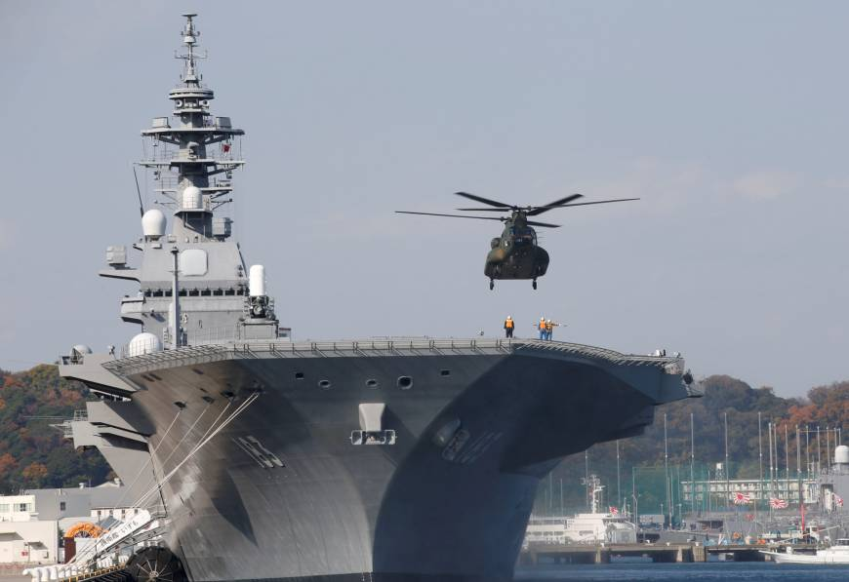
Interoperability - Allies’ Agreed Definition –
“ The ability to act together
coherently,
effectively and
efficiently
to achieve Allied
tactical, operational and strategic
objectives”
- NATO Interoperability Policy and Strategy (2009)

Slide 11
Interoperability Enablers
Demonstrations, Trials, Tests
Coorperative Programmes
Lessons Learned
Education, Exercises, Training, Evaluations
Standards
NATO Interoperability Policy and Strategy (2009)

Slide 12
Why is standardization important for NATO ?

Slide 13
NATO: an Evolving Alliance !
2014/2016/2018 Summits: Strengthened Deterrence and Defence Posture, to include:
Forward Presence in the eastern part of the Alliance (eFP)
40,000-strong NATO Response Force (NRF) with a brigade-sized Very High Readiness Joint Task Force (VJTF)
NATO Readiness Initiative (four thirties: 30 battalions, 30 combat ships, 30 air squadrons ready to use within 30 days)
Improved rapid reinforcement / Alliance‘s military mobility by land, air, sea
Enhanced emphasis on regional Partnerships and capacity building efforts (e.g. Regional Hub for the South)
Notes:
VJTF: Very High Readiness Joint task Force, ntm 2-7 days eNRF: division size joint force

Slide 14
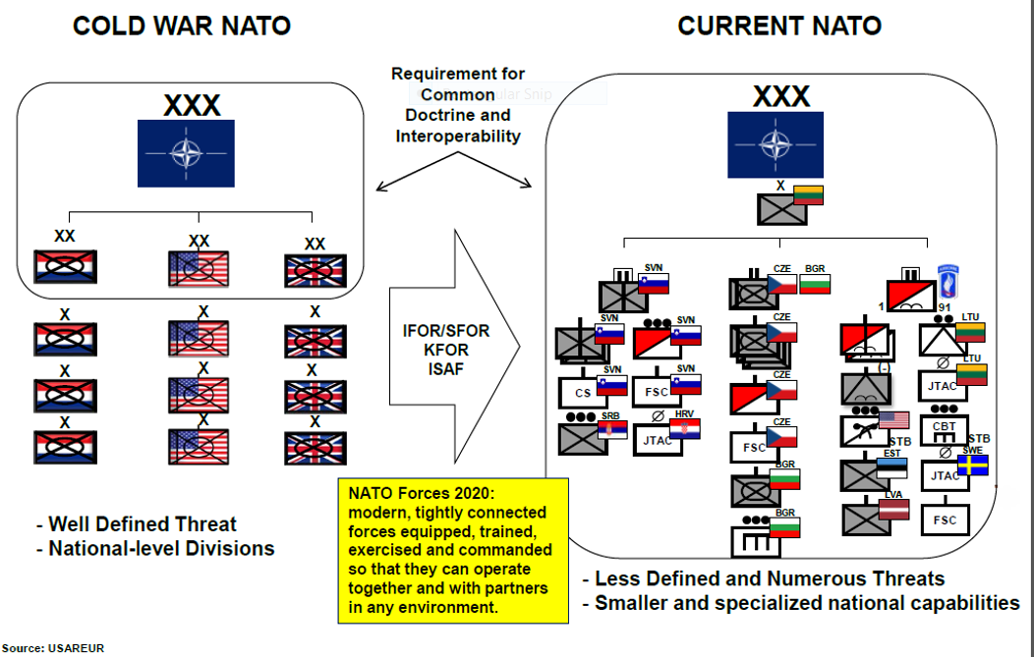
NATO Evolution
Increased need for interoperability even on the tactical level!

Slide 15
Modular Capability Concept
20

Slide 16
Standardization
- Why? -
“…to support achieving, maintaining and enhancing interoperability “
in order to
- improve efficiency in the use of available resources
- strengthen Alliance defence capabilities
- enhance Alliance’s operational effectiveness

Slide 17
What are NATO’s principles for standardization ?

Slide 18
NATO Policy for Standardization
Revised Policy NAC approved on 20 May 2016, PO(2016)0315
Steers Alliance standardization activities to support developing, maintaining and enhancing interoperable capabilities for missions and operations
Defines NATO standardization
Outlines guiding principles
Describes roles and responsibilities of main standardization stakeholders: Allies, Partners, Standardization Tasking Authorities (TAs), Committee for Standardization (CS), NATO Standardization Office (NSO)

Slide 19
Guiding Principles for NATO Standardization
Overarching and Systematic Approach
Timeliness of Standardization
Commitment to Implementation
Transparency
Use of Civil Standards
Consistency and Coherence
Terminology

Slide 20
Which key documents guide NATO standardization activities ?

Slide 21
Standardization Key Documents
NATO Policy for Interoperability, C-M(2009)0145
NATO Policy for Standardization, PO(2016)0315
NATO Strategy for Standardization, AC/321-D(2018)0003
MC 0020/11: Military Committee Policy for Military Operational Standardization (MC approved on 24 Apr 15)
AAP-03: Production, Maintenance and Management of NATO Standardization Documents (Edition K promulgated 28 Feb 18, effective 01 Jul 18)
AAP-32: Publishing Standards for NATO Standardization Documents (last edition promulgated 18 Dec 14)
AAP-47: Allied Joint Doctrine Development (last edition promulgated 19 Feb 19)

Slide 22
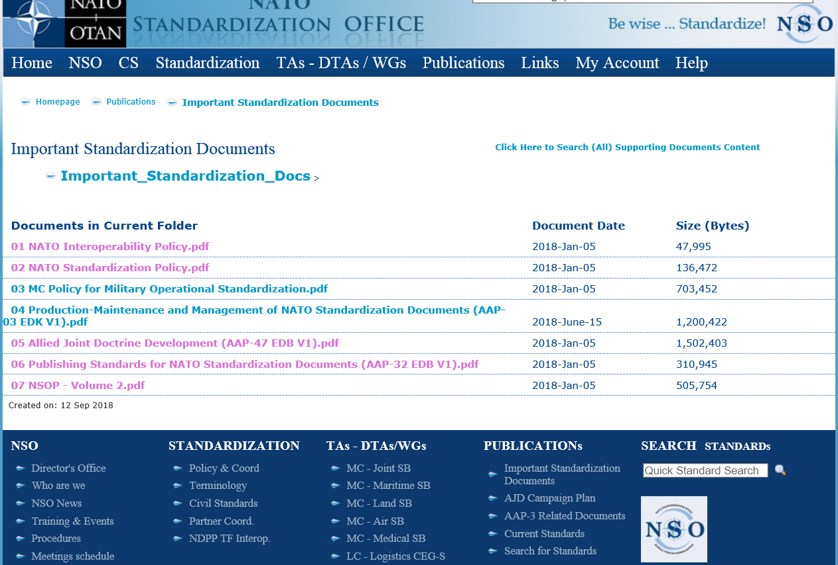
Standardization Key Documents

Slide 23
Time for your questions…

