Slide 1
S
NATO STANDARDIZATION PROCESS
Production and Maintenance
of NATO Standardization Documents
LtCol Tomasz Kemski, WCJNiK
Warsaw, 16 September 2019

Slide 2
Agenda
S
1.
Introduction
2.
Products
3.
Process
4.
Glossary
5.
Reference Documents

Slide 3
Agenda
S
1.
Introduction
2.
Products
3.
Process
4.
Glossary
5.
Reference Documents

Slide 4
S
AAP-03 Edition K, Version 1
Approved by Allies in the Committee for Standardization
Endorsed by all senior committees overseeing the development of NATO standardization documents*
Approved by the Council
Promulgated on 28th February 2018
Effective from 1st July 2018
* Tasking Authorities (TAs) / Delegated Tasking Authorities (DTAs)

Slide 5
Agenda
1.
Introduction
2.
Products
3.
Process
4.
Glossary
5.
Reference Documents

Slide 6
NATO Standardization Documents

Slide 7
Fields of Standardization
OPERATIONAL
NATO standardization documents that specify the conceptual, organizational or methodological requirements to enable material, installations, organizations or forces to fulfil their functions or missions.
Doctrine, standards for tactical level training, procedures, etc.
MATERIEL
NATO standardization documents that specify the common technical requirements for materiel throughout its life cycle:
systems (i.e. consultation, command and control systems, weapon-systems and sub‑systems), interfaces, components, spare parts and consumables, including ammunition, fuel, and supplies.
ADMINISTRATIVE
NATO standardization documents that facilitate Alliance administration in various areas including, but not limited to, terminology, finances, human resources and military ranks.

Slide 8
Allied Standards
ALLIED STANDARD:
Allied standards are standards developed
or selected in the framework of
the NATO standardization process.

Slide 9
Allied Standards
!
There are Allied Standards that are not NATO Standards
NATO STANDARD:
A NATO standard is a standard developed and promulgated in the framework of the NATO standardization process.
NON-NATO STANDARD:
A non-NATO standard is a standard developed outside NATO.
Non-NATO standards include civil standards, national and multinational defence standards. Non-NATO standards become Allied Standards when adopted by NATO.

Slide 10
Allied Standards
> 1200 Promulgated Allied Standards (as beginning of Feb 18)

Slide 11
Covering Documents

Slide 12
Covering Documents
STANdardization AGreement:
A STANAG is a NATO standardization document that specifies the agreement of member nations to implement one or several NATO or non-NATO standards, in whole or in part, with or without reservation, in order to meet an interoperability requirement.
Allies’ agreement is given through the national ratification process.
STANdardization RECommendation:
A STANREC is a NATO standardization document used exclusively in the materiel field of standardization, that lists one or several NATO or non-NATO standards relevant to a specific Alliance activity unrelated to interoperability. Non-binding.

Slide 13
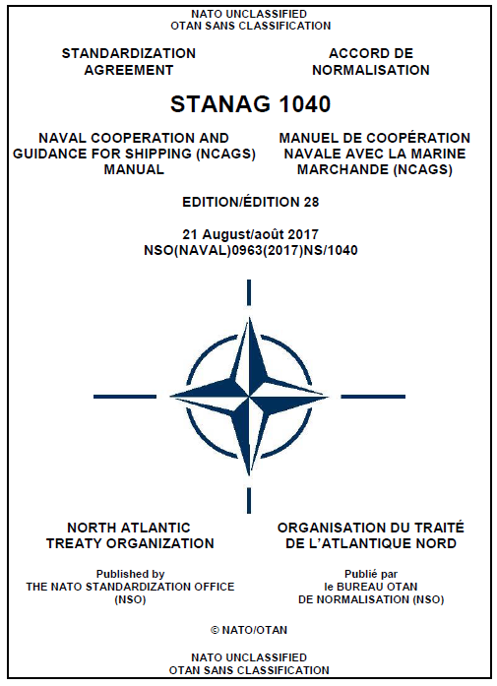
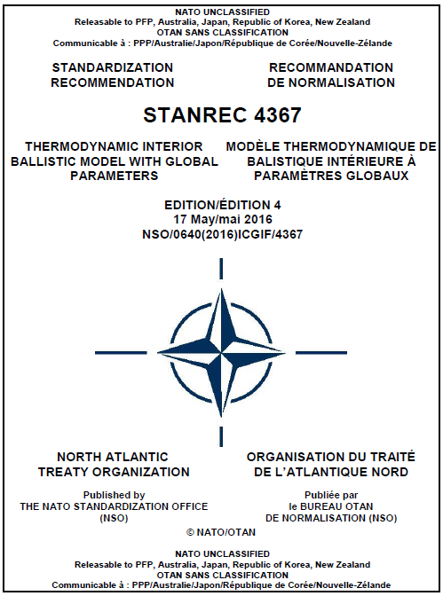
Covering Document Selection
!
Look at: scope of the Allied standard(s) covered,
contribution to interoperability & intended use
Aims at
enhancing interoperability
STANAG
Aims at
recommending useful practices
STANREC

Slide 14
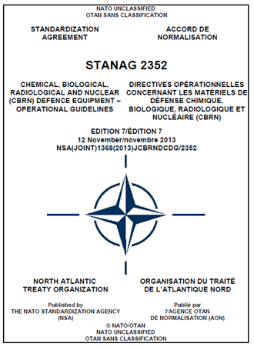
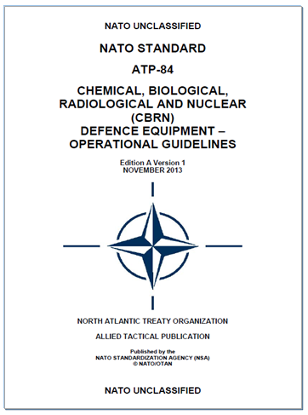
Promulgated Standardization Docs
COVERING DOCUMENT
ALLIED STANDARD
+

Slide 15
Standard-Related Documents

Slide 16
Standard-Related Documents
A standard-related document (SRD) is a standardization document that facilitates understanding and implementation of one or more Allied standards.
It may provide additional data and information to support the management and implementation of Allied standards.
Examples are national data catalogues, standards implementation guides, etc.

Slide 17
Allied and Multinational Publications
S
!
ALLIED PUBLICATION (AP)
Example:
AJP - Allied Joint Publication, ATrainP Allied Education and Training Publication
MULTINATIONAL PUBLICATION (MP):
Example:
MPP - Multinational Procedural Publication
Standards and Standard-Related Documents published by NATO are also called AP and MP
EXTRACT FROM AN AP
FOR DISTRIBUTION AND USE OUTSIDE NATO

Slide 18
Standardization Documents Classification
S
!
Always the lowest level of classification required to protect info
If possible: no classification markings

Slide 19
Agenda
1.
Introduction
2.
Products
3.
Process
4.
Glossary
5.
Reference Documents

Slide 20
Standardization Document
Development Process
Phase 7
Requirements Identification
Requirements Validation and Task Development
Stand. Documents Development
Ratification / Approval &
Promulgation
Implementation / use of Standard(s)
Phase 1
Phase 2
Phase 3
Phases 4/5
Phase 6
Review

Slide 21
Phase 1: Requirements Identification
Phase 2: Requirements Validation and Task Development
EITHER
Bottom-up: Standardization Proposal
(any interested party)
OR
Top-down: High Level Directives
(Council, Capability Priorities, NDPP)
Phase 7
Requirements Identification
Requirements Validation and Task Development
Standard(s) Development
Ratification / Approval &
Promulgation
Implementation / use of Standard(s)
Phase 1
Phase 2
Phase 3
Phases 4/5
Phase 6
Review

Slide 22
Phase 1: Requirements Identification
Requirements Identification
Phase 1
Bottom-up:
ANY INTERESTED PARTY: | initiate SP and send to TA/DTA or NSO
TA/DTA STAFF: | receive and distribute SP and SI form (to Allies, partners, NATO bodies and other staffs)
ALLIES, PARTNERS: NATO BODIES: | respond to SI
NSO: | include SP in NSDD (after the ST is approved and the profile is created)
!
SI FORM:
- Part 1: to confirm Allies support (for bottom-up only).
- Part 2: to collect information.

Slide 23
The Standardization Proposal
initiates the bottom-up standardization process
can be submitted by any interested party
shall be developed in accordance with SP format provided in AAP-03
(available on NSO website)
shall address
- subject
- standardization need and the impact on interoperability
- proposed standardization solution
- urgency
shall be submitted by the author to the appropriate TA/DTA Staff for
the initiation of the validation process. If more than one planning domain is
engaged, or there is uncertainty concerning the appropriate TA/DTA for
the SP, the SP shall be submitted to the NSO.
If required, the NSO will assist.
Provide sufficient information for assessment of requirement by nations
!

Slide 24
The Standardization Inquiry
will be submitted by TA/DTA staff to nations together with SP
all Allies and invited Partners should respond
information required for assessing support by Allies and for development
of standardization task
Allies have to engage at the beginning of the process
!

Slide 25
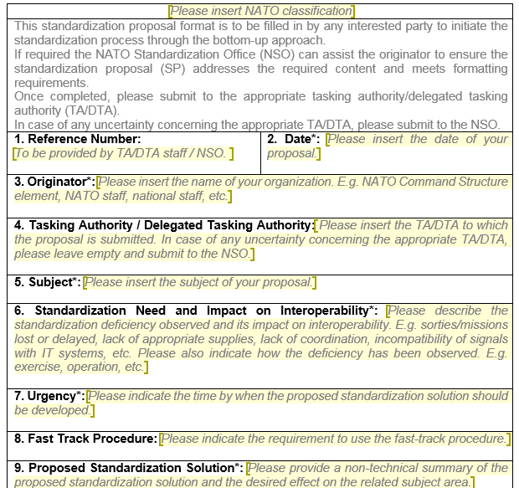
SP Template

Slide 26
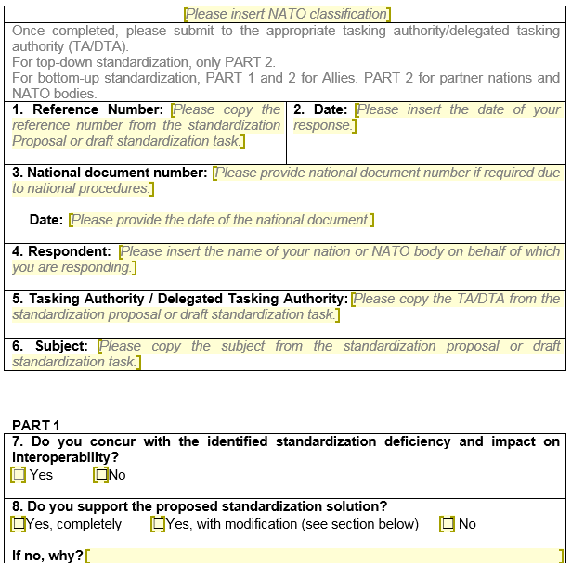
SI Form

Slide 27
Phase 2: Requirements Validation
and Task Development
Requirements Validation and Task Development
Bottom Up:
ALLIES, PARTNERS: NATO BODIES: | respond to SI
TA/DTA STAFF: | collect SI responses
 | NEED AND CAPACITY CONFIRMED
TA/DTA STAFF: | develop, coordinate and submit draft ST (with WG/SMEs and NATO Bodies)
TA/DTA: | approve draft ST
NSO: TA/DTA STAFF: | allocate study number and include approved ST in NSDD distribute approved ST (to Allies, partners, NATO bodies and other staffs)
Phase 2
NOT CONFIRMED
TA/DTA STAFF: | recommend rejection of SP
TA/DTA: | reject SP

Slide 28
Phase 1: Requirements Identification
Requirements Identification
Phase 1
Top-down: | High Level Directives
TA/DTA STAFF: | develop and coordinate draft ST (with WG/SMEs and NATO Bodies)
TA/DTA STAFF: | distribute draft ST and SI form (to Allies, partners, NATO bodies and other staffs)
ALLIES, PARTNERS: NATO BODIES: | respond to SI
!
Top-Down is already validated by Allies.
No SP.
SI FORM:
- only Part 2: to collect information.

Slide 29
SI Form

Slide 30
SI Form

Slide 31
Phase 2: Requirements Validation
and Task Development
Requirements Validation and Task Development
!
Top-Down is already
validated by Allies
ST to provide
additional info
Phase 2
Top-down: `
ALLIES, PARTNERS: NATO BODIES: | respond to SI
TA/DTA STAFF: | collect SI responses
TA/DTA STAFF: | elaborate, coordinate and submit draft ST (with WG/SMEs and NATO Bodies)
TA/DTA: | approve draft ST
NSO: TA/DTA STAFF: | allocate study number and include approved ST in NSDD distribute approved ST (to Allies, partners, NATO bodies and other staffs)
do NOT
approve draft ST
S

Slide 32
The Standardization Task
will only be developed, if responses to SI indicate that need and capacity
to contribute to the development are confirmed by Allies
development is responsibility of TA/DTA staff but will require support
from national SMEs and, if appropriate, NATO bodies’ staff
specifies the intended standardization solution
(gives specific guidance to custodian)
shall be developed in accordance with ST format in AAP-03
(available on NSO website)
Requires TA/DTA approval
No standardization task, no NATO standard
!

Slide 33
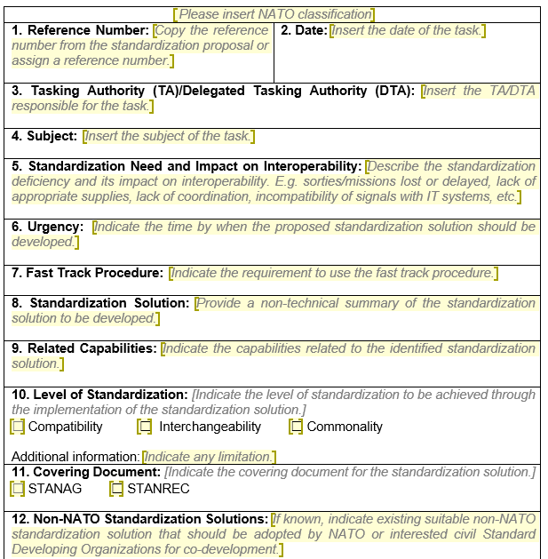
ST Template

Slide 34
How to Develop a ST
SHOULD ADDRESS
Description of standardization need and its impact on interoperability
Urgency/timeline .
Use of fast-track procedure .
Description of standardization solution to be developed (procedure, materiel, etc)
Related capabilities
Level of standardization
Covering document (STANAG / STANREC)
Existing non-NATO standardizations solutions that may be adopted
WG and custodian
Partner Nations’ and NATO Bodies’ Involvement
Coordination / engagement with other actors (CoEs, industry, other DTAs/WGs) .
Classification and release
Language required
Promulgation Criteria
Relationship to existing NATO documents
Military Services affected
!
ST specifies the
intended solution &
guides the WG/custodian

Slide 35
How to Set Promulgation Criteria
S
CONSIDER:
Impact of future Allied standard on interoperability
Allied capabilities supported by the future Allied standard
Allies contributing or planning to contribute to the capabilities supported by the future standard
Allies which are major contributors to the supported capabilities
Urgency for the required standardization solution
Envisaged use of the standard (time, lifespan, specific event or series of events, etc.)
!
“Majority” as default is for most standards probably
not the right approach

Slide 36

SP vs ST
SP addresses observed gap and proposed solution
ST confirms gap (Lesson Identified), identifies and tasks action body
to develop solution in order to close identified gap (Lesson Learned)
SP content very similar to ST content, a well written SP helps to develop
the ST
ST developed by TA/DTA staff in close coordination with SMEs, based
on proposal and SI feedback from Nations and, if appropriate NATO bodies’ staff

Slide 38
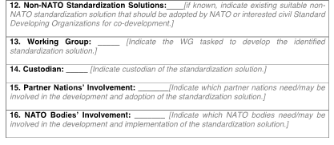
Proposal
Task

Slide 39

Phase 3: Stand. Documents Development
Phase 7
Requirements Identification
Requirements Validation and Task Development
Standard(s) Development
Ratification / Approval &
Promulgation
Implementation / use of Standard(s)
Phase 1
Phase 2
Phase 3
Phases 4/5
Phase 6
Review
Identify / Develop
Solutions

Slide 40
Phase 3: Stand. Docs. Development
Stand. Documents Development
Phase 3
CUSTODIAN

Slide 41

Phase 3: Stand. Docs. Development
Stand. Documents Development
Phase 3
WORKING GROUP:
Suitable Non-NATO Standards | Recommend Adoption
Suitable NATO Standards to Modify | Modify NATO Standards
Suitable civil SDOs for co-development | Co-develop
Develop new NATO Standards
YES
NO
YES
NO
YES
NO

Slide 42
Phase 3: Stand. Docs. Development
Stand. Documents Development
Phase 3
CUSTODIAN

Slide 43
Phase 3: Stand. Docs. Development
Stand. Documents Development
Phase 3
CUSTODIAN

Slide 44
Phase 3: Stand. Docs. Development
Stand. Documents Development
Phase 3
CUSTODIAN

Slide 45

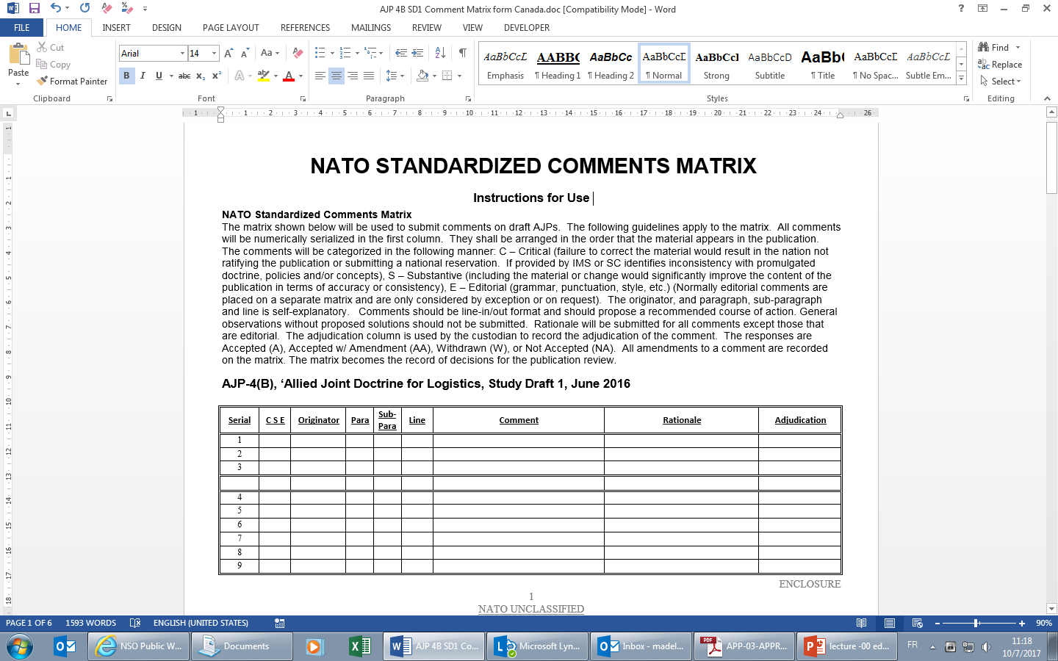
Phase 3: Stand. Docs. Development
Stand. Documents Development
Phase 3
CUSTODIAN
SD1
SD2
SD3
SDX
WORKING GROUP
+
FINAL DRAFT
RATIFICATION DRAFT
APPROVAL DRAFT
or
!
!
Ratification Draft is a draft STANAG
Approval Draft is a draft STANREC
!
!
Covering Document also required for adoption of a non-NATO standard
!
Covering Document NOT required for Administrative Publications
Covering Document NOT required for SRDs – linked to Allied Standards

Slide 46
Phase 3: Stand. Docs. Development
Stand. Documents Development
Phase 3
CUSTODIAN
SD1
SD2
SD3
SDX
WORKING GROUP
+
FINAL DRAFT
RATIFICATION DRAFT
APPROVAL DRAFT
or
!
If WG does not endorse Final Draft (FD) Chair Report + last SD to TA/DTA
(further guidance, withdraw ST, approve SD with or without modification)

Slide 47
How to Reference
Non-NATO Standards
S
copyrights shall be respected in all cases
content can be reproduced only with the permission of the copyright holder
all referenced non-NATO standards shall be included in the list of references
specific use of referenced non-NATO standards shall be identified as follows:
normative references: those directly referenced as part of the
requirement (IN STANAG)
informative references: those listed for information purposes only (not part of the requirement)

Slide 48
Implementation Guidance in STANAGs
S
!
Each STANAG shall contain a section on implementation of the agreement.
Guidance should be sufficiently detailed and shall set a list of specific actions, including qualification if necessary, that Allies should take to complete implementation.
OPERATIONAL STANDARDS - guidance may address the need to:
include standard(s) covered in national concepts and doctrine
change/develop national education and training courses
use standard(s) covered in national exercises and evaluation programmes.
MATERIEL STANDARDS - guidance may address the need to:
change/develop national technical specifications or defence standards
change national procurement programmes
develop of interface solutions
participate in tests and trials

Slide 49
Other requirements in STANAGs
S
Normative reference, that shall be implemented with the covered standard(s) – if any
NATO Effective Date (NED) – if required by the ST
- Proposed in the RD
- Forecasted based on the national implementation
forecast dates and the related capability implementation
target date
- Confirmed 1 month prior to the forecasted date

Slide 50
Phases 4/5: Ratification/Approval
& Promulgation
Phase 7
Requirements Identification
Requirements Validation and Task Development
Standard(s) Development
Ratification / Approval &
Promulgation
Implementation / use of Standard(s)
Phase 1
Phase 2
Phase 3
Phases 4/5
Phase 6
STANAG Ratification
STANREC Approval
Promulgation
Review

Slide 51
Phase 4: Ratification of STANAGS
Ratification / Approval &
Promulgation
TA/DTA STAFF: | check format and terminology and submit FD+RD
TA/DTA | approve FD+RD, promulgation criteria and timeline for ratification
TA/DTA STAFF: | submit FD+RD, prom. criteria and timeline for rat. to NSO
NSO: | distribute FD+RD and request for ratification
NSO: | include FD+RD in NSDD
ALLIES: | respond to request for ratification
NSO, TA/DTA STAFF : | assess ratification responses
 | PROMULGATION CRITERIA MET
NSO: | submit promulgation request
ALLIES: | approve promulgation
NSO: | promulgate, distribute and include in the NSDD
Phases 4/5

Slide 52
National Ratification Process
!
The ratification process is the process by which a NATO member nation determines its position regarding the implementation of a STANAG.
NATIONAL ANALYSIS OF :
Capabilities supported b Allied standard(s)
National plans for development/procurement of affected capabilities
National military services concerned
Required national actions for the implementation of the standard(s), e.g.
  procurement of new material
  change of national education and training courses
  software changes to existing IT systems
Required and available resources for the implementation
Timelines/roadmaps for implementation
National limitations/caveats preventing full implementation
S

Slide 53

Ratification Responses
ratifying and implementing
will implement fully
provide date/timescale
ratifying and implementing - with reservations;
will implement but has concerns/impediments in some areas
provide date/timescale
ratifying, future implementation;
will implement fully
unable to provide date/timescale
ratifying, future implementation - with reservations;
will implement but has concerns/impediments in some areas
unable to provide date/timescale
not ratifying
object to promulgation / inability to implement
not participating
do not have the capability / not interested
E-REPORTING TOOL

Slide 54
Phase 4: Approval of STANRECS
Ratification / Approval &
Promulgation
Phases 4/5
TA/DTA STAFF: | check format and terminology and submit FD+AD
TA/DTA | approve FD+AD and timeline for approval
TA/DTA STAFF: | submit FD+AD and timeline for approval to NSO
NSO: | distribute FD+AD and request for approval
NSO: | include FD+AD in NSDD
 | SILENCE PASSED
NSO: | promulgate, distribute and include in the NSDD
!
Administrative Publications which are not covered by a STANAG or a STANREC are also approved using the silence procedure.

Slide 55
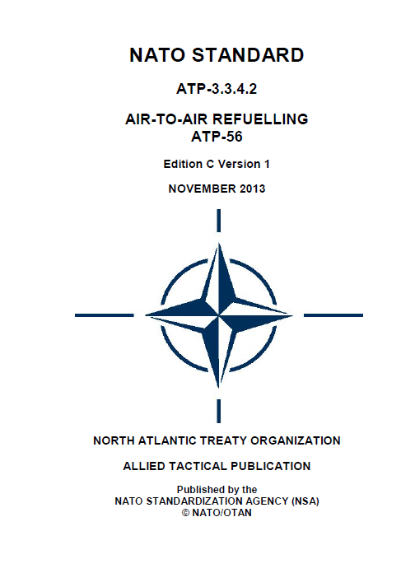
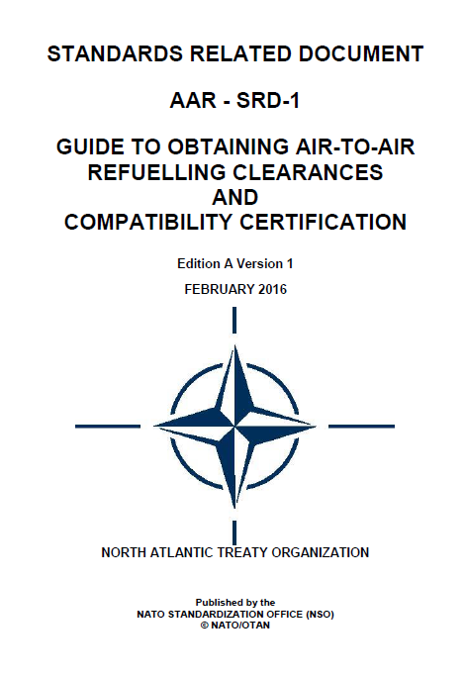
Standard Related Documents
TAs/DTAs shall approve the link of an SRD to one or more Allied standards either:
as part of a ratification or approval process package. SRDs shall be included as related documents within the covering document.
by separate approval, if the SRD is planned to be linked to an already promulgated Allied standard.

Slide 56
Process to Meet Urgent Standardization Requirements (FAST TRACK)
S
!
Expedited process to meet urgent standardization requirements
Identified in the ST/RT and may be proposed in SP
Validated/approved by relevant TA/DTA
Phases/steps same as ‘normal process’, always covered by a STANAG
Allocated time for ratification to be set by TA/DTA and to be kept as short as possible
Promulgation criteria: absence of objection to promulgation at the end of the ratification suspense date
If no objection, NSO promulgates
TA/DTA to define secondary promulgation criteria (= promulgation criteria for ‘normal process’) to be used for the review of the document
First review after 2 years, then enter the normal (5 year) review cycle
Use of fast track visible in the NSDD

Slide 57
Phase 6: Implementation/Use
Phase 7
Requirements Identification
Requirements Validation and Task Development
Standard(s) Development
Ratification / Approval &
Promulgation
Implementation / use of Standard(s)
Phase 1
Phase 2
Phase 3
Phases 4/5
Phase 6
Should be reported by nations and NATO bodies:
- implementation reports for STANAGs
- feedback on use of STANRECs
Addressed in NDPP Step 5
Exercises and Evaluations
Review
E-REPORTING TOOL
!
Also for partners’ adoption

Slide 58
Phase 7: Review
!
Always confirm/update custodial information and report changes
!
Always communicate the result of the review. Even if the document is retained unchanged.
Phase 7
Requirements Identification
Requirements Validation and Task Development
Standard(s) Development
Ratification / Approval &
Promulgation
Implementation / use of Standard(s)
Phase 1
Phase 2
Cancel
Replace by non-NATO standard
Transfer to civil SDO
Incorporate in other stand. doc
Transfer to other TA/DTA/WG
Update. If major RT
Retain unchanged
Phase 3
Phases 4/5
Phase 6
Review
Every 5 years
Anytime with a ModP
!
ModP and RT not mandatory but recommended
!
Cancelled documents remain in the NSDD
!
If new edition, changes shall be indicated in the promulgation letter
S

Slide 59
Update
MODIFICATION | DESCRIPTION | RESULTS
minor | AMENDMENT A minor change that has no significant impact on the use made by the interested parties of a standardization document. The amendment is approved by the appropriate TA/DTA. | New Version An amendment results in a new version of an Allied standard but not of its covering document. Example: ATP-99 Ed. A Ver.1 superseded by ATP-99 Ed. A Ver.2
major | REVISION A major change that has an impact on the use made by the interested parties of a standardization document. The revision is approved by a new ratification/approval process. | New Edition A revision results in a new edition of an Allied standard and of its covering document. Example: ATP-99 Ed. A Ver.1 covered by STANAG 6509 Ed. 2 superseded by ATP-99 Ed. B Ver.1 covered by STANAG 6509 Ed. 3

Slide 60
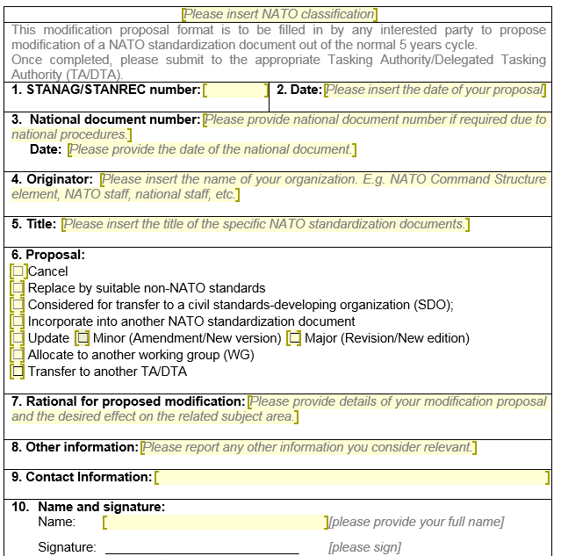
ModP Template

Slide 61
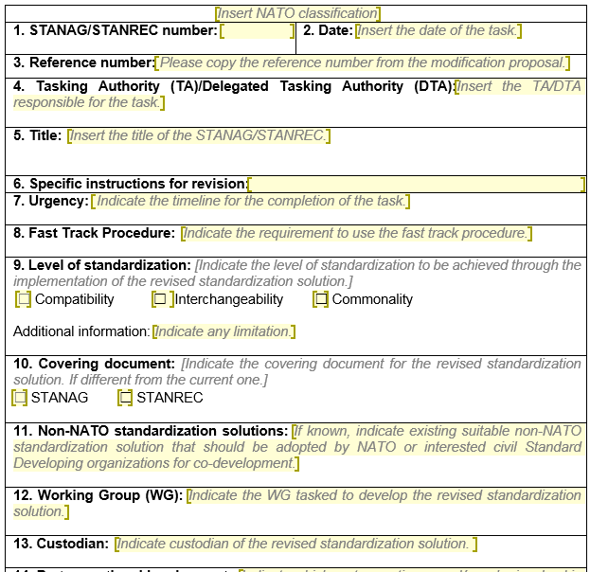
RT Template

Slide 62
Agenda
1.
Introduction
2.
Products
3.
Process
4.
Glossary
5.
Reference Documents

Slide 63
Glossary

Slide 64
Agenda
1.
Introduction
2.
Products
3.
Process
4.
Glossary
5.
Reference Documents

Slide 65
Reference Documents
PO(2016)0315 - NATO Policy for Standardization
MC 20/11 - MC Policy for Military Operational Standardization
AAP – 47, Ed. (C), Ver. (1) – Allied Joint Doctrine Development
AAP – 32, Ed. (B), Ver. (1) – Publishing Standards for NATO Standardization Documents
NATO Standardization Office Website ← TEMPLATES
(http://nso.nato.int)

Slide 66
AAP-03
❑ Procedures mandatory for
TAs/DTAs, WGs, custodians, …
❑ Defines NATO standardization
documents
❑ Describes NATO standardization
process
❑ Addresses roles/responsibilities of
standardization actors
❑ Provides guidance for selection of
cover documents, content of SP
and ST, determination of
promulgation criteria, content of
implementation paragraph
❑ Templates for SP, SP inquiry, ST,
STANAG, STANREC, …

Slide 67
AAP-32
❑ Detailed requirements
concerning structure, format
and layout of NATO
standardization documents:
- general structure of covering
documents
- general structure of Allied publications
- page layout and formatting guidelines
for text, figures and tables

Slide 68
AAP-47
❑ Supplement to AAP-03
❑ Specific procedures for
development of Allied Joint
Doctrine

Slide 69
MC 20/11
❑ Policy for development and
management of NATO
standardization documents
under MC
❑ Describes MC standardization
structure (MC Standardization
Boards)
❑ Addresses roles/
responsibilities (TOR for MC
SBs)

Slide 70
NATO STANDARDIZATION PROCESS
Production and Maintenance
of NATO Standardization Documents

