Slide 1


Implementation of the NATO Standardization Policy -
Ratification and Implementation of Standards
by Greece
Lt Jr Gr Konstantinos CHALKIAS (GRC, N)
Standardization Officer
Defence Planning and Programming Directorate
k.chalkias@hndgs.mil.gr
Warsaw, 19 Sep 2019

Slide 2
Agenda
1
INTRODUCTION
2
RATIFICATION AND IMPLEMENTATION PLAN
3
MANAGEMENT TOOLS
4
EDUCATION AND TRAINING
5
CONCLUSION

Slide 3
Agenda
1
INTRODUCTION
2
RATIFICATION AND IMPLEMENTATION PLAN
3
MANAGEMENT TOOLS
4
EDUCATION AND TRAINING
5
CONCLUSION

Slide 4



Standardization Structure
Direction - Policy
Stakeholders
Implementation
MOD
DEFENCE PLANNING
CAPABILITIES TARGETS
DIRECTORATE
ARMAMENTS
DIRECTORATE
INTEROPERABILITY
STANDARDIZATION
SECTION
00
LIFE CYCLE MANAGMENT
OPERATIONAL
STANDARDIZATION
QUALITY ASSURANCE
ADMINISTRATIVE
STANDARDIZATION
CODIFICATION
Notes:
4

Slide 5
Standardization Structure
MCJSB
MCLSB
MCMSB
MCASB
MCMedSB
NAFAG
NAAG
NNAG
C3B
AVC
LC
PC
Notes:
5

Slide 6
Standardization Directives
National Military Strategy–Defence Planning
  Harmonization of National and NATO Capability Targets
National Defence Council Directive
  Incorporation of NATO Standards to National Standards
Defence Standardization Ministerial Guidance
National Representatives Ministerial Guidance
National Terminology Regulation
Notes:
6

Slide 7

Standardization Directives
ANNEX A
NATO STANDARDIZATION
INCORPORATION OF NATO STANDARDS TO NATIONAL STANDARDIZATION
ANNEX B
PROCEDURES FOR THE DEVELOPMENT OF HELLENIC ARMED FORCES TECHNICAL SPECIFICATIONS
MINISTRY OF DEFENCE
MINISTERIAL GUIDANCE
ON
DEFENCE STANDARDIZATION
GENERAL GUIDELINES
INTERGRATION OF EUROPEAN LEGISLATION
EU Directive 81/2009 National Law 3978/2011
AND NATO PROCESS
AAP-03(K)
Notes:
7

Slide 8
Agenda
1
INTRODUCTION
2
RATIFICATION AND IMPLEMENTATION PLAN
3
MANAGEMENT TOOLS
4
EDUCATION AND TRAINING
5
CONCLUSION

Slide 9


STANAGs Ratification
TA/DTA
Recommends promulgation
TA/DTA
Initiates ratification process
Coordinating
Directorate
Coordinating
Directorate
Identification of
Responsible Directorate
Submits National Response
Responsible
Directorate
Responsible
Directorate
Designates a NR
Defines possible orders of action
Checks the submitted response
National Representative
(NatRep)
Designates and coordinates SMEs
Harmonize actions with possible orders
Creates Action List and Timetable
Produce an Implementation Impact Analysis
Suggests National Ratification Response
Notes:
9

Slide 10
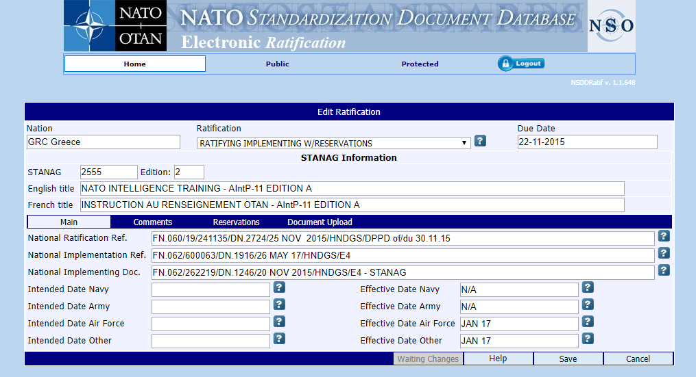
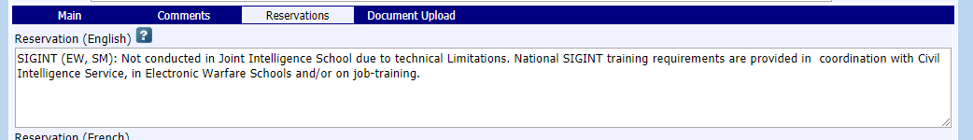
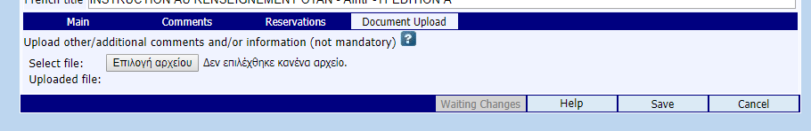
eResponse - Reservations
Notes:
10

Slide 11





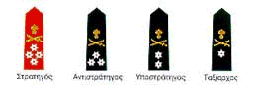

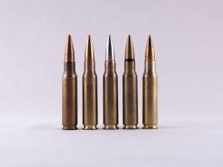

ARMY Standardization Model
NATIONAL
DELEGATION
STAGES OF ASSESSMENT
(directly to NatRep)
HAGS/D2 Coordinating DTE
NatRep
HAGS/DTE-DIV
STAGE 1:
IDENTIFY SUPPORT SINGLE SERVICE/ OTHER SERVICES
HΝGS
HAFGS
ADMINISTRATIVE
OPERATIONAL
MATERIEL
STAGE 2:
IDENTIFY THE FIELD OF STANDARDIZATION
HAGS/DTE
HAGS/DIV
GEN.STAFF COLLEGE/ STUDIES SECT
MILITARY SCHOOLS/ STUDIES SECT
LEGAD
FINANCIAL CORPS DTE

Slide 12


ARMY Standardization Model
OPERATIONAL
MATERIEL
NatRep
HAGS
DTE
STAGE 3:
PROCESSING
EVALUATION
NatRep
LEVEL
MAJ OPER COMMANDS
EVL DTE
LIFE CYCLE
COST MGM
OPS
FINANCIAL
LOG DTE
TACTICAL
BGDES
MAINTENANCE
FIN DTE
TRAINING
SERV SUP DIV
TRAIN & DOCTR DIV
DOCTRINE
TECH DTE
ORD DTE
PHASE1
RATIFICATION
ASSESSMENT
IMPLEMENTATION
ASSESSMENT
PHASE2
STAGE 4:
ASSESSSMENT
NatRep
SINGLE SERVICE REPLY
STAGE 5:
NATIONAL POSITION
NAVY PROPOSAL
ARMY PROPOSAL
AIR FORCE PROPOSAL
COMMON REPLY OF SERVICES
HAGS/D2

Slide 13
Implementation Impact Analysis
Ratification Response Assessment
ANALYSIS STEPS
RATIFICATION RESPONSE
I. Capabilities: Linked with National Capability?
NO
NOT PARTICIPATING
YES
II. Interoperability: Validated Requirements;
NO
YES
NOT RATIFYING
III. Impact Analysis:
-Solutions?
-Impact?
NOΙ
Command/Force Structure
Doctrine
Organization
Training
Technical
Budget
Laws
IPRs
Cost-effectiveness
PARTIAL
YES
RATIFYING/IMPLEMENTING
YES
With RESERVATIONS
IV. Programming: Implementation Forecast;
NO
RATIFYING
FUTURE IMPLEMENTATION
With RESERVATIONS
Notes:
13

Slide 14
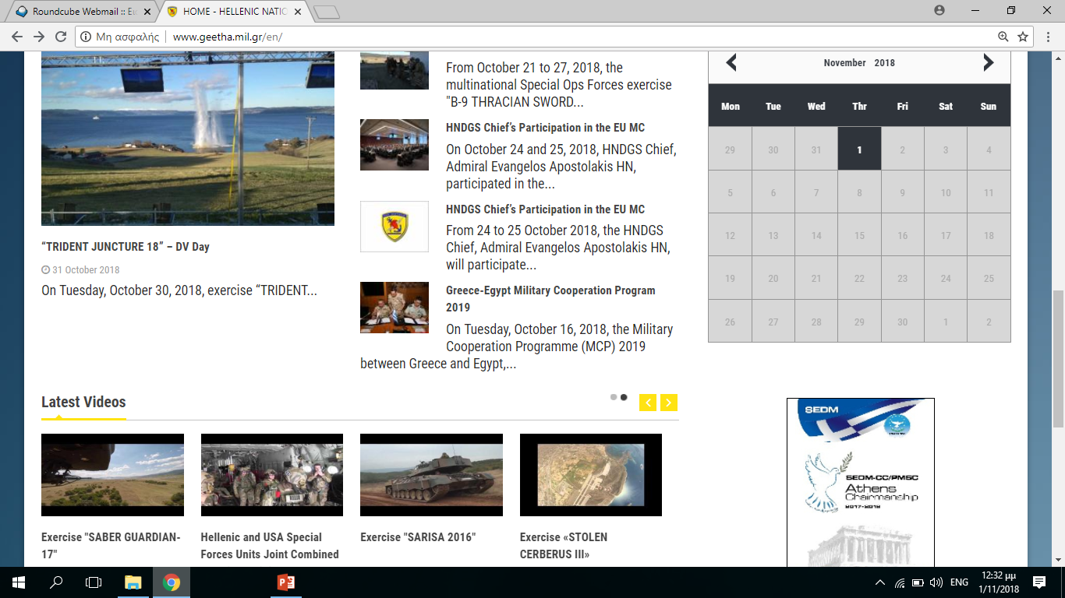
STANAGs Implementation
SAVE OPEVAL
TACEVAL
CREVAL
Trials, Tests
ETEE
STANDARDS
Cooperative Programms
LL

Slide 15
Agenda
1
INTRODUCTION
2
RATIFICATION AND IMPLEMENTATION PLAN
3
MANAGEMENT TOOLS
4
EDUCATION AND TRAINING
5
CONCLUSION

Slide 16
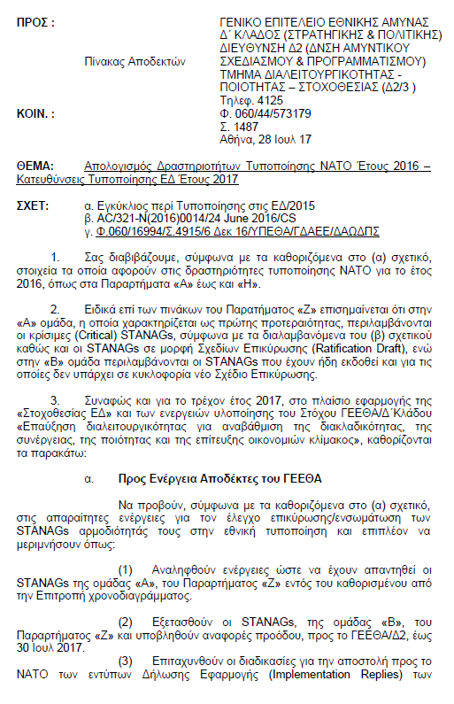
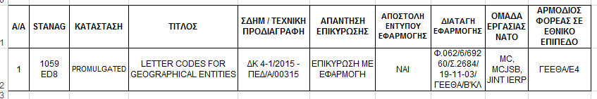
Standardization
Management Tools
Annual Ratification / Implementation Report/CHOD’s guidance
NSDD
Implementation Tracking Tool
Mil-Specs Management System
Notes:
16

Slide 17
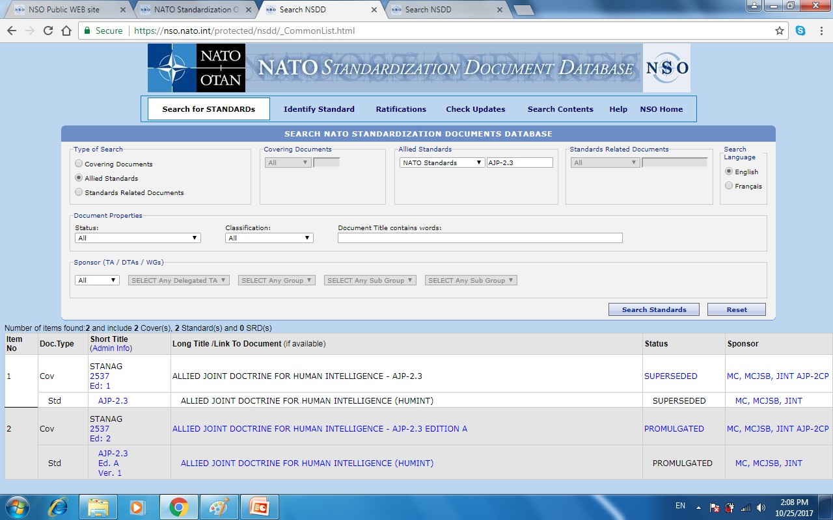
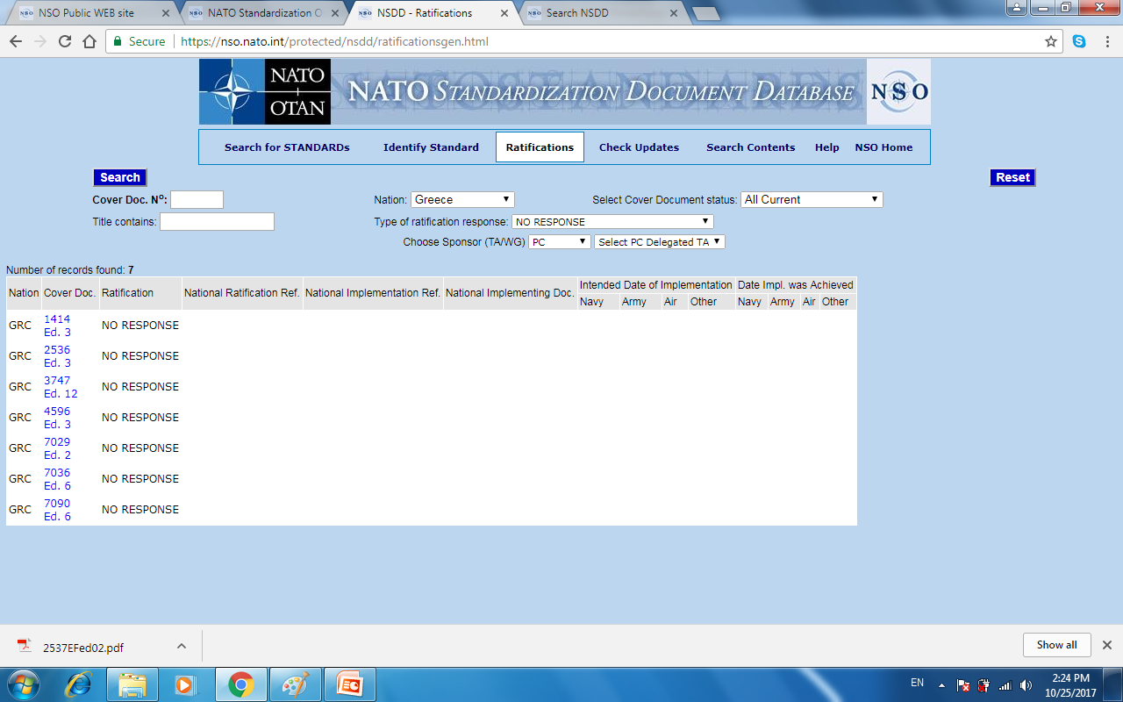
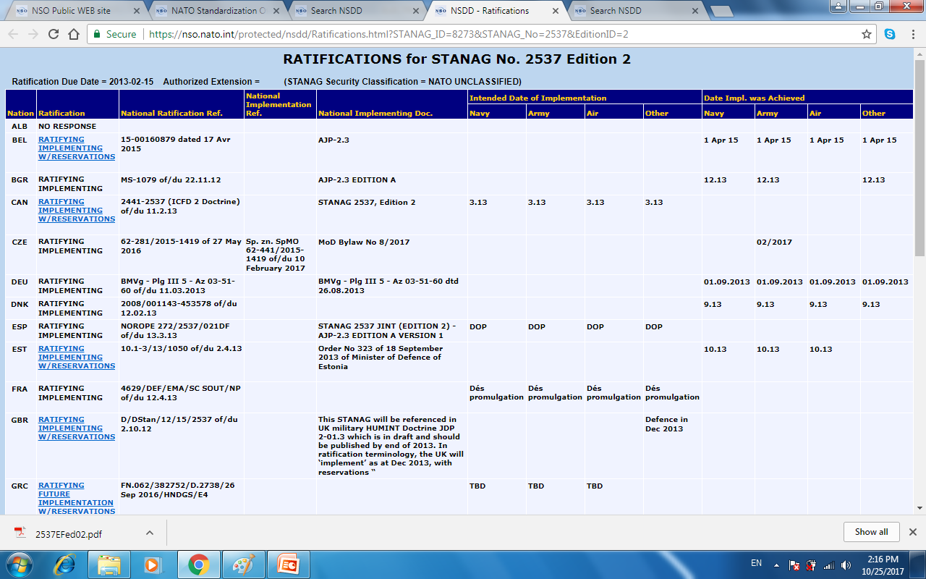
Standardization
Management Tools
NSDD
♦ Access to STANAGs
♦ Ratification / Implementation responses, information and reports
♦ Reservations - Comments
♦ Lists – Reports – SMEs Portfolios
Notes:
17

Slide 18
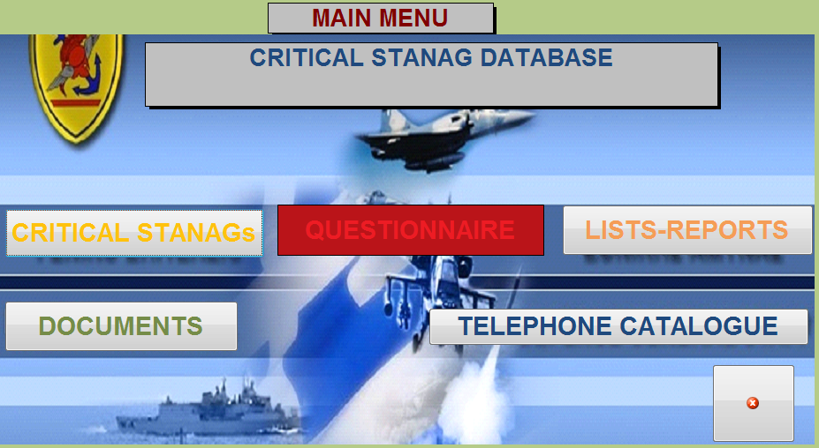
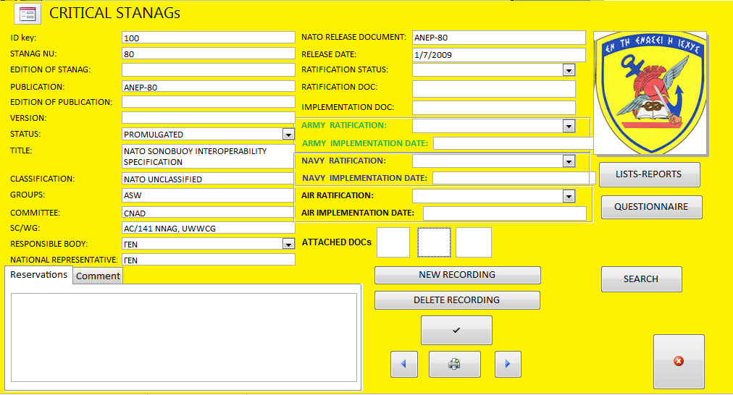
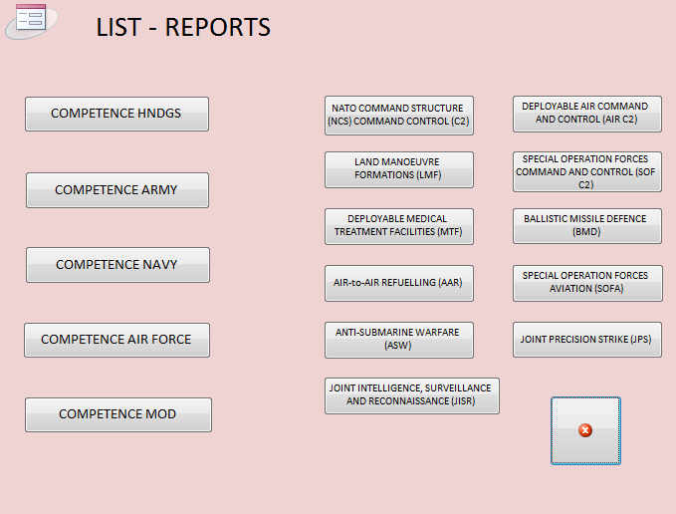
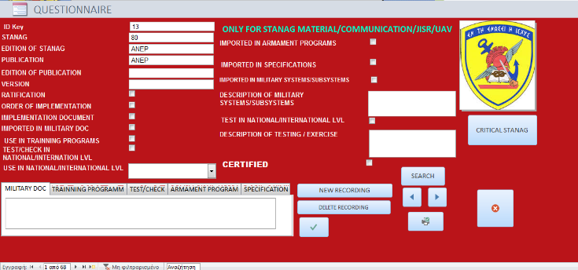
Standardization
Management Tools
NDPP Critical STANAGs Implementation Tracking Tool
Designed by HNDGS
Lists, Files, Ratification and Implementation Reports
Implementation Questionnaire
Notes:
18

Slide 19

Standardization
Management Tools
Implementation Response Assessment
Link with NATO and National CC/S
Notes:
19

Slide 20
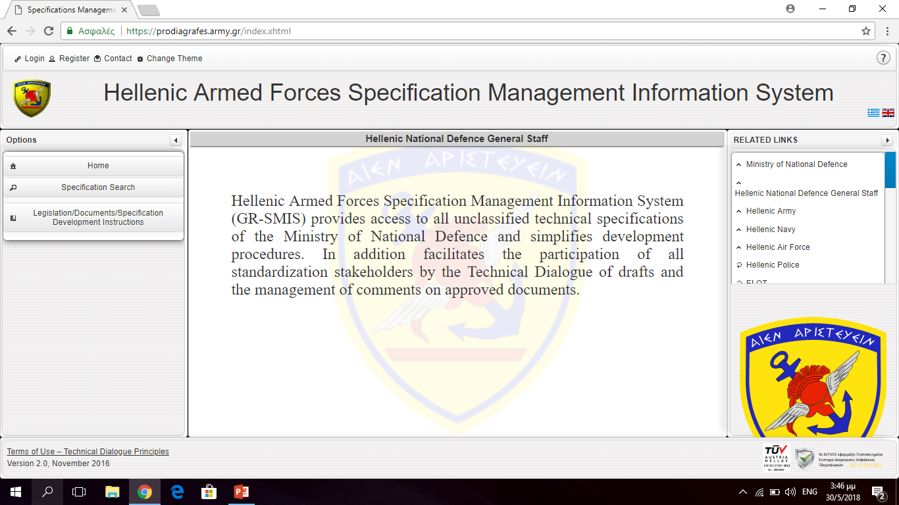
Standardization
Management Tools
Notes:
20

Slide 21
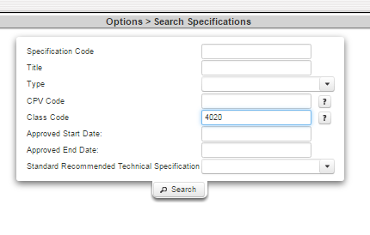
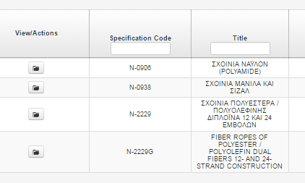
Standardization
Management Tools
Technical Specifications Electronic Management System
information / use of agreed specifications
Technical Dialogue of Draft Specifications
Enhances cooperation among Air Force, Army and Navy, leading to:
  Development of unified Hellenic Armed Forces Specifications
  Increase of productivity / reduction of related cost
Facilitates the implementation of approved STANAGs
Introduces a formal and productive interaction with other involved / interested public sector organizations
Introduces a transparent interaction with interested private sector companies
Improves procurement procedures
Notes:
21

Slide 22
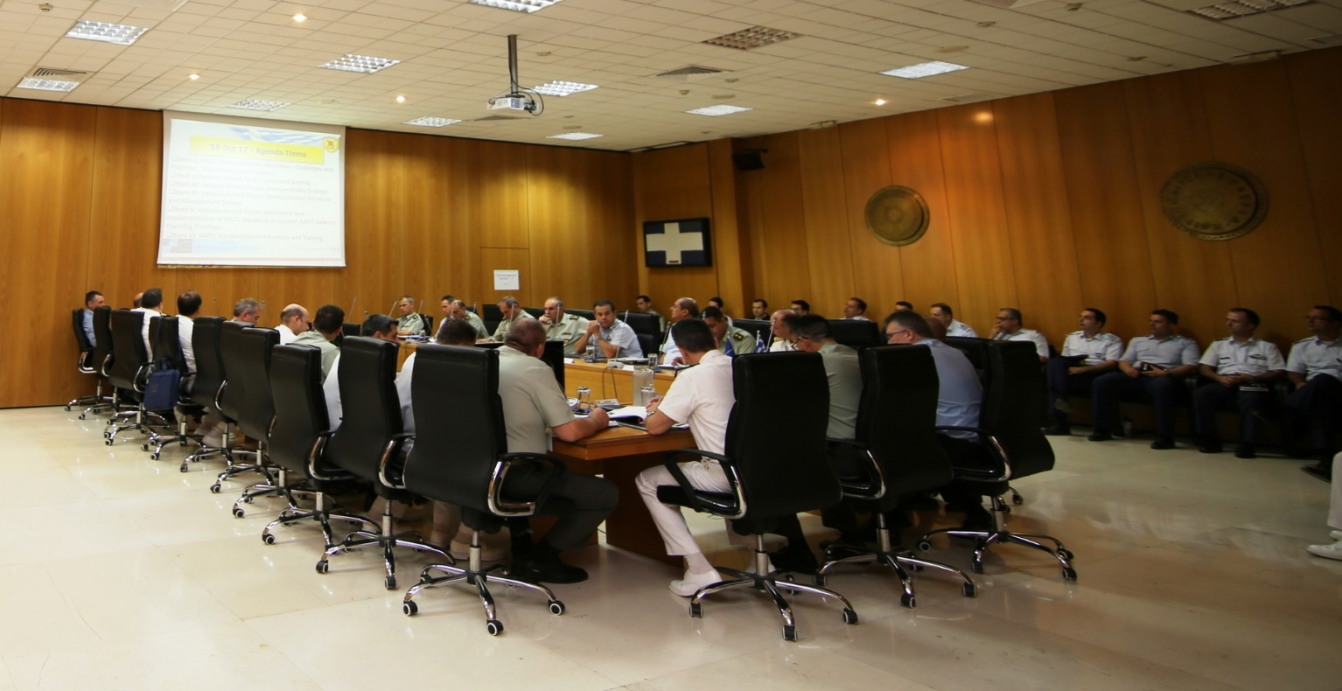
Critical STANAGs
National Joint Standardization Board on Critical STANAGs
HNDGS Led - Participants: MoD Standardization Bodies - SMEs
4 meetings per year
  Assess progress reports
  Provides guidance
  Sets and monitors priorities (e.g Critical STANAGs/DPCS)
Notes:
22

Slide 23
Agenda
1
INTRODUCTION
2
RATIFICATION AND IMPLEMENTATION PLAN
3
MANAGEMENT TOOLS
4
EDUCATION AND TRAINING
5
CONCLUSION

Slide 24
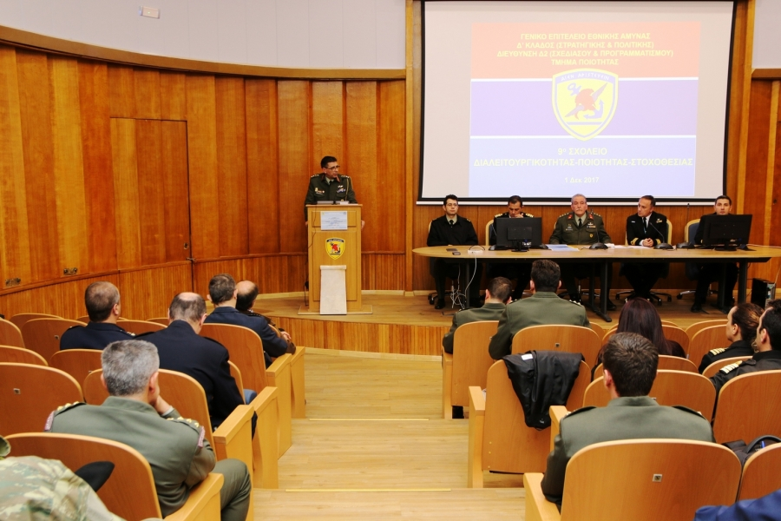
National Training
Annual Standardization Course – 5 days (since 2006)
Semi-annual Standardization SMEs Seminar – One Day
Defence Standardization – Industry Seminar – One Day
On demand training – Mobile Training Teams (i.e National Medical SMEs, Balkan Nations)
On the job training (Standardization coordinators)
Notes:
24

Slide 25
NATO Training
Standardization Within NATO Master Course
MUT, POL (NSO-MUT MoU)
Since 2004, ACT NATO Selected Accreditation 2012
On – Line ADL Tool
DEU-GRC-POL-NSO
NSO Orientation Course
NSO, NATO HQs
MODULE 1
Drafting, Production and Maintenance of NATO Standards
POL-GRC-SMG-NSO
NMIOTC
MODULE 2
NATO Use of Civil Standards
May 2018,
POL-GRC-SMG
Greece
MODULE 3
Top-Down and Bottom Up Standardization Processes
2020-2022 (TBD)
MODULE 4
Terminology
2020-2022 (TBD)
Notes:
25

Slide 26
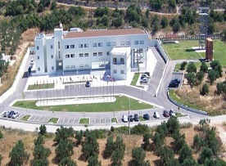
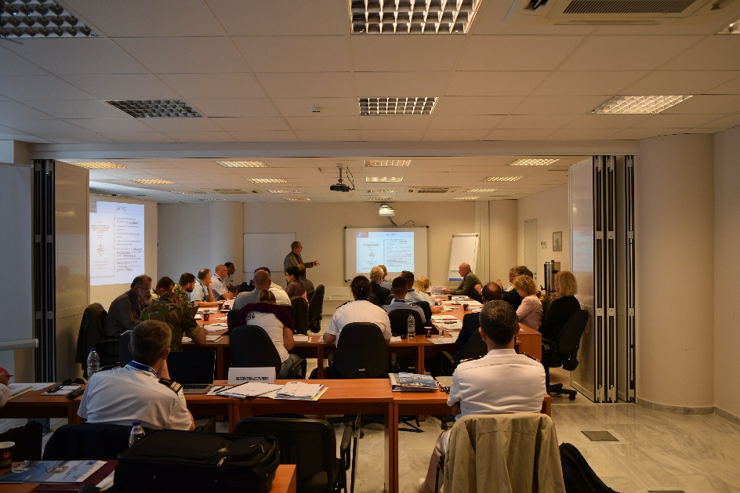




Drafting, Production and
Maintenance of NATO Standards
NMIOTC - CRETE
Drafting, Production and Maintenance of NATO Standards
            Monday to Friday 24 - 28 June 2019 and 30 Sep - 04 October 2019
            Hosted by NMIOTC, ACT Accredited NETF
            Lecturers: ACT, NSO, DEU, GRC, POL, UK, USA
            Total Participation for 2019: 58
            2020: 22-26 June and 05-09 October, Calling Notices will be issued in December and will be uploaded on the NSO and NMIOTC websites

Slide 27
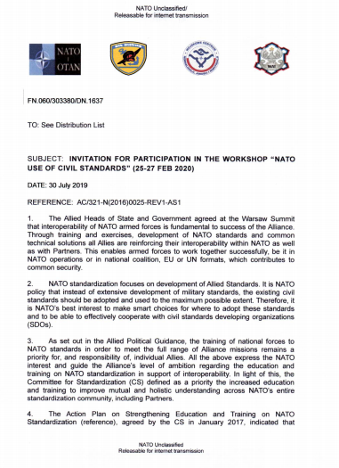

NATO Use of Civil Standards
ARMED FORCES OFFICERS CLUB - ATHENS
NATO Use of Civil Standards Workshop
            Tuesday to Thursday 25-27 February 2020
            Hosted in the Armed Forces Officers Club
            Course was conducted under the auspices of Joint POL-GRC Authorities
            Education Material from AAP-03, Civil Standards SRD and educational activities of SDOs
            Lecturers from NATO Bodies and SDOs
            Course fee: 150 euro

Slide 28
Agenda
1
INTRODUCTION
2
RATIFICATION AND IMPLEMENTATION PLAN
3
MANAGEMENT TOOLS
4
EDUCATION AND TRAINING
5
CONCLUSION

Slide 29
Conclusion
Notes:
29

Slide 30
Conclusion
GRC
171
Notes:
30

Slide 31
Way Ahead 2019
CHALLENGES
Compatibility between Defence Planning and Standardization
DPCS 2019
National Terminology Regulation Review / Update
Custodianship Plan
NO RESPONSE
Confront “No Response”
New Ratification Drafts timelines
ENHANCE EDUCATION
National education programs
Support NATO modules
Organize SMG modules 1 and 2 for 2020

Slide 32
Conclusion
National Standardization Policy and Strategy
    Harmonization of defence planning priorities
    Synchronization between NATO and National capabilities development process
    Adoption of the best practice model in standardization governance
    Standardization Management tools in place
    Standards Implementation Tracking Mechanisms /Tools in place
    Conformity Assessment Mechanisms – Tools in place
    Education and Training Programmes
    Collaboration with National SDO
Level of Ambition
Notes:
32

Slide 33


















Conclusion
NATIONAL
INDUSTRY
ARMED
FORCES
INTERNATIONAL
DOMAIN
EUROPEAN
DOMAIN
DEFENCE
MINISTRIES
PUBLIC SECTOR –SERVICES
ACADEMIA
NATIONAL QUALITY ORGANIZATIONS
INTERNATIONAL
INDUSTRY
SECURITY
FORCES
Notes:
33

Slide 34







Conclusion

