Slide 1
INTEROPERABILITY AND STANDARDIZATION
Roles & Responsibilities of
Working Group Chairpersons and Secretaries
Dieter Schmaglowski
Deputy Director NSO
Warsaw, 18 Sep 2019

Slide 2
Agenda
Important references
Appointment of Chairpersons and Secretaries
Summary of important Chairperson/Secretary functions
Guidance and advice for WG/Panel Chairpersons
Guidance and advice for WG/Panel Secretaries

Slide 3
Important References
AAP-03 – Directive for the Production, Maintenance and Management of NATO Standardization Documents (also available en français)
NSOP-VOL II - NATO Standardization Office Procedures – Volume II, Guidance and Instructions for Operational Standardization
MC 0020/11 - MC Policy for Military Operational Standardization
NS0 Protected Web Site http://nso.nato.int

Slide 4
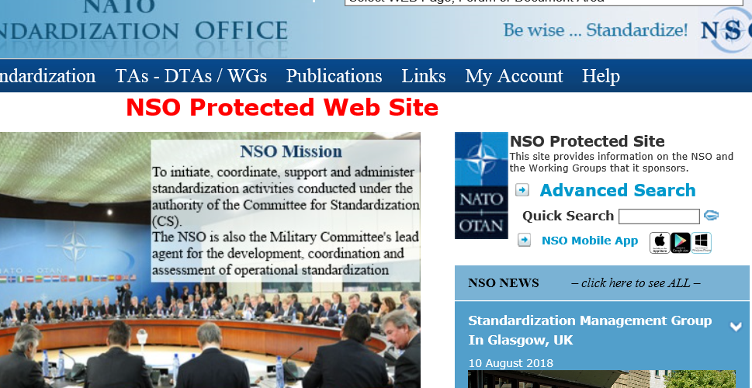
Important Standardization Documents
NATO POLICY FOR INTEROPERABILITY, C-M(2009)0145
NATO POLICY FOR STANDARDIZATION, PO(2016)0315
MC 20/11: MILITARY COMMITTEE POLICY FOR MILITARY OPERATIONAL STANDARDIZATION
AAP-03: PRODUCTION, MAINTENANCE AND MANAGEMENT OF NATO STANDARDIZATION DOCUMENTS
AAP-32: PUBLISHING STANDARDS FOR NATO STANDARDIZATION DOCUMENTS
AAP-47: ALLIED JOINT DOCTRINE DEVELOPMENT
Update

Slide 5
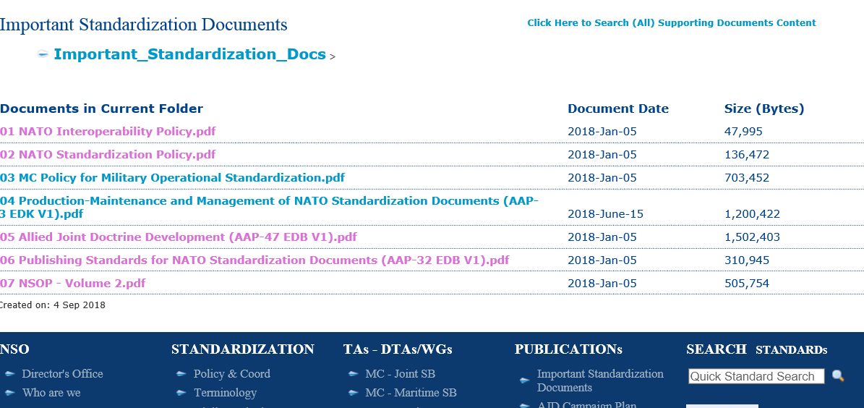
Important Standardization Documents
NATO POLICY FOR INTEROPERABILITY, C-M(2009)0145
NATO POLICY FOR STANDARDIZATION, PO(2016)0315
MC 20/11: MILITARY COMMITTEE POLICY FOR MILITARY OPERATIONAL STANDARDIZATION
AAP-03: PRODUCTION, MAINTENANCE AND MANAGEMENT OF NATO STANDARDIZATION DOCUMENTS
AAP-32: PUBLISHING STANDARDS FOR NATO STANDARDIZATION DOCUMENTS
AAP-47: ALLIED JOINT DOCTRINE DEVELOPMENT

Slide 6
Appointment of a Chairpersons and Secretaries
Chairman:
WGs nominate chair
Approval normally by DTA (for MC the MC Standardization Boards)
Process to select a Panel chair may be included in WG Terms of Reference (TOR)
Secretary:
For MC WGs: NSO assigns staff officer as secretary
For WGs under other TAs: IS/IMS/NHQ C3S might provide secretary
If not provided by supporting staff: nomination and approval by WG/Panel (in general provided by chair nation)

Slide 7
The Chairpersons’ Role
You represent the chairperson of the MCSB (for WGs under the MCSBs) at lower level
Facilitator for the WG
Guardian of the process
Mediator
Achiever of acceptance of WG products

Slide 8
Initial Actions for a new WG/Panel chairperson (1)
Observe the conduct of a WG/Panel meeting before assuming the Chair
Initial/early actions:
establish contact with the WG/Panel Secretary
obtain a hand-over brief from previous Chairman
contact host nation Point of Contact
Complete the following recommended reading:
NSOP Vol II, in particular chapters 3, 4, 5, 6, 7, 9,
MC Policy for Military Operational standardization
AAP-03, latest edition

Slide 9
Initial Actions for a new WG/Panel chairperson (2)
Additional recommended reading in preparation for your first WG/Panel meeting:
WG/Panel documents (ToRs, reports, actions lists)
DTA Records of Decisions from the previous 12 months
latest MCJSB General Guidance to MCSB Working Groups (for MC WGs)

Slide 10
Pre-meeting Actions
Calling Notice (about 6 months prior to the meeting)
Development of WG Agenda and Convening Order (about 3 months prior to the meeting)
Consider Introductory Letter to the WG/Panel

Slide 11
Considerations for the Conduct of a Meeting (1)
Early Arrival at the Meeting Site
Chairing of the Meeting:
consider the multinational composition of the WG/Panel
be diplomatic, yet firm in directing discussions
avoid direct confrontation if possible
do not express national positions
ensure that all delegates are given the opportunity to engage
strive to achieve agreement when producing recommendations
try to conclude the discussion of every agenda item with a short summary
ensure that minutes are taken (usually by the secretary)

Slide 12
Considerations for the Conduct of a Meeting (2)
Social event
Syndicate sessions
Participation of Partners
TA/DTA representation
Chairman’s report and working group input to it

Slide 13
Considerations for the Conduct of a Meeting (4)
Typical Meeting sequence (1):
Introductions (1) open the meeting and give a chairman’s introduction (2) introduce TA/DTA Representative, who will provide TA/DTA guidance (3) introduce WG Secretary, who will provide administrative instructions (4) review objectives for the meeting (5) invite each Head of Delegation (HOD) to introduce their delegations
Selection of a drafting team (if required)
Comments on the agenda, additional items to be addressed under Any Other Business (AOB)
Liaison Reports
Presentations to the plenary
Split into Syndicates, Panels or Teams (if required)

Slide 14
Considerations for the Conduct of a Meeting (5)
Typical Meeting sequence (2):
g. If necessary, return to plenary sessions at times throughout the week
h. Final plenary session, normally held on the final day to cover (1) reports from subordinate elements (2) Any Other Business (3) review of the WG TOR (4) arrangements and dates for the next meeting (5) tentative agenda for next meeting (6) review of recommendations for inclusion in the chairman’s report (7) closing remarks

Slide 15
Post and Interim Meeting Actions
WG Chairman's Report
provide guidance to Secretary
review draft of the report before it is posted on the WG forum for comments
ensure that all key points are reflected in the executive summary
provide guidance to Secretary for development of the Action List
review Action List before submission to TA/DTA for approval (for MC WGs)
Maintain contact with Secretary
Review Action List periodically and engage with WG (for MC WGs through the forum) to ensure actions are progressed in accordance with due dates

Slide 16
WG/Panel Secretary
Guidance
and Advice for WG/Panel Secretaries

Slide 17
Secretary’s Responsibilities
Meeting preparation
Maintenance of WG Action List
Execution of tasks assigned to the secretary in the WG Action List
Management of the approval and ratification process for standardization document development
Liaison between DTA (for MC WGs: MCSB), NSO, WG and custodians
Advisor regarding development and maintenance of standards (if secretary is provided by NSO)

Slide 18
Secretary’s Pre-meeting Actions
Detailed Checklist designed to assist Secretaries with preparation and execution of WG meeting in NSOP-VOL II, Chapter 7, important actions include:
Development of WG agenda and convening order
Confirm reservation of conference facilities (about 3 months prior to the meeting)
Submit request for IT equipment, if required
Review TOR, if required
Prepare skeleton report and meeting notes
Review liaison reports, custodian reports, presentations and statements received from WG delegates
Prepare draft outline of WG Chairman’s Report
Prepare required administrative documents

Slide 19
Secretary’s Post-meeting Actions
Complete and issue WG Chairman’s Report
Prepare the Action List
Update the WG forum
Prepare an official letter to thank the host, if applicable
Update the Terms of Reference

Slide 20
Secretary’s Tasks Between Meetings
Monitor progress of all actions related to last meeting’s Action List
Communicate with Chairman and WG members to ensure that tasks are completed on time
Monitor posts on the WG forum and engage if required
Ensure that standardization development and maintenance follows established procedures as addressed in AAP-03

Slide 21
Summary
Summary of important Chairperson/Secretary functions

Slide 22
Summary
The Chairperson
Responsible to ensure:
meetings agenda is followed and outstanding actions are addressed
delegates’ opinions are fairly expressed and recorded
flow of the meeting is productive
meeting advances NATO standardization while following the TA/DTA guidance
Generally Non-voting member
Impartial and neutral
Specific recommendations to assist Chairmen are addressed in NSOP-Vol II, Chapter 5

Slide 23
Summary
The Secretary
Responsible for:
preparing the meeting
supporting the chairman during the meeting
note taking during the meeting in order to prepare the Chairman’s Report and Action List
advising on procedures and timelines for the development and maintenance of standards (if provided by NSO)
Executes designated actions assigned by WG/Panel
Specific recommendations to assist Secretaries are addressed in NSOP-Vol II, Chapter 7

Slide 24
Time for your questions…

