Slide 1
INTEROPERABILITY AND STANDARDIZATION
NSO Support to
Standards Development and Maintenance
Dieter Schmaglowski
Deputy Director NSO
Warsaw, 17 Sep 2019

Slide 2
Agenda
1.
NATO Standards Development Process
2.
NSO Support Functions
3.
NSO Support to Standards Development under the MC
4.
NSO Support to Senior Committees other than the MC
5.
Summary of NSO Functions

Slide 3
Topic
1.
NATO Standards Development Process

Slide 4
Standardization Document Development Process
Requirements Identification
Requirements Validation and Task Development
Standard(s) Development
Ratification / Approval & Promulgation
Use of Standard(s)
Review

Slide 5
Standard Development Process
IAW AAP-03(K)
DP
DP
DP
Standardization Proposal
Or Top-down directive
Validation
&
Draft ST Development
Development
Ratification
ST
Requirement(s)
ST
Promulgation
SP
Final Draft
Implementation
Standardization Task

Slide 6
Topic
2.
NSO Support Functions

Slide 7
NSO Mission
The NSO:
supports the Military Committee Standardization Boards
initiates, coordinates, supports or administers all those NATO standardization activities that are conducted under the authority of the Committee for Standardization
provides standardization management support and standardization advice for the standardization community

Slide 8
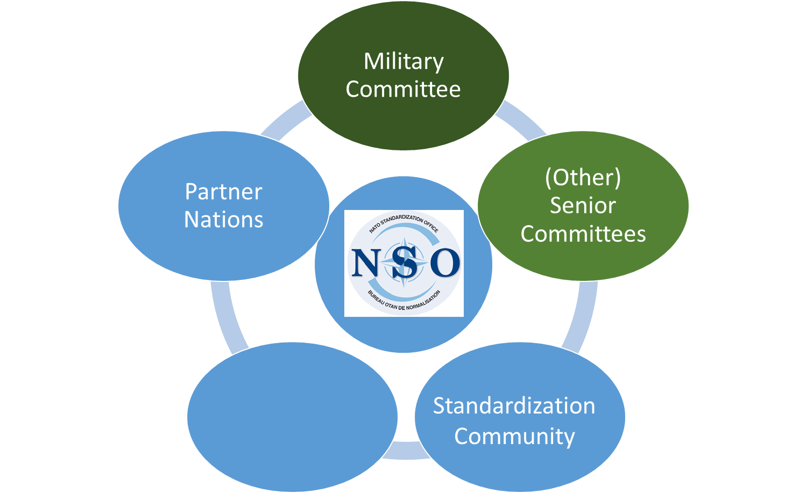
NSO Support Functions
NATO Defence
Planning Process

Slide 9
NATO
Standardization Tasking Authorities
NAC
Support & Advice
Advice
MC
CNAD
LC
CS
C3B
AVC
PC
NSO
AAP-6 (NATOTerm)

Slide 10
Topic
3.
NSO Support to Standards Development under the MC

Slide 11
MC Standardization Elements - Roles & Responsibilities -
Oversee
Give broad guidance
Approve priorities
Military Committee
Standardization
Boards
Nations propose priorities
Nations approve documents
Nations consult with ACO and ACT
NSO
support
Working Groups
Coordinate document development
Teams / Panels
National experts drafting NATO documents
Develop national and NATO expertise
Guidance
Report

Slide 12
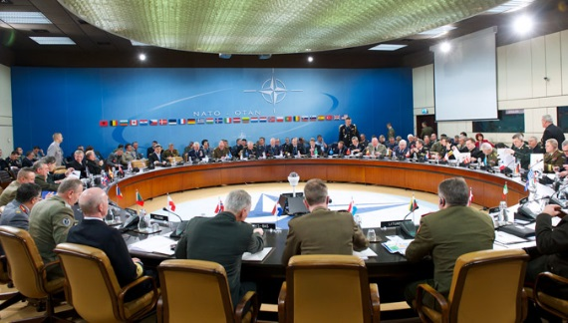
NSO Support to MC Standardization
DNSO principal advisor to MC on (operational) standardization
NSO Branch Heads chair MC Standardization Boards (MCSBs: Joint, Land, Air, Maritime, Medical) as Delegate Tasking Authorities (DTAs) for operational standardization
NSO provides
secretarial and administrative support to all MCSBs and Working Groups
standardization advice to all other standards-developing bodies under the MC (panels, writing teams, custodians)
staffing support during all steps of document development
NSO manages approval process for all standardization documents

Slide 13
NATO Standardization Office Structure and Manning
Director
NSO
Front Office
(MA/PA/DDNSO)
Standardization Support Branch
Policy & Coord.
Branch
Joint
Branch
Army
Branch
Naval
Branch
Air
Branch
Supporting CS +
Policy
Support to NDPP
Cooperation w/ SDOs
Support to Partners
Terminology
LL
Supporting
MCJSB
MCMEDSB
LCEG(S) & Sub WGs / Panels
Supporting
MCLSB &
Sub WGs / Panels
Supporting
MCMSB &
Sub WGs / Panels
Supporting
MCASB & Sub WGs/ Panels
20 SOs dedicated to manage/support standardization under MC

Slide 14
NSO Support to STANAG Development / Maintenance under the MC
Approval of Ratification: nations to approve for entering ratification, to confirm promulgation criteria and allocated time for ratification (silent procedure/MCSB meeting)
ST approval:
Nations to approve ST via Silent Procedure or at MCSB meeting
Approval for promulgation: Nations to approve under silence/ MCSB meeting
SP analysis /assessment:
Nations/SCs to analyze and respond to SP inquiry
Development:
WG/Custodian (Nations/SCs) to develop FD and RD (draft standard and cover); submit to NSO
Ratification:
Nations to assess and respond
Validation
& ST
Development
Development
Ratification
3w
4w
2 w
2d
2w
2w
1w
2w
2w
1w
SP
SP finalization, SI preparation and distribution: NSO to check format/ content, advice, liaise and submit to SCs/Nations
ST distribution
Ratification responses assessment / preparation of request for promulgation
Compliance check of FD and RD with guidance in ST and AAP-03; development of recommendation to TA/DTA
Draft ST preparation:
NSO to analyze nations/SCs responses, to develop draft ST ICW SP originators for MCSB approval
Promulgation
Request for ratification
Legend
_____NSO to liaise, advice, support
_____Nations/SCs to contribute

Slide 15
Topic
4.
NSO Support to Senior Committees other than the MC

Slide 16
NATO
Standardization Tasking Authorities
NAC
Support & Advice
Advice
MC
CNAD
LC
CS
C3B
AVC
PC
NSO
AAP-6 (NATOTerm)

Slide 17
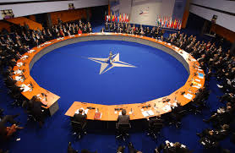
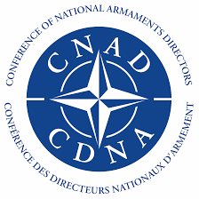
Support to other Senior Committees
The NSO as service provider for NATO’s standardization community …
assists the Committee for Standardization (CS) with
secretarial and administrative support
its contribution to the harmonization and coordination of all NATO standardization activities
assists the LC, CNAD, C3B, AMDC and AVC with the
provision of standardization advisors for standard-developing bodies, where appropriate
facilitation of the approval process for standards

Slide 18
NSO Support to STANAG Development / Maintenance to TAs other than the MC
Approval of Ratification: nations to approve for entering ratification, to confirm promulgation criteria and allocated time for ratification (silent procedure/MCSB meeting)
Approval for promulgation: Nations to approve under silence/ MCSB meeting
Ratification:
Nations to assess and respond
Validation
& ST
Development
Ratification
3w
4w
2 w
2d
Development
2w
2w
2w
1w
SP
Ratification responses assessment iccw TA/DTA staff/ preparation of request for promulgation
Request for ratification
Promulgation
NSO support starts here
Legend
_____NSO to liaise, advice, support
_____Nations/SCs to contribute

Slide 19
Agenda
5.
Summary of NSO Functions

Slide 20
NSO Functions - Summary -
Military
Committee
Committee for Standardization
Deputy
CMC is
Co-Chair
International
Military Staff
Board
Board
Board
Board
Board
Board
Armaments
C3 Board
ACO
ACT
Group
Group
Group
Group
Group
Group
Group
National Standardization SMEs
(Allies and Partners)
Logistics
Aviation
Aviation
International Staff

Slide 21
Time for your questions…

