Slide 1
NATO Terminology Programme Introduction
Warsaw, 18 September 2019
Dieter Schmaglowski
Deputy Director NSO

Slide 2
Agenda
Background
NATO Terminology Programme
Tools

Slide 3
Agenda
Background
NATO Terminology Programme
Tools

Slide 4
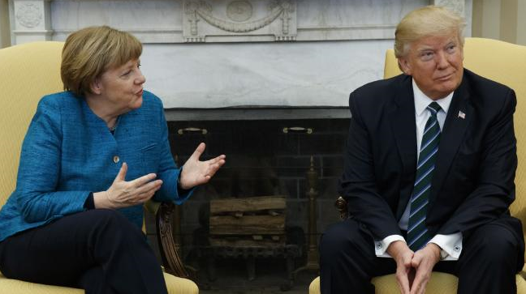
Why standardize terminology?
In an organization like NATO, different understandings
of terms may lead to inefficiency, misunderstanding, disagreement, or worse…

Slide 5
interoperability

Slide 6
Soon after NATO was established in 1949 expert groups start to develop their own terminology...
Z
Air and Missile Defence
Command & Control
Crisis
Response
Operations
Logistics
Intelligence
Training
X
Chemical Warfare
Host Nation Support
Anti Submarine Warfare
Engineers
Standardization
Civil Emergency Planning
Medicine
Combat Service Support
Fire Support
Special Ops
Y

Slide 7
Start of NATO’s efforts to standardize its terminology:
2000: North Atlantic Council approved C-M(2000)54 NATO Policy for Standardization: “NATO documents must use NATO agreed terminology.”
Current documents governing the NATO Terminology Programme:
2015: PO(2015)0193 NATO Terminology Directive – responsibilities and procedures.
2018: AAP-77 NATO Terminology Manual – how to select terms, write definitions, etc.

Slide 8
NATO Terminology Programme
Z
Air and Missile Defence
Command & Control
Crisis
Response
Operations
Logistics
Intelligence
Training
X
Chemical Warfare
Host Nation Support
Anti Submarine Warfare
Engineers
Standardization
Civil Emergency Planning
Medicine
Combat Service Support
Fire Support
Special Ops
Y

Slide 9
……so
NATO standardizes
its terminology!

Slide 10
What does this mean?

Slide 11
The same terms and definitions
in all NATO documents.

Slide 12
How?

Slide 13
Agenda
Background
NATO Terminology Programme
Tools

Slide 14
Terminology Process
in 4 steps

Slide 15
...but first a general point:
You can choose to accept the terminology from the reference dictionaries.
If you do, there is no need to submit proposals for the terminology in your document.

Slide 16
Reference dictionaries
If the terminology from the COED and Le Petit Robert is acceptable, there is no need to submit a terminology proposal!

Slide 17
Terminology process
I. Preparation and Submission
Write your document, using NATO Agreed terminology.
Check the rest of the terminology in your document against the NATO Agreed terminology in NATOTerm: are there terms/definitions to be added, modified or cancelled? On the basis of this, prepare proposals for addition, modification, cancellation or revalidation.
Prepare proposals in accordance with the NATO Terminology Manual.
Submit to NTO at terminology@nso.nato.int
II. Quality Assurance
NTO checks your proposal and may propose changes.
III. Approval
When you are happy with the substance and NTO is happy with the form, NTO will submit your terminology proposal to approving committee and request approval.
If approved by consensus, the terminology becomes ‘NATO Agreed’ terminology (compulsory throughout NATO).
IV. Promulgation
NTO updates NATOTerm – this constitutes the promulgation.
NATO Agreed terminology is the terminology to use in NATO.

Slide 18
Terminology process
I. Preparation and Submission
Write your document, using NATO Agreed terminology.
Check the rest of the terminology in your document against the NATO Agreed terminology in NATOTerm: are there terms/definitions to be added, modified or cancelled? On the basis of this, prepare proposals for addition, modification, cancellation or revalidation.
Prepare proposals in accordance with the NATO Terminology Manual.
Submit to NTO at terminology@nso.nato.int
II. Quality Assurance
NTO checks your proposal and may propose changes.
III. Approval
When you are happy with the substance and NTO is happy with the form, NTO will submit your terminology proposal to approving committee and request approval.
If approved by consensus, the terminology becomes ‘NATO Agreed’ terminology (compulsory throughout NATO).
IV. Promulgation
NTO updates NATOTerm – this constitutes the promulgation.
NATO Agreed terminology is the terminology to use in NATO.

Slide 19
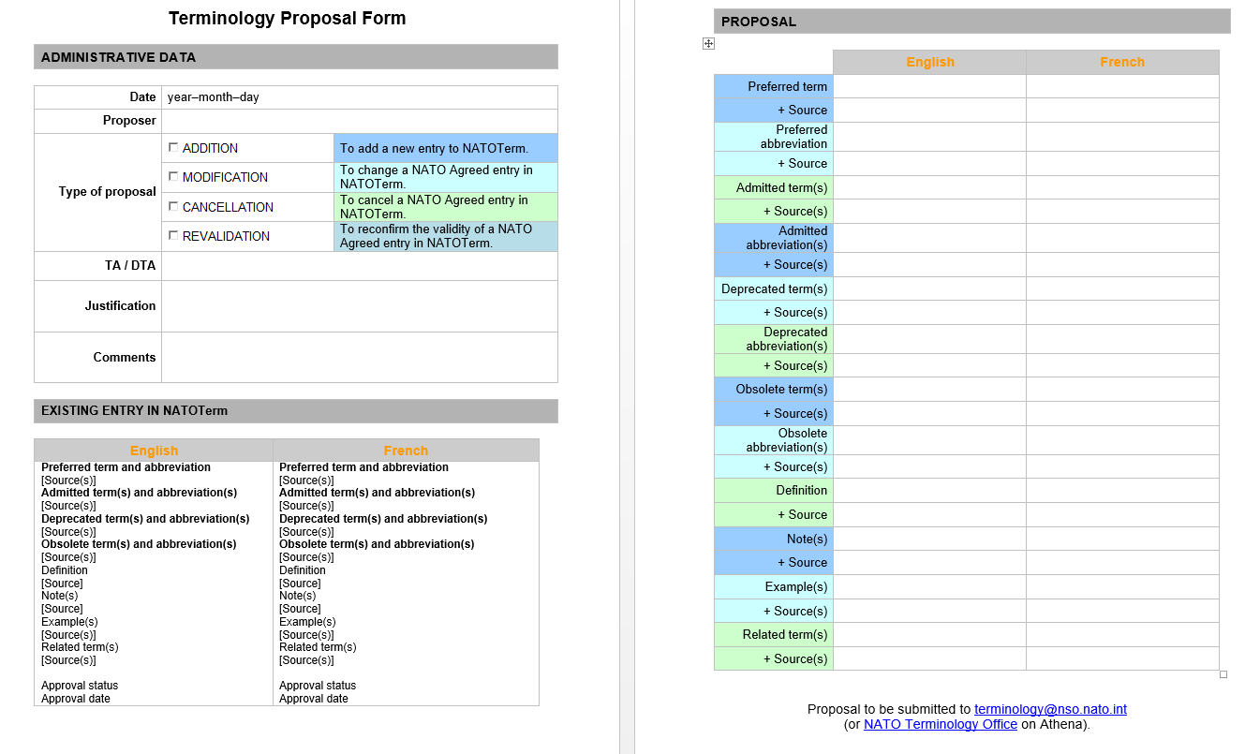
Terminology proposal form
Template

Slide 20
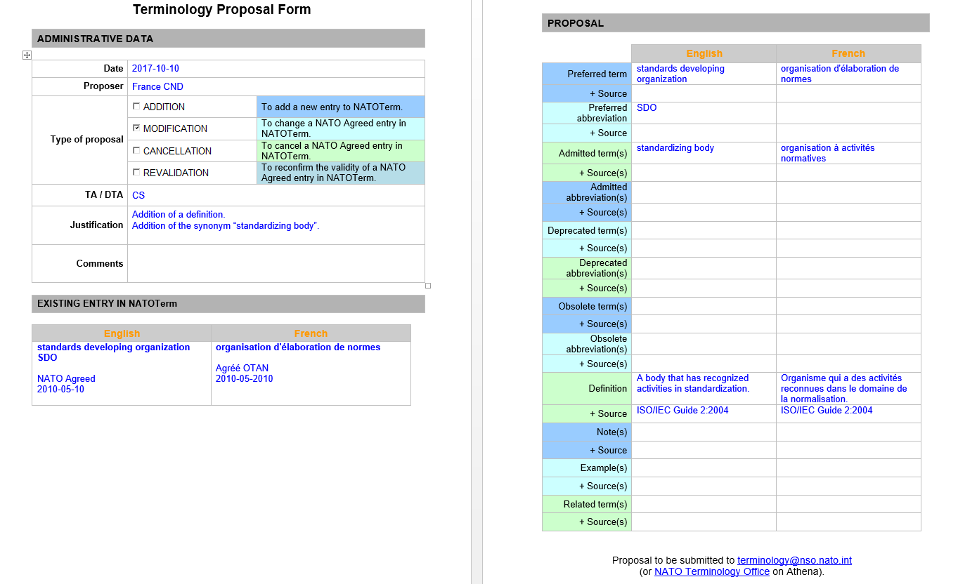
Terminology proposal form
Example

Slide 21
Separate approval of document and terminology
Study drafts
Final
draft
Ratification
Promulgation
Development
of a document
TERMINOLOGY PROCESS
Terminology is approved by consensus!
TERMINOLOGY APPROVAL
Part of a new EDITION/ VERSION (if term is explained in the standard, i.e. in a lexicon or footnote)
TERMINOLOGY APPROVAL
Part of the promulgated EDITION

Slide 22
Terminology process
I. Preparation and Submission
Write your document, using NATO Agreed terminology.
Check the rest of the terminology in your document against the NATO Agreed terminology in NATOTerm: are there terms/definitions to be added, modified or cancelled? On the basis of this, prepare proposals for addition, modification, cancellation or revalidation.
Prepare proposals in accordance with the NATO Terminology Manual.
Submit to NTO at terminology@nso.nato.int
II. Quality Assurance
NTO checks your proposal and may propose changes.
III. Approval
When you are happy with the substance and NTO is happy with the form, NTO will submit your terminology proposal to approving committee and request approval.
If approved by consensus, the terminology becomes ‘NATO Agreed’ terminology (compulsory throughout NATO).
IV. Promulgation
NTO updates NATOTerm – this constitutes the promulgation.
NATO Agreed terminology is the terminology to use in NATO.

Slide 23
Quality assurance
- MAIN POINTS
Terms and abbreviations listed correctly
Consistency with existing NATO Agreed terminology (e.g. use of NATO Agreed terms within definitions)
One-sentence definitions - no Russian-style ‘encyclopaedic’ definitions
No abbreviations in definitions
Nouns defined as nouns, verbs as verbs, etc.
Alignment of definitions, if necessary: EN and FR to say the same thing
No attempts to duplicate (using another term) terminology for a concept that is already in NATOTerm
If terminology is shared between different SME groups:
Coordination with other groups

Slide 24
Quality assurance
- WHY?
1. To make sure that the terminology developed by subject-matter experts is understood by non-experts.
2. To make sure that all NATO Agreed terminology is internally coherent (NATO Agreed terms to be used within definitions of other concepts; definitions not to contradict each other; etc.).
3. The NTO’s quality assurance is impartial and can help find the devils in the details (ambiguities; difference in meaning caused by commas; issues with restrictive and non-restrictive clauses, etc.).

Slide 25
Terminology process
I. Preparation and Submission
Write your document, using NATO Agreed terminology.
Check the rest of the terminology in your document against the NATO Agreed terminology in NATOTerm: are there terms/definitions to be added, modified or cancelled? On the basis of this, prepare proposals for addition, modification, cancellation or revalidation.
Prepare proposals in accordance with the NATO Terminology Manual.
Submit to NTO at terminology@nso.nato.int
II. Quality Assurance
NTO checks your proposal and may propose changes.
III. Approval
When you are happy with the substance and NTO is happy with the form, NTO will submit your terminology proposal to approving committee and request approval.
If approved by consensus, the terminology becomes ‘NATO Agreed’ terminology (compulsory throughout NATO).
IV. Promulgation
NTO updates NATOTerm – this constitutes the promulgation.
NATO Agreed terminology is the terminology to use in NATO.

Slide 26
Terminology
is now
‘NATO Agreed’

Slide 27
Terminology process
I. Preparation and Submission
Write your document, using NATO Agreed terminology.
Check the rest of the terminology in your document against the NATO Agreed terminology in NATOTerm: are there terms/definitions to be added, modified or cancelled? On the basis of this, prepare proposals for addition, modification, cancellation or revalidation.
Prepare proposals in accordance with the NATO Terminology Manual.
Submit to NTO at terminology@nso.nato.int
II. Quality Assurance
NTO checks your proposal and may propose changes.
III. Approval
When you are happy with the substance and NTO is happy with the form, NTO will submit your terminology proposal to approving committee and request approval.
If approved by consensus, the terminology becomes ‘NATO Agreed’ terminology (compulsory throughout NATO).
IV. Promulgation
NTO updates NATOTerm – this constitutes the promulgation.
NATO Agreed terminology is the terminology to use in NATO.

Slide 28
NATOTerm - TermOTAN

Slide 29
Agenda
Background
NATO Terminology Programme
Tools

Slide 30
NATO Agreed
terminology
NATOTerm
NATO
Terminology Programme
TTF Tracker

Slide 31
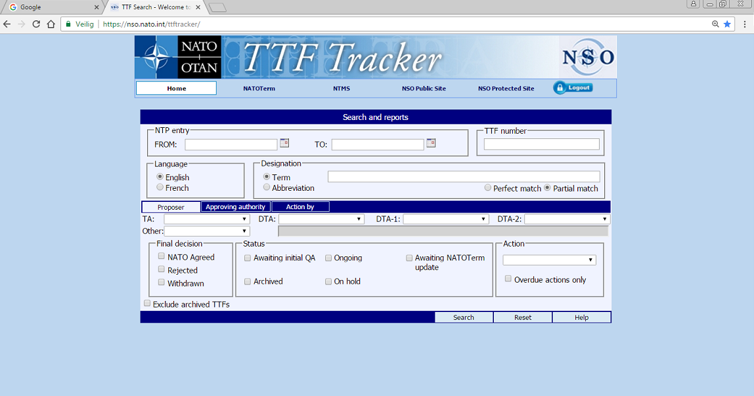
TTF Tracker

Slide 32
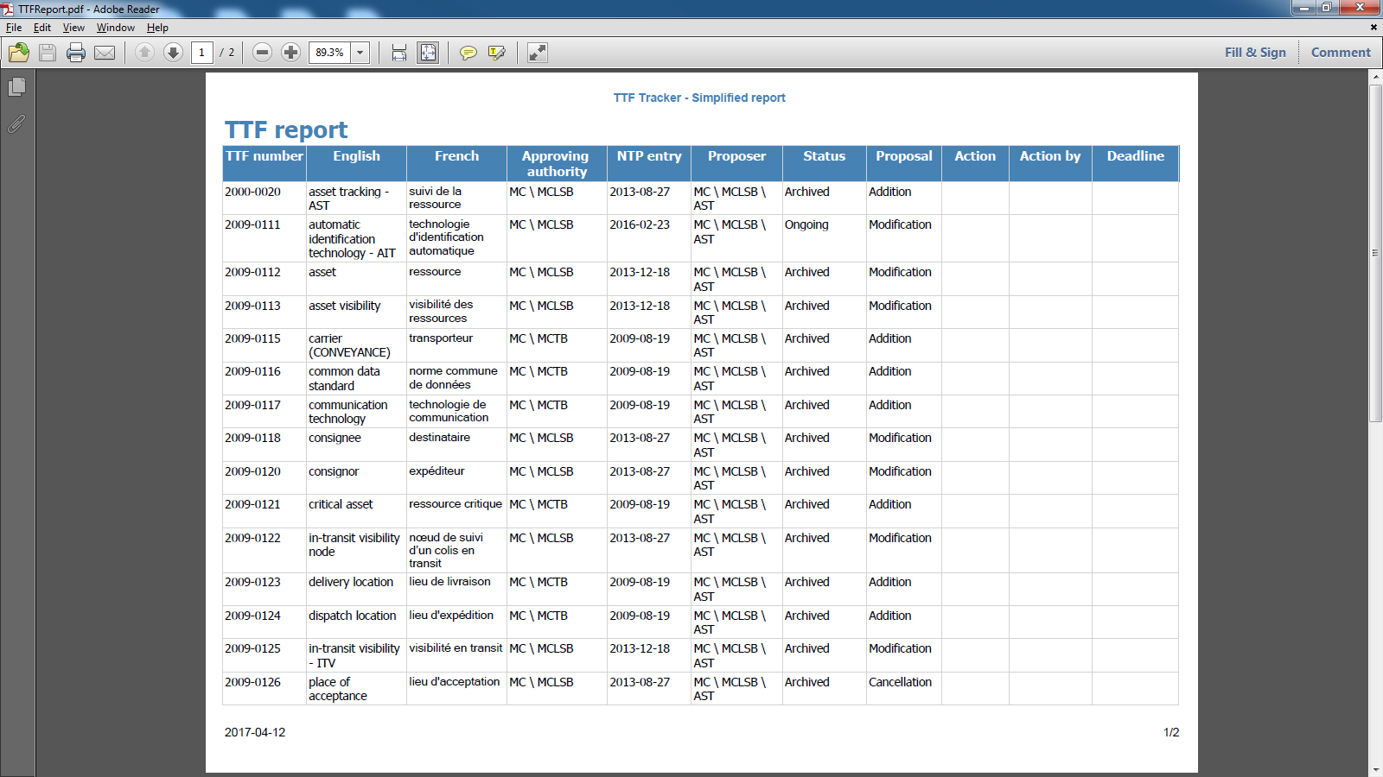
TTF Tracker
sample report

Slide 33
NATOTerm - TermOTAN
https://nso.nato.int/natoterm

Slide 34
NATOTerm - TermOTAN
Help function, e.g. different types of searches

Slide 35
NATOTerm - TermOTAN
Colour-coded returns in the ‘hit list’ to indicate the approval status
Notes:
The returns for your search are colour-coded.

Slide 36
Different approval statuses in NATOTerm
NATO Agreed
From approx. 2005: terminology developed and QAed iaw ISO standards – indicated with a green bullet
Cancelled
Terminology that was previously NATO Agreed and is no longer current – but still physically present in NATOTerm – indicated with a red bullet
Not NATO Agreed
Mostly, legacy terminology (from before the introduction of the NATO Terminology Programme) that is not yet NATO Agreed – indicated with a yellow bullet
NATO Adopted
Terminology from authoritative civilian sources, used by NATO but not necessarily in accordance with NATO and ISO terminology standards – indicated with a purple bullet

Slide 37
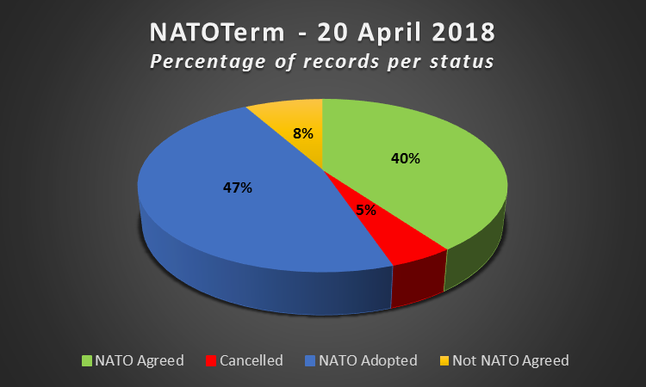
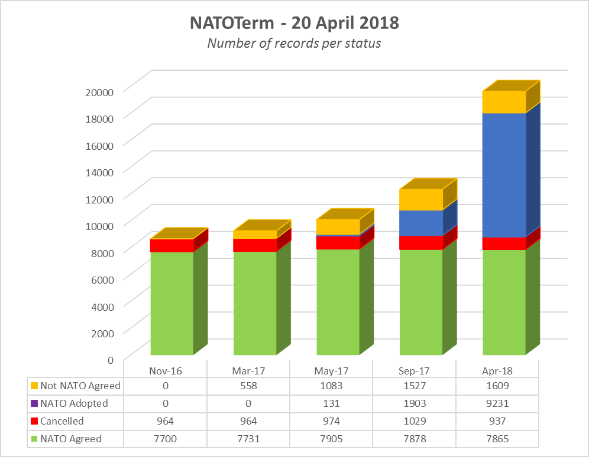
NATOTerm Figures
Total entries: 19642

Slide 38
Thank you for your attention!
NATO Terminology Office
terminology@nso.nato.int

