Slide 1
NATO Standardization Elements
- Roles and Responsibilities -
Warsaw, 16 September 2019
Dieter Schmaglowski
Deputy Director NSO

Slide 2
Who are the main stakeholders for NATO Standardization ?
What are their specific roles and responsibilities ?
How does the NSO fit in ?
How are they organized ?

Slide 3
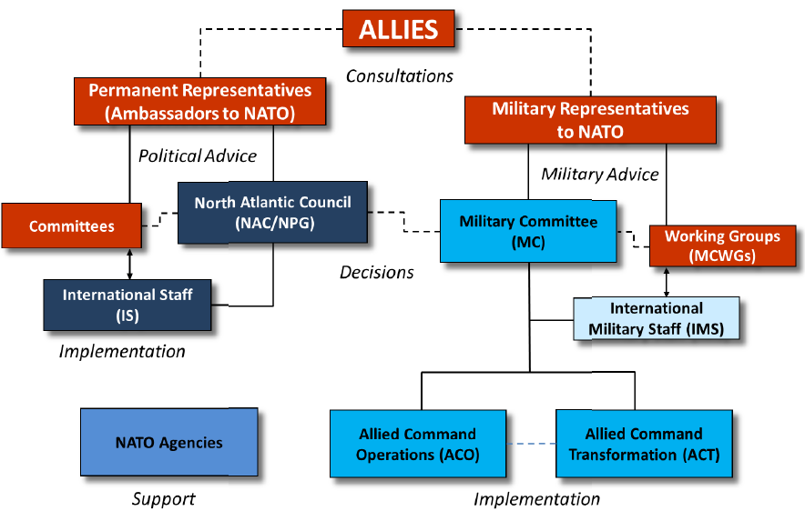
NATO’s Simplified Organizational Structure

Slide 4
NATO
Standardization Community (1)
Allies (NATO Nations):
Propose standards, provide subject matter experts (SMEs) to develop standards, ratify, and implement standards.
NATO Partners:
Propose standards, participate with SMEs in standard development activities open for partners, adopt and implement standards.
NATO Standardization Tasking Authorities
(Senior Committees):
Validate standardization proposals, develop and approve tasks, produce, agree, review and maintain NATO standardization documents.

Slide 5
NATO
Standardization Community (2)
NATO Standardization Office (NSO):
- Initiates, coordinates, supports or administers all those standardization
activities that conducted under the authority of the CS,
- Provides standardization management support and standardization
advice for the standardization community,
- Supports the Military Committee standardization activities.
Other NATO Bodies (e.g. SCs):
Contribute to NATO standardization in accordance with their respective governing documents.

Slide 6
NATO
Standardization Tasking Authorities
NAC
Support & Advice
Advice
MC
CNAD
LC
CS
C3B
AVC
PC
NSO
“In NATO standardization,
a senior committee that has the remit to
validate standardization objectives or […] proposals,
establish the related standardization tasks […]
produce, endorse and maintain the resulting NATO standardization documents.“
Note: A tasking authority may delegate its remit to a subordinate body,
which then becomes a Delegated Tasking Authority.
AAP-6 (NATOTerm)

Slide 7
NATO
Standardization Tasking Authorities
Support & Advice
Advice
NAC
MC
CNAD
LC
CS
C3B
AVC
PC
NSO

Slide 8
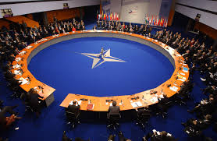
Committee for Standardization (CS)
- Functions and Responsibilities-
Primary source of standardization advice
to the NAC
Tasking Authority (TA) for standardization
management within the Alliance (procedures for production, maintenance and management of NATO standardization docs)
Develops and maintains the NATO Policy for Standardization
Provides standardization management advice and guidance to the standardization community
Ensures linkage to and coherence with NATO defence planning
NAC
MC
CNAD
LC
C3B
AVC
CS

Slide 9
Committee for Standardization (CS)
- Composition -
NATO Nations senior government
delegates (civil or military)
Senior representatives from CNAD, LC, C3B, BI-SCs;
Partner Nations on invitation
Chair: Secretary General;
permanent Co-Chairmen:
- Assistant Secretary General Defence Investment (ASG DI)
- Deputy Chairman of the Military Committee (DCMC)
NAC
MC
CNAD
LC
C3B
AVC
CS

Slide 10
NATO
Standardization Tasking Authorities
Support & Advice
Advice
NAC
MC
CNAD
LC
CS
C3B
AVC
PC
NSO

Slide 11

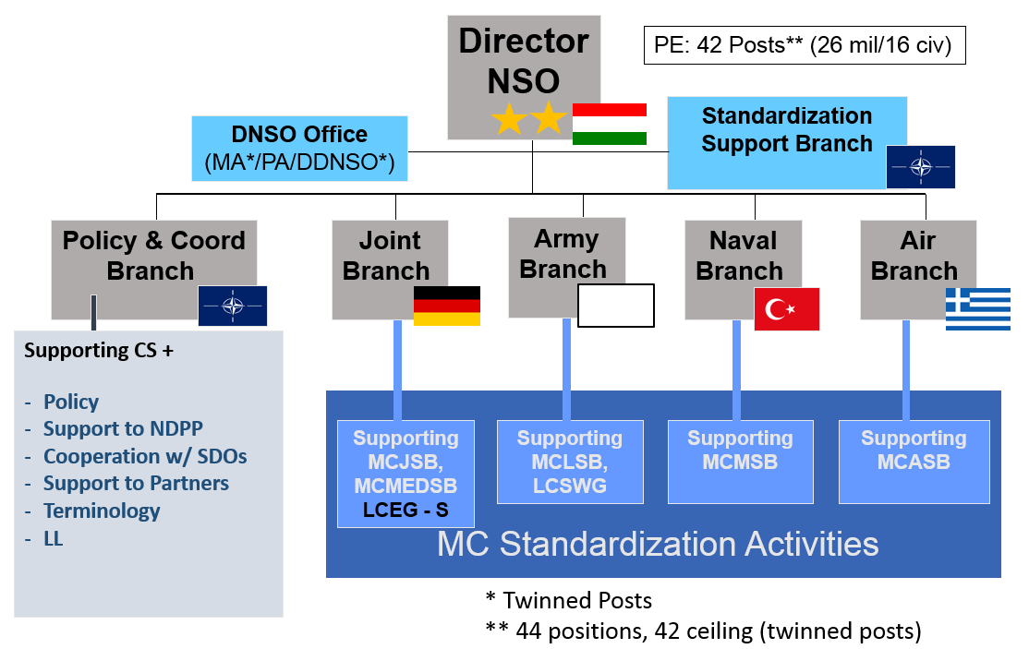

NATO Standardization Office
DGIMS
Executive Coordinator
Operations & Planning
Cooperation & Security
Policy & Capabilities
Intelligence
Logistics & Resources
NHQC3Staff
NATO Standardization Office
SITCEN
Supporting Offices

Slide 12



NSO Structure
Director
NSO
PE: 42 Posts** (26 mil/16 civ)
Director
+ 2 Partner Posts
3 (1/2)
Standardization Support Branch
A4
10 (1/9)
DNSO Office
(MA*/PA/DDNSO*)
10 (4/6)
5 (5/0)
5 (5/0)
5 (5/0)
5 (5/0)
Policy & Coord
Branch
A5
Joint
Branch
OF5
Army
Branch
OF5
Naval
Branch
OF5
Air
Branch
OF5
Supporting CS +
Policy
Support to NDPP
Cooperation w/ SDOs
Support to Partners
Terminology
LL
Supporting
MCJSB,
MCMEDSB
LCEG - S
Supporting
MCLSB,
LCSWG
Supporting
MCMSB
Supporting
MCASB
MC Standardization Activities
* Twinned Posts
** 44 positions, 42 ceiling (twinned posts)

Slide 13
NSO Mission
The NSO:
supports the Military Committee Standardization Boards;
initiates, coordinates, supports or administers all those NATO standardization activities that are conducted under the authority of the Committee for Standardization;
provides standardization management support and standardization advice for the standardization community.

Slide 14
NATO
Standardization Tasking Authorities
Support & Advice
Advice
NAC
MC
CNAD
LC
CS
C3B
AVC
PC
NSO

Slide 15
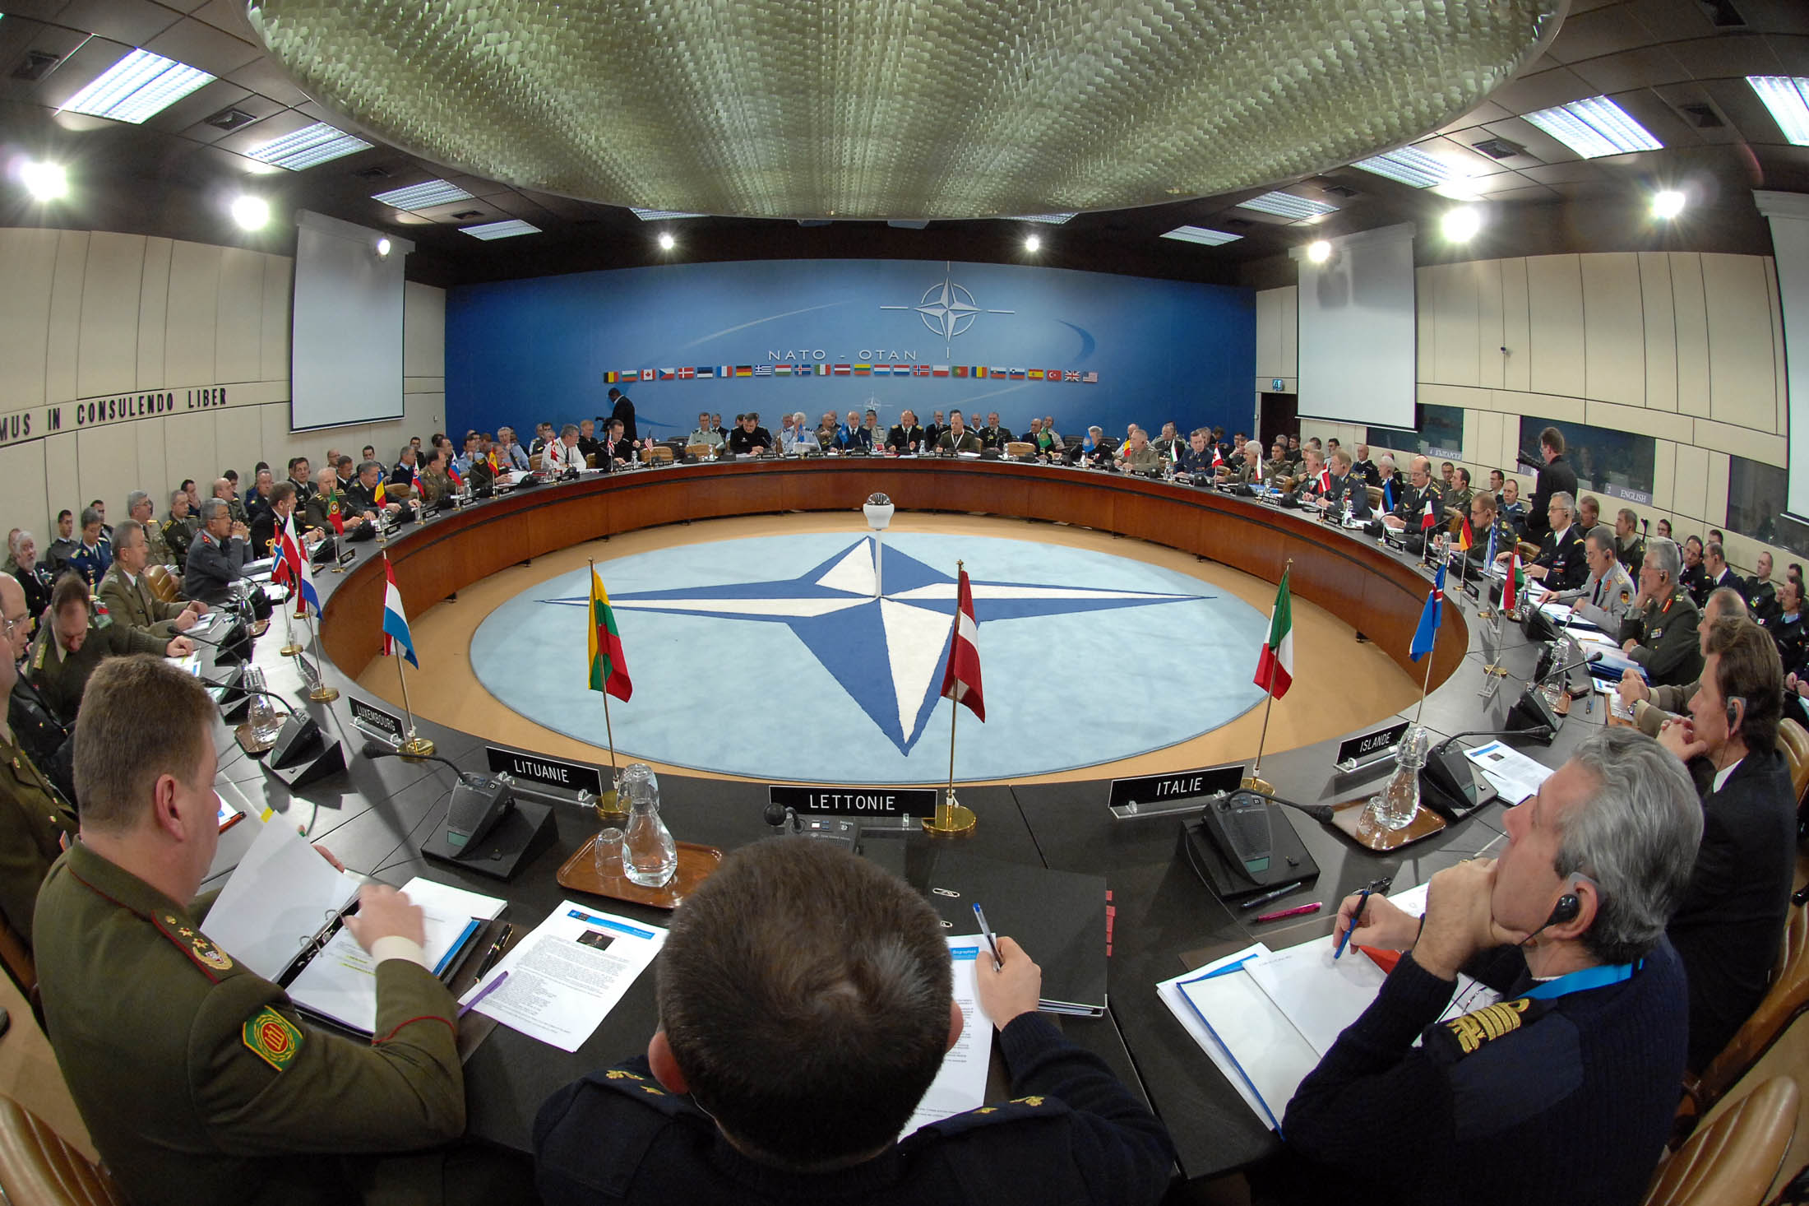

Tasking Authorities
MC
TA
MC

Slide 16
Tasking Authorities /
Delegated Tasking Authorities
NAC
CNAD
C3B
LC
CS
AVC
MC
Tasking Authorities
MCJSB
MCASB
Delegated Tasking
Authorities
MedSB
MCTB
MCLSB
MCMSB

Slide 17
Hierarchy of Standardization Elements
TASKING AUTHORITY
Only NATO nations’
representatives
to task and approve
Guidance
Annual Report
Standardization Board
Guidance Report with recommendation
Working Group
Guidance Report
Experts provided
by NATO nations, NATO bodies and Partners to review and develop NATO
Standards
Panel
Guidance Report
Team

Slide 18
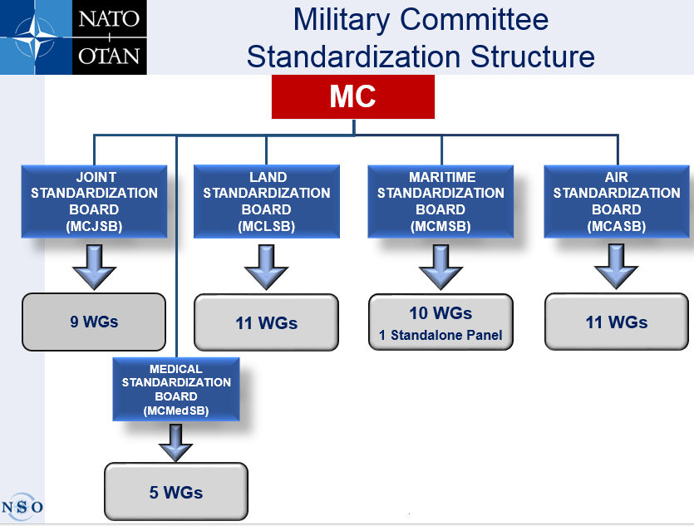
18

Slide 19
MC Standardization Boards
- Composition -
NSO **
(Chair & Secr)
28 NATIONS *
  (one voting board
  member from
  each NATO
  nation)
2 SCs **
(ACT & SHAPE)
Guests **
(WG secretars/chairmen, SMEs, …)
* Iceland not participating
** Non-voting members

Slide 20




TA/ DTA Decisions
  Note: reflects receipt of information (e.g. a document). Requires no action, nor does it imply agreement. Notation cannot be refused.
  Agree: agreement indicates concurrence on an action, requires consensus.
  Approve: final and formal agreement on matters that are within the authority of the TA/DTA. Outcome is usually an approved TA/DTA document or a formal notification to a subordinate body, giving approval for follow-on action or activity.
  (WG ToRs, Action List, entering ratification, approval for promilagation)
  Endorse: Represents TA/DTA agreement on matters requiring subsequent higher-level consideration.
Notes:
20

Slide 21



Consensus & Silent Procedure
  Note
  Agree
Consensus:
“A general agreement characterized
by an absence of declared opposition
from any of the parties concerned”
Silent Procedure:
“A procedure by which consensus is
achieved unless an objection is received
by a given date”
- within NATO, only member nations
may break silence
  Approve
  Endorse
Notes:
21

Slide 22
MC Standardization Boards
- Roles and Responsibilities -
Foster military operational standardization activities in assigned areas of responsibility:
- manage development and maintenance of STANAGs and APs
- initiate, staff and validate SPs / STs
- allocate ST to appropriate WG for development
- manage subordinate bodies, including:
+ establishment or disbandment of WGs
+ approval of TORs, PoW and priorities
+ provision of convening orders and guidance for meetings
+ revision of reports
- provide annual report to MC (PoW, objectives and priorities)
Decision making by consensus

Slide 23
MCJSB Substructure
NATO Training Group (NTG)
Allied Joint Operations Doctrine WG
Joint Geospatial Standards WG
Joint Intelligence WG
Joint CBRN Defence Capability Development Group
Environmental
Protection WG
Information Exchange Requirements Harmonization WG
Financial WG
Meteorological and Oceanographic Military Committee WG
MCJSB
Combined
Custodial Review Panel
Information Management Panel
Environmental Aspects of Military Compounds Panel
Joint Symbology (JSP)
Technical Manage-ment Panel
Joint Intelligence Surveillance and Recon-naissance Panel
Military Meteorology Panel
Doctrine and Terminology Panel
Senior Joint Information Exchange Requirements Panel
Military Oceanography Panel
AJP-2 Series Coordination Panel
Hazard Management Panel
Joint Intelligence Information Exchange Requirements Panel
Physical Protection Panel
Training and Exercise Panel

Slide 24
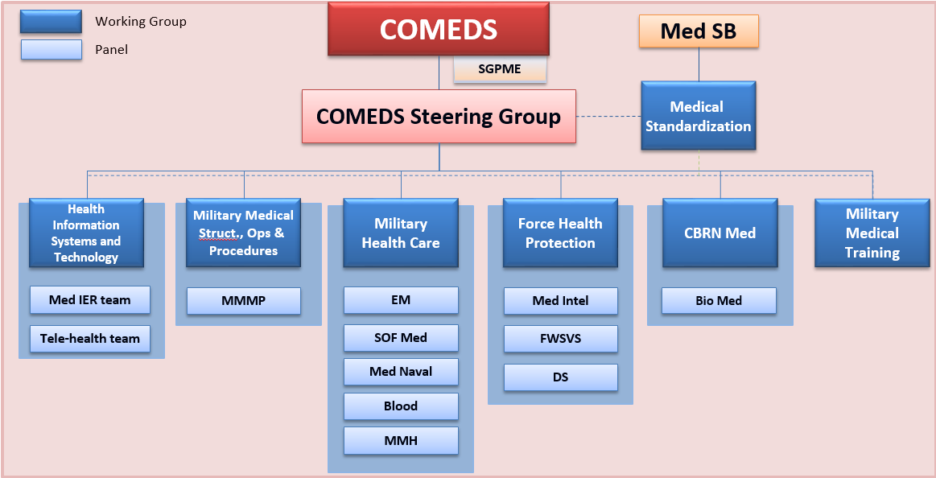
MCMedSB Substructure

Slide 25
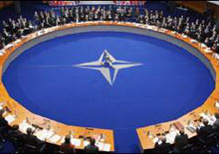

Working Groups
- Composition and Establishment -
Working Groups (WG):
Subordinated to and tasked by TA/DTA to produce and maintain standardization docs
Subject Matter Experts (SME)
DTA representative usually assigned to WG meetings
Act according to the Terms of Reference (TOR)
In permanent session
TA/DTA
Tasking
DTA Rep
ToR
WG
SMEs
from Allies and Partner Nations, Bi-SC, NCS, NFS, NATO Military Bodies, NATO accredited Centres of Excellence (COEs), other NATO entities, partner Nations, SDOs

Slide 26
Panels
- Composition and Establishment -
Panels:
Driven by a specific requirement, approved by the DTA
Subordinated to and tasked by WG to produce and maintain standardization documents
SMEs
Distinct ToR or tasks included in parent WG TOR
WG
Tasking
Panel ToR
WG
ToR
(Panel Tasks)
or
Panel
SMEs
from Allies and Partner Nations, Bi-SC, NCS, NFS, NATO Military Bodies, NATO accredited Centres of Excellence (COEs), other NATO entities, partner Nations, SDOs

Slide 27
Teams
- Composition and Establishment -
Teams:
Subordinated to and tasked by Panels (typically) or WG in order to solve particular problems
SMEs
No Team TOR but instructions included in WGs’/Panels’ CO and Report
Team TOR
Team
Team
Team

Slide 28
Working Groups and Panels
- Roles and Responsibilities (1/2) -
Support TA/DTA staff in the preparation of Standardization Tasks (ST),
Develop and maintain standardization documents from their own portfolio (review at least every five years),
Develop and maintain terminology within that community, at least alongside the review of their standards,
Submit TOR, POW and agenda(s) to DTA for approval,
Develop and maintain Information Exchange Requirements (IER) within that community,
Assess and pursue liaison requirements with other WG, bodies, and activities,
Review lessons identified / lessons learned from operations, exercises, experimentation and evaluations for their potential impact on standardization documents.

Slide 29
Working Groups and Panels
- Roles and Responsibilities (2/2) -
Meetings:
Arranged per Convening Order (CO) (or Calling Notice) approved by TA/DTA,
WG – at NATO HQ (conference facilities granted) or away,
Panels – hosted by a NATO or Partner Nation / SC
(conference facilities not necessarily granted at NATO HQ).
After a meeting:
Chair’s Report – to be noted by TA/DTA,
Action List – to be approved by the TA/DTA.

Slide 30
Summary of the Hierarchy of WGs, Panels and Teams
Comprised of experts within that domain / community
Makes recommendations for Board / DTA decision
Connection with respective MCSB (DTA) counterpart is crucical
Meets in accordance with a Convening Order; > 1/year
Use of NSO website for progressing the programme of work
Transparency is key, especially regarding Allied Publications
Working Group
Meets in accordance with the Terms of Reference
Normally meets away from NATO HQ
Makes recommendations for WG endorsement
Panel
Panel
Meets in accordance with agreement
Meets as necessary
Normally 2-5 delegates
Short life span
Makes recommendations to the WG/Panel
Team

Slide 31
NATO
Standardization Tasking Authorities
Support & Advice
Advice
NAC
MC
CNAD
LC
CS
C3B
AVC
PC
NSO

Slide 32
CNAD DTAs
CNAD
NATO Army Armaments Group
NATO Air Force Armaments Group
NATO Naval Armaments Group
CNAD Ammunition Safety Group
CNAD Life Cycle Management Group
Group of National Directors on Codification

Slide 33
NATO
Standardization Tasking Authorities
Support & Advice
Advice
NAC
MC
CNAD
LC
CS
C3B
AVC
PC
NSO

Slide 34
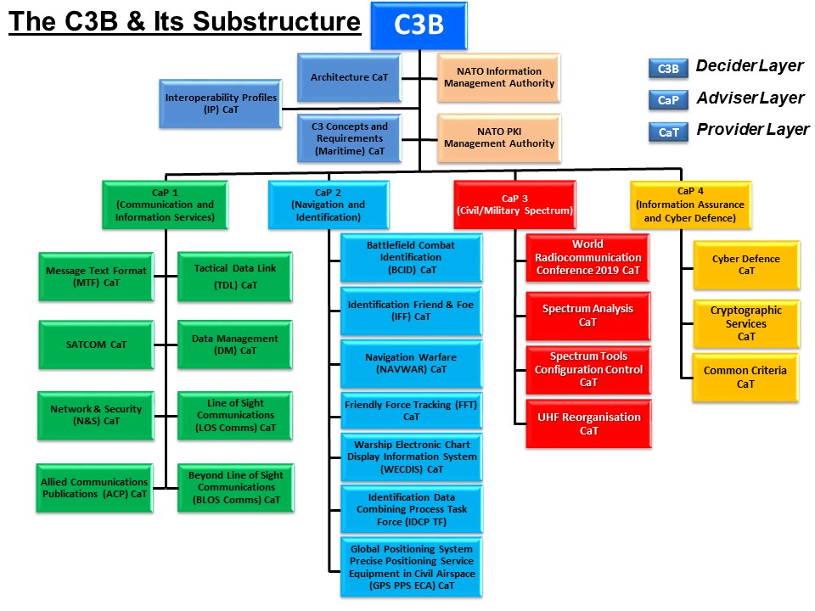
Consultation, Command & Control Board (C3B)
TA
WGs
34

Slide 35
Standards per Tasking Authority
as of 23 Apr 19
1167 Promulgated NATO Standards
MC & COMEDS | 532
CNAD | 394
C3B | 138
PC | 42
AVC | 45
LC | 6
STB | 5

Slide 36
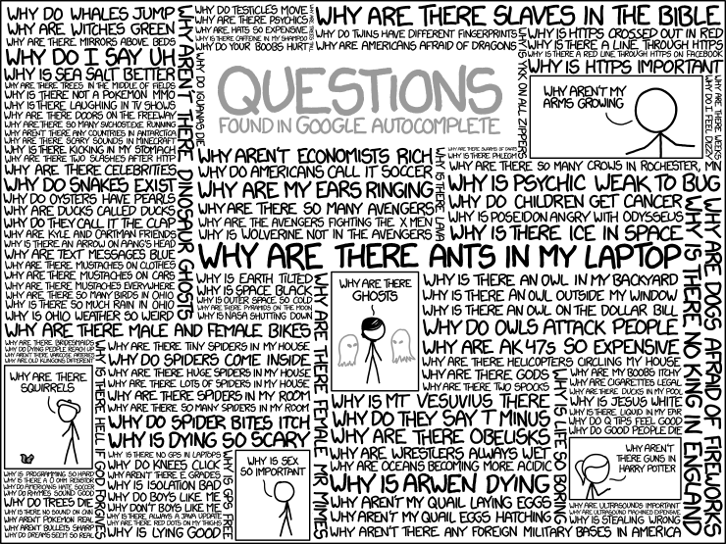
Time for your questions…

