Slide 1

DEFENCE STANDARDIZATION
IN POLAND
MAJ PIOTR PETRYNOWSKI
Wcnjik
Tel. +48 261 845 755
E-mail: p.petrynowski@ron.mil.pl

Slide 2
MINISTRY OF NATIONAL DEFENCE
SECRETARY OF STATE
ARMAMENT POLICY
DEPARTMENT
MILITARY CENTRE FOR STANDARDIZATION, QUALITY
& CODIFICATION
MILITARY CENTRE FOR METROLOGY
INSPECTORATE FOR IMPLEMENTATION OF INNOVATIVE DEFENCE TECHNOLOGIES
MOD AUTHORITY FOR
DESIGN AND IMPLEMENTATION
OF NATIONAL CENTRE
FOR AIR OPERATIONS SUPPORT

Slide 3
WCNJiK ROLE IN DEFENCE STANDARDIZATION
Legal basis for defence standardization
(shaping the activity model, running contracts)
Ratification and implementation of NATO standardization documents (coordination)
Coordination of defence standards’ development
(operational and materiel)
Military terminology & translation
Acquisition support
(standardization helpdesk)
Standardization trainings
(including international courses)
Co-operation with national standardization body
(Polish Committee for Standardization)

Slide 4
LEGAL BASIS FOR STANDARDIZATION RELATED TO STATE
DEFENCE AND SECURITY
Standardization Act
(2002) as amended
NEW DECISION
MOD Decision (2018)
on handling of NATO
standardization documents
NEW DECISION
MOD Decision (2018)
on Standardization
Works Principles
Government’s Decree
on Standardization
related to
State Defence
and Security (2002) as amended
MOD Decision (2003, 2011)
on the creation of
standardization service
Secretary of State Decision (2015)
as amended
on release of standardization documents
NEW DECISION
MOD Decision as amended (annual)
on NO and PDNO approval and
implementation

Slide 5

STANDARDIZATION DOCUMENTS RELATED TO DEFENCE
PN-V
National Standards related to State’s Defence
Promulgated by the President of the PKN
NO
Defence Standards
Promulgated by the Minister of National Defence
PDNO
Standardization Handbooks
Promulgated by the Minister of National Defence

Slide 6
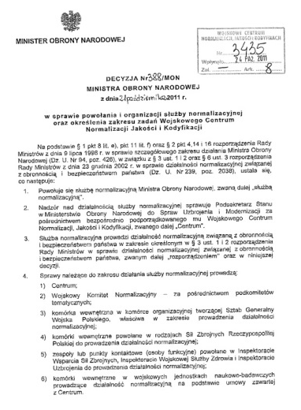
MINISTER OF NATIONAL DEFENCE DECISION
ON FOUNDATION AND ORGANIZATION OF STANDARDIZATION SERVICE
21 Oct 2011 (current)
COMPOSITION OF STANDARDIZATION SERVICE;
CENTRAL ROLE OF WCNJiK;
WCNJiK TASKS (STANDARDIZATION, QUALITY ASSURANCE, CODIFICATION);
FOUNDATION, TASKS AND COMPOSITION OF MILITARY COMMITTEE FOR STANDARDIZATION;
The standardization service activity shall be supervised by the MOD top manager proper for armament and modernization through Military Centre for Standardization, Quality and Codification directly subordinate to him.
Standardization service shall conduct the standardization activity related to State’s defence and security (...).

Slide 7
Standardization service’s tasks are conducted by:
Military Centre for Standardization, Quality and Codification (WCNJiK)
Military Standardization Committee (WKN)
Logistics standardization Section in AF General Staff
Standardization Section in AF General Command
Teams/PoCs within Inspectorates – AF Support Inpectorate, Health Department, Armament Inspectorate
Standardization Sections in R&D Military Institutes – on the basis of contracts signed between tchem and WCNJiK
Technical Committee No. 176 on military technology and supply
(KT 176) and its subcommittees within the scope of NO, PDNO and AB works
and: cells and organizational units of the Ministry of National Defence, particularly: acquirers, functional systems’ organizers (OSF), mangers of weapon systems, Central Logistics Authorities (COL) as well as military equipment users
In fact – almost every organizational unit of the Ministry of National Defence participates in defence standardization

Slide 8
ORGANIZATION OF STANDARDIZATION SERVICE IN THE POLISH MOD
MOD
SECRETARY
OF STATE
PKN
NATO
National Standardization Board
WCNJiK
COLLEGIATE BODIES
PKN
WKN
Military Standardization Committee
KT 176
Technical Committee
No. 176 on military technology and supply
Operational standardization
Materiel standardization
PERMANENT STRUCTURE
GENERAL STAFF
ARMED FORCES GENERAL COMMAND
INSPECTORATES
R&D MILITARY INSTITUTES
J4 – ONE OFFICER
+
STANDARDIZATION
SECTION
INSPECTORATES
SPECIALISTS

Slide 9
COMMITTEES AND SUBCOMMITTEES
MATERIEL STANDARDIZATION
TECHNICAL COMMITTEE No 176
(KT 176)
OPERATIONAL STANDARDIZATION
MILITARY STAND. COMMITTEE (WKN)
National Standards related to State’s Defence
PN-V
MISSILES & ARTILLERY
ARMY
MILITARY VEHICLES
Defence Standards NO
AIR FORCE
ENGINEERING EQUIPMENT
NAVY
CBRN ISSUES
Defence Standards NO
LOGISTICS
COMMS EQUIPMENT
JOINT SERVICES
Standardi-zation Handbooks PDNO
AIR FORCE
ARMAMENT AND MATERIEL
TERMINOLOGY
Standardi-zation Handbooks PDNO
LOGISTICS SUPPORT
NAVY
ARMAMENT AND MATERIEL
MILITARY MEDICINE

Slide 10
Development
of standardization
documents

Slide 11
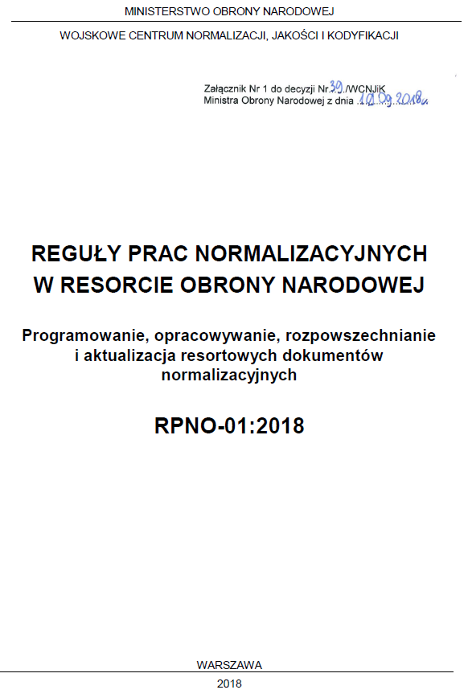
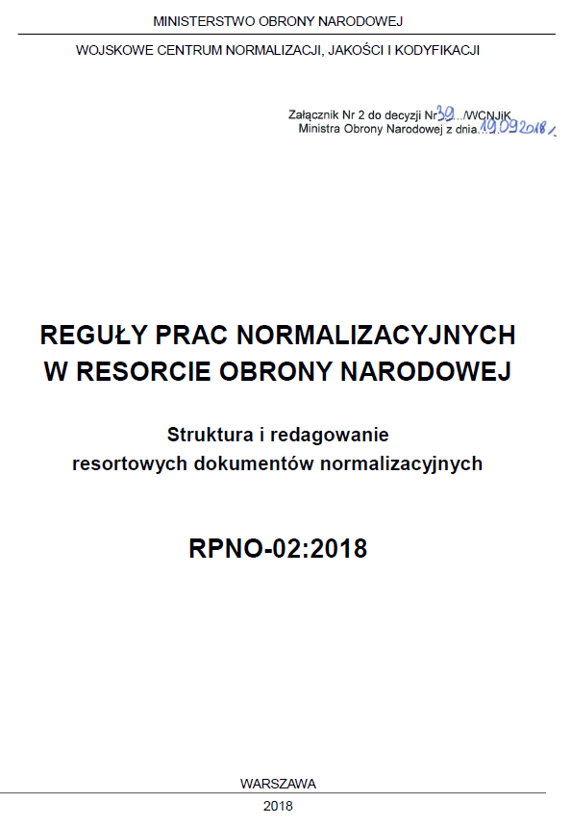
KEY GUIDELINES FOR STANDARDIZATION ACTIVITY
MoD Decision of 19 Sept 2018
on Standardization Works Principles
STANDARDIZATION WORKS PRINCIPLES
RPNO-01 – Programming, development, releasing and updating
of defence standardization documents
RPNO-02 – Layout and editing of defence standardization
documents

Slide 12
PLANNING DOCUMENTS FOR STAND. ACTIVITY WITHIN THE MOD
PROGRAMME
OF STANDARDIZATION WORKS
FOR ........ (3 years - rolling document)
PLAN
OF STANDARDIZATION WORKS
FOR ........ (particular year)

Slide 13
PROGRAMMING of STANDARDIZATION WORKS
SECRETARY OF STATE
MINISTRY OF NATIONAL DEFENCE
APPROVES THE PROGRAMME / PLAN
MILITARY CENTRE
FOR STAND, Q & COD - WCNJiK
COORDINATES STANDARDIZATION WORKS,
DRAWS UP THE PROGRAMME
ARMED FORCES’
SERVICES
MOD
DEPARTMENTS
WCNJiK
TECHNICAL
COMMITTEE No. 176 - KT 176
STANDARDIZATION
PROPOSALS
MILITARY STANDARDIZATION
COMMITTEE - WKN
R&D
MILITARY
INSTITUTES
GENERAL STAFF

Slide 14
DEVELOPMENT OF A DEFENCE STANDARD
Introduction of proposal into
The MOD Programme of Works
Translation of
the source document
(if applicable)
WCNJiK
SUBCOMMITEE
Editorial review
of draft standard
Draft standard for
enquiry
Standard’s working
draft
COMITTEE
Promulgation of
Defence Standard
by Minister of National Defence
Draft standard
for approval

Slide 15
DECISION No 117MON
of the Minister of National Defence dated 29 July 2019 r.
regarding approval and introduction into use of standardization documents related to national defence and security
DECISION 117/MON:
944
DOCUMENTS
New decision
2019
published

Slide 16
STANDARDIZATION DOCUMENTS PORTFOLIO
STANDARDIZATION DOCUMENTS
    Defence Standards (NO) and Handbooks (PDNO)
    Polish Standards for SD&S (PN-V)
944
153
REVIEW OF NO and PDNO – 5 years period

Slide 17

HANDLING of
NATO STANDARDIZATION
DOCUMENTS

Slide 18
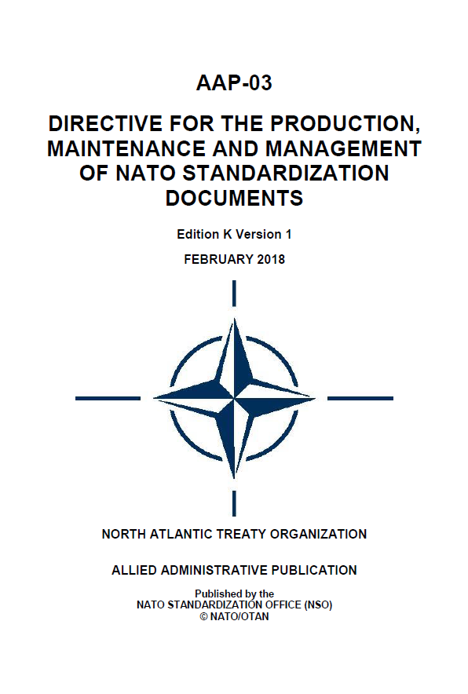
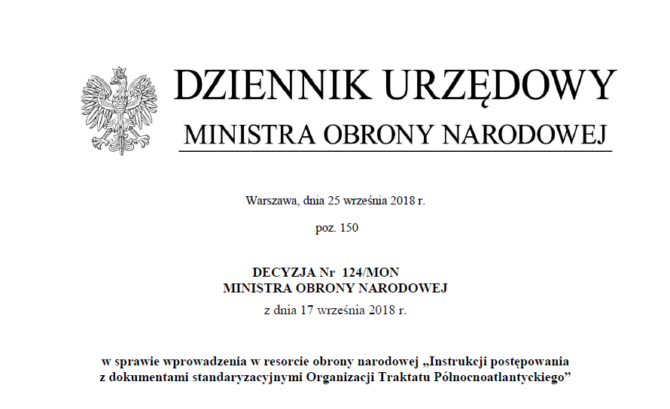
LEGAL BASIS
AAP-03
Production, Maintenance and Management of NATO Standardization Documents
MOD DECISION
on ‘Handling of NATO
standardization documents’

Slide 19
LEGAL BASIS
AAP-03(K)
PROMULGATED
Effective from
1st July 2018
MOD DECISION 124/MON
dated 17 September 2018
on ‘Handling of NATO standardization documents’
based on Allied Publication AAP-03

Slide 20

INSTRUCTION ON HANDLING OF NATO STANDARDIZATION DOCUMENTS
CHAPTER VII
INTRODUCTION INTO USE
CHAPTER VIII
IMPLEMENTATION AND USE
CHAPTER IX
COMMENTING
CHAPTER X
RESPONSIBILITY FOR REALIZATION OF TASKS RELATED TO HANDLING OF NATO STANDARDIZATION DOCUMENTS
Annexes, templates
CHAPTER I
GENERAL INFORMATION
CHAPTER II
OBTAINING OF NATO DOC.
CHAPTER III
ANALYSIS AND HARMONIZATION
CHAPTER IV
TRANSLATION
CHAPTER V
AVAILABILITY
CHAPTER VI
RATIFICATION AND APPROVAL

Slide 21
INTRODUCTION OF NATO STANDARDIZATION DOCUMENT
    The basic form of introducing the provisions of a NATO standardization document in the MOD is the development,
    on its basis, of:
A Defence Standard (NO) or a defence standardization handbook (PDNO),
Doctrine or a doctrinal document.
    Based on a NATO standardization document, the following
    may be developed:
Polish Standard (PN-V),
Other documents introduced into use by a decision of an authorized head/director of Polish Armed Forces element.

Slide 22
NATO STAND. DOCs in the POLISH ARMED FORCES
Primary Method
STANAG,
STANREC, AP
Defence Standard (NO),
Defence Standardization Handbook (PDNO)
Doctrine, Doctrinal document,
other document
Polish Standard
(PN-V)
Documents subject to Minister of Defence promulgation
Documents subject to KKJ (Head of organizational unit or cell)
for promulgation
Documents subject to promulgation by the PKN President
Other possibility
Original NATO document
(full version without any modifications,
exclusions or appendixes)
Doctrines
Doctrinal documents
Armed Forces Doctrine
and Training Centre
located in Bydgoszcz

Slide 23
INTRODUCTION OF NATO DOCUMENTS INTO USE
NATO REQUIREMENTS
Doctrines
Doctrinal documents
Armed Forces Doctrine
and Training Centre
located in Bydgoszcz
STANAG / STANREC
WCNJiK
STANDARDIZATION PROCESS
Proper subject authority
Standard
Executive document
Armed Forces General Command
DOCTRINE
KT 176
PN-V
General Staff
ORDER
Exceptionally in original version
NO
REGULATION
WKN
Inspectorates
PDNO
GUIDANCE
MOD Departments
HANDBOOK

Slide 24
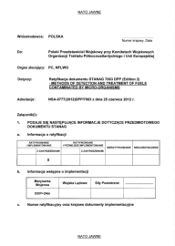
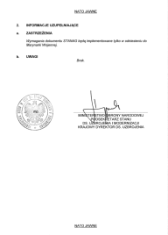
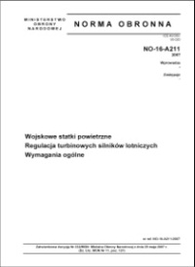
HANDLING of NATO STANAGs
OBTAINING
WCNJiK
COLLECTING
QUALIFICATION
Proper authority (KKJ)
HARMONISATION
WKN, KT 176
RATIFICATION
NATIONAL RATIFICATION REPLY
DEFENCE STANDARD (NO)
DEFENCE STD HANDBOOK (PDNO)
IMPLEMENTATION
NATIONAL IMPLEMENTATION REPLY

Slide 25
HANDLING of NATO STANRECs
OBTAINING
WCNJiK
COLLECTING
Proper authority (KKJ)
QUALIFICATION
HARMONIZATION
WKN, KT 176
APPROVAL
APPROVAL OF STANREC’S PROMULGATION
DEFENCE STANDARD (NO)
DEFENCE STD HANDBOOK (PDNO)
USE
INFORMATION ABOUT USE OF STANREC

Slide 26
KKJ
Commander/director of the organizational element appropriate with regard to the responsibility for the specific subject matter area described in the NATO standardization document

Slide 27
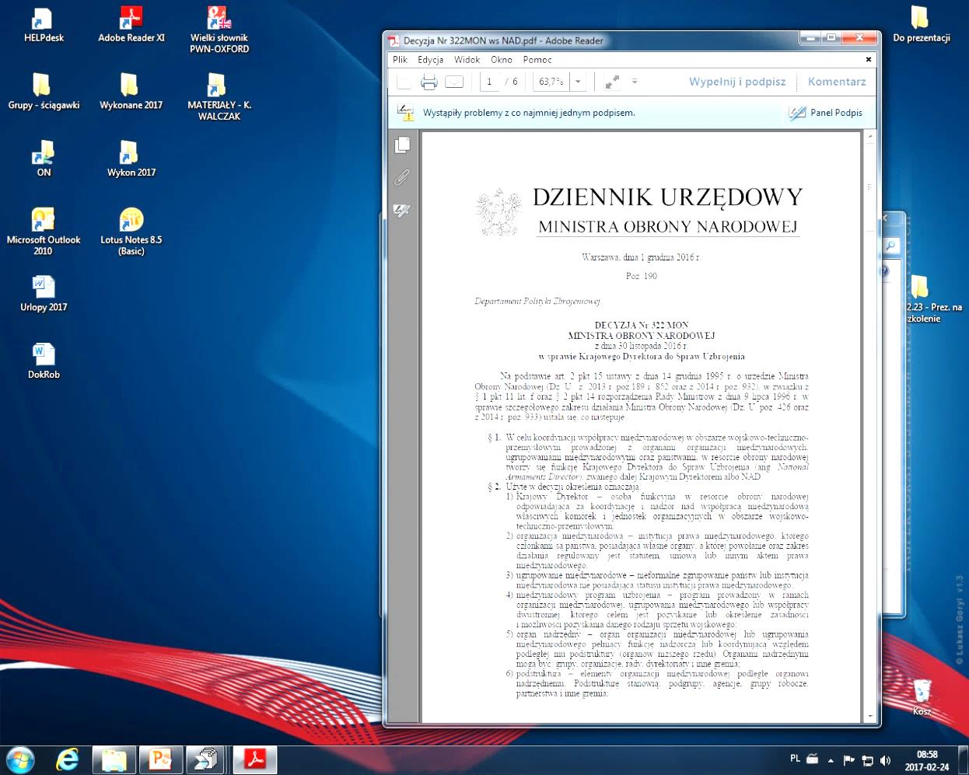
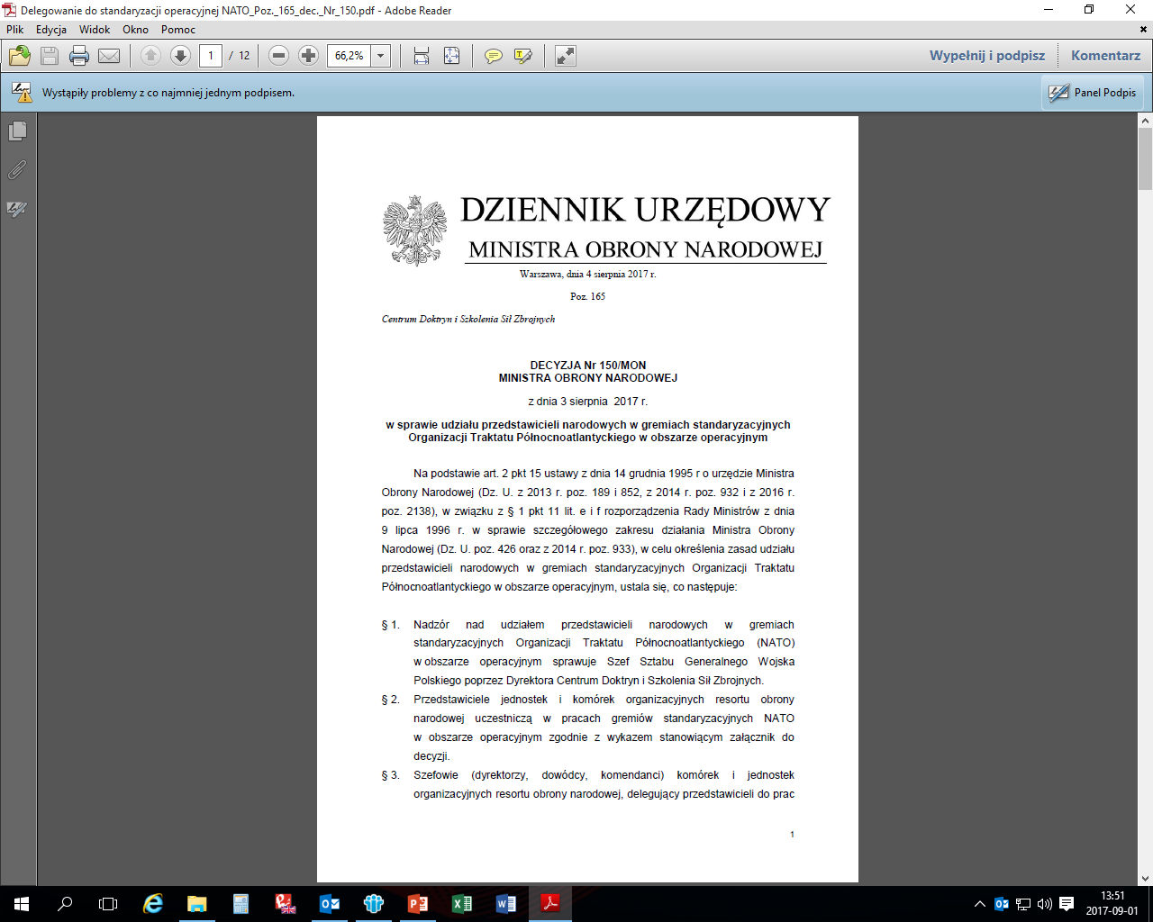
KKJ for NATO Standardization Document
MOD DECISION No 322/MON
MOD DECISION No 150/MON
List of directors/commanders who delegate representatives to NATO standardization bodies

Slide 28
RATIFICATION
Assessment of NATO documents’ provisions (KKJ)
Determination of ratification possibility:
ratifying & implementing
ratifying & implementing with reservations
ratifying, future implementation
ratifying, future implementation with reservations
not ratifying
not participating
Preparation of draft national reply
Signing national reply – WCNJiK Director
under the authority of DEPUTY MINISTER - SECRETARY OF STATE OF MOD
OF THE REPUBLIC OF POLAND
E-RATIFICATION - WCNJiK NSDD Admin
Updating NSDD on the basis of Polish national reply

Slide 29
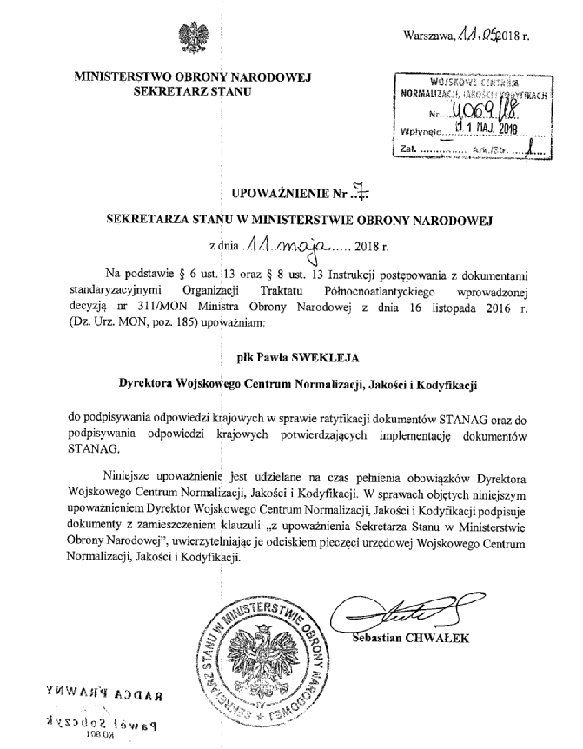
Letter of Authorization No. 7
Deputy Minister - Secretary of State of MOD
dated 11 May 2018
National responses related to ratification and implementation of STANAGs signed by the WCNJIK Director
e-ratification
Administrative accounts which let countries to fill in their ratification responses in the NSDD. Every Ally is responsible for the status of national ratification and implementation responses to STANAGs.

Slide 30
IMPLEMENTATION
Preliminary assessment of actions to be taken following
ratification
Assignment of tasks to executors
Development of Defence Standard / Executive Document
Funds for tasks
Implementation requirements fulfiled
Implementation reply

Slide 31
GUIDANCE ON IMPLEMENTATION OF STANAGS
Implementation of STANAG means fulfilment of prescriptions/requirements detailed in a given NATO Standardization Agreement.
Implementation of STANAGs with the accompanying NATO standards is one of the Allies’ primary duties.
Implementation of STANAG with accompanying NATO standards implies their introduction into use in the MoD by normative documents (including defence standardization documents, doctrines, doctrinal documents, decisions, instructions, requirements related to a military equipment, etc.) and action in accordance with their prescriptions during exercises and operations and taking additional, necessary actions, e.g. modifications of educational system (with trainings and classes), military equipment’s purchase.

Slide 32
Implementation of operational STANAG can involve:
necessary legal fixation in the military service; STANAG’s introduction into use in the MoD by an update (development) of normative documents, including standardization documents, doctrines, procedures and regulations,
making STANAG available for personnel involved in actions covered by the document and their familiarization with its provisions,
educational process and trainings’ update in accordance with the STANAG’s content,
use of the STANAG’s provisions during trainings and exercises, both on national and NATO levels.
Implementation of materiel STANAG can involve:
necessary legal fixation in the military service; STANAG’s introduction into use in the MoD by an update (development) of normative documents, including standardization documents, and use in projects where it is quoted as requirement,
military equipment purchase,
making sure that STANAG is used in researches (if quoted in requirements), and military equipment fulfils requirements and characteristics defined in a STANAG,
making sure that STANAG is used in research and verification programmes of military equipment,
update of educational and training materials in accordance with a STANAG, in a way allowing
a user to gain knowledge on how to optimally handle military equipment,
use of military equipment in exercises for which it was intended and evaluation of its optimal utilization.

Slide 33
RATIFICATION AND IMPLEMENTATION – COORDINATION BY WCNJiK
Update of policy and legal regulations for ratification
and implementation processes
Programming and planning of standardization works in the MOD
Securing funds for standardization works
Coordinating WKN and KT 176 activities (running the secretariats)
Participating in NATO Stand. forums (mainly CS)
Cooperation with Stand. cells in the Armed Forces General Command,
General Staff, Inspectorates
Coordination - the flow of ratification/implementation replies by the MOD
Maintaining ratification and implementation data – e-ratification

Slide 34
STANDARDIZATION TOOLS AND TRAININGS

Slide 35
STANDARDIZATION SUPPORT
NATO Standardization Document Database (NSDD) – after registration one has access to information about all standardization documents developed in NATO – possible downloading of unclassified standards – nso.nato.int
Standardization IT System (NSI) – access to information about all current defence standards (handbooks), via secured military IT system (intranet) – possibility of non-classified standards (handbooks) downloading - nsi.ron.int
Ratification Database – access via WCNJiK’s website in the secured military IT system (intranet) – information about ratification and implementation status of STANAGs – EXCEL file
E-library of Polish Standards (PN) – access to over 50 thousands standards (PN-EN, PN-ISO) after getting login and password from WCNJiK – wiedza.pkn.pl

Slide 36

STANDARDIZATION DOCUMENTS DATABASE
AGREEMENT
President of Polish Committee for Standardization (PKN) and WCNJiK Director
Access to PN-EN, PN-ISO standards for all users from the Polish MOD
INSPECTORATES
DEPARTMENTS
GENERAL STAFF
Database of Polish Standards - PN-EN, PN-ISO (website) – Access to
50 000 standards
Since March 2016 – Access to all PN-EN, PN-ISO standards for all POL MOD users
over 900 users

Slide 37
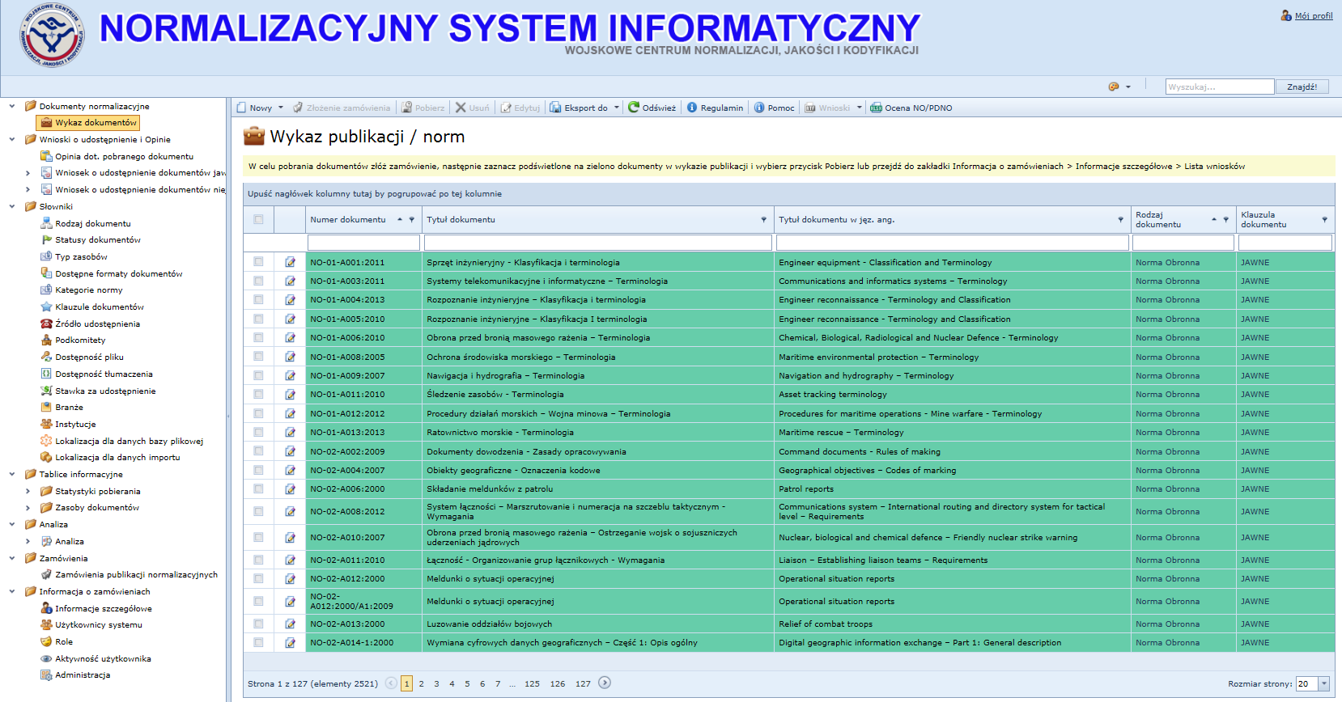
DEFENCE STANDARDIZATION DOCUMENTS DATABASE ON INTRANET SITE
STANDARDIZATION IT SYSTEM (NSI) – Provision of standardization documents for the whole POL MOD within POL MOD Intranet network
NO, PDNO documents made available
STANAG – information about current editions
Tool for maintenance of standardization documents
Tool for maintaining standardization documents’ release

Slide 38
PERSONNEL TRAINING
COURSE ON HANDLING OF NATO STANDARDIZATION DOCUMENTS
NATIONAL LEVEL
WCNJiK
Military Centre for Stand,
Q & Cod
Quaterly (4 times a year) – 1 day course regarding
handling of NATO standardization documents (STANAG, STANREC)
in the Polish MOD.
Adressed to participants of POL MOD
standardization service.

Slide 39
PERSONNEL TRAINING
COURSE ON DEFENCE STANDARDIZATION
NATIONAL LEVEL
WCNJiK
Military Centre for Stand,
Q & Cod
WAT
Military University of Technology
Twice a year - 1 week-course concerning defence standardization
in the Polish MOD at WAT with active participation of WCNJiK.
The course is mainly adressed to participants of POL MOD
standardization service.

Slide 40





”STANDARDIZATION WITHIN NATO” COURSE - MILESTONES
2003 Jan – Poland’s initiative at NCS forum
2004 Apr – MOU between NSA and Polish MOD
2004 May – Training of the lecturers
2004 Jun – Course initiation
2011 Jun – CSREPs agreed with the idea of course accreditation
2011 Dec – Request to ACT for course accreditation
2012 Apr – ACT accreditation – „NATO selected”
1
2004 Jun – Course Edition I
2-31
2004 Oct - 2019 May – Course Edition II -XXXI
32
Sep 2019 – Course Edition XXXII
‘Pilot’ course

Slide 41
PARTICIPATION IN „STANDARDIZATION WITHIN NATO” COURSE
Nations
27 +12
TOTAL: 563 PARTICIPANTS

Slide 42
THANK YOU
FOR ATTENTION

